Slide 1
Improving Integration of Renewable Generation and Electric Vehicles
Peter A. O’Connor, Ph.D.
November 16, 2017

Slide 2
Research Question
How do EVs and renewable energy fit together? Can EVs help the grid use more renewables?

Slide 3
EVs on Current Grid

Slide 4
The Potential of Smart Charging
100% EVs?
~3 Trillion VMT
~1000 TWh (25% increase)
Wind and solar
Not dispatchable
Rapid growth 2000-2016
Source: AWEA
Source: SEIA

Slide 5
Vehicle-Grid Integration (VGI)
Reduce EVs’ own impact on the grid
Possibly help with other grid conditions

Slide 6
Hourly Variability of Solar March 31, 2017

Slide 7
Impacts of Increasing Solar
Non-dispatchable
Requires aligning supply and demand
Hourly (load shifting) and minute-to-minute
Ancillary services (e.g. regulation up/down)
Potential solutions compete on price
Imports/exports
Generator flexibility
Stationary storage
Demand flexibility (EVs, AC, water heaters)
Smart charging might not earn much revenue if high levels of PV are very easy to integrate

Slide 8
Types of VGI
Basic “Smart Charging”
Time of Use rates
Short-term ancillary services
Demand response
Frequency regulation
V2G
Energy storage
Concerns: Interconnection, Battery degradation
V2H or V2B
Backup power when islanded

Slide 9
Convening the Experts

Slide 10
~200 Attendees
Utilities
Eversource, National Grid, Con Ed, Southern Company, Duke Energy, JEA, TVA, others
Car and Bus Manufacturers
Ford, GM, BMW, Daimler, Nissan, Tesla, Deltawing
BYD, Proterra, New Flyer
EV Charging Providers
Networks, Installers, Manufacturers
Regulators, NGOs, Academics, Fleet Operators

Slide 11
Modeling
Several studies in recent months (NREL, LBNL)
“Managed” vs “unmanaged” with ReEDS
“Valley filling” but not more sophisticated capabilities
Even rapid penetration only ~1.6% of generation in 2030
Reduced curtailment of RE and decreased CO2/kWh?
“Smart” > least-cost (unless include externalities)
Account for generation and what is on the margin
Changes are very minor and of uncertain confidence

Slide 12
Findings
Technically feasible
Driver needs and preferences
Need value proposition
Local RE conditions vary
Data to utilities
Rate design
Stationary storage

Slide 13
Pilot Projects
NRG & University of Delaware
V2G
Frequency Regulation (PJM)
Image from University of Delaware (http://www.udel.edu/udaily/2013/may/vehicles-grid-050213.html)

Slide 14
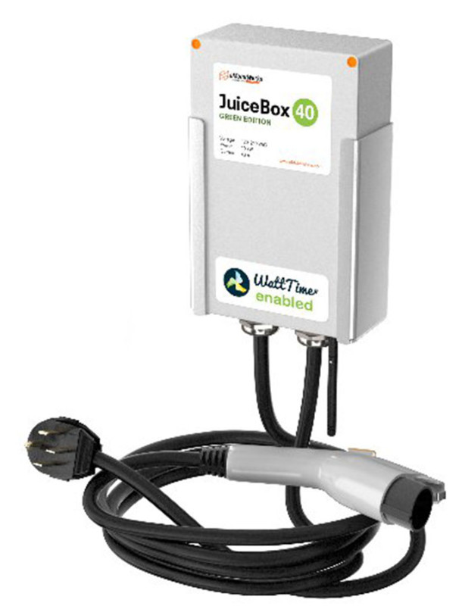
Pilot Projects
EMotorWerks
Smart Charging (one-way)
Resource Adequacy
Demand Response
“Green Charging” option

Slide 15
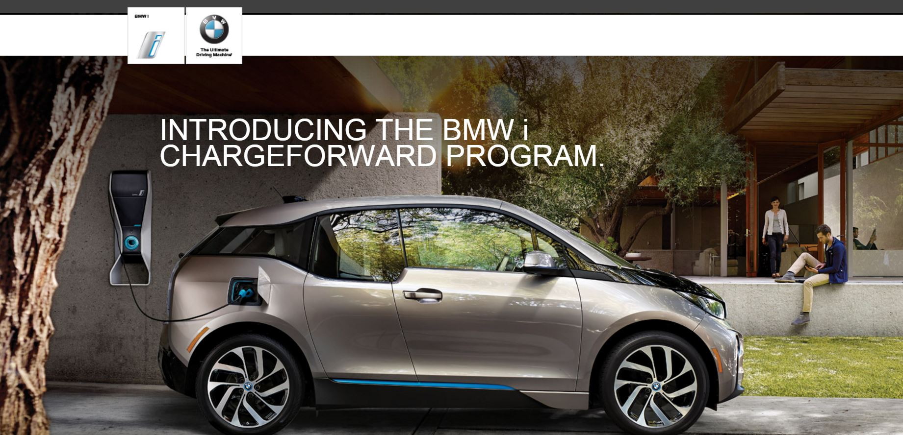
Pilot Projects
BMW/PG&E
Smart Charging (one-way… sort of)
Demand Response
“Battery Second Life” as back-up
Image from BMW (http://content.bmwusa.com/bmwi_pge/index.html)

Slide 16
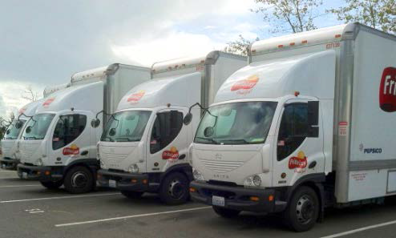
Pilot Projects
Frito-Lay Trucks
11 trucks (Smith Electric)
Charge rate 10-11 kW, 3.5-5.5 hrs
Fast Responding Regulation Service (ERCOT)
Full response within one second
100 kW minimum threshold
Photo: Mike Simpson, NREL
http://www.nrel.gov/docs/fy14osti/61455.pdf

Slide 17
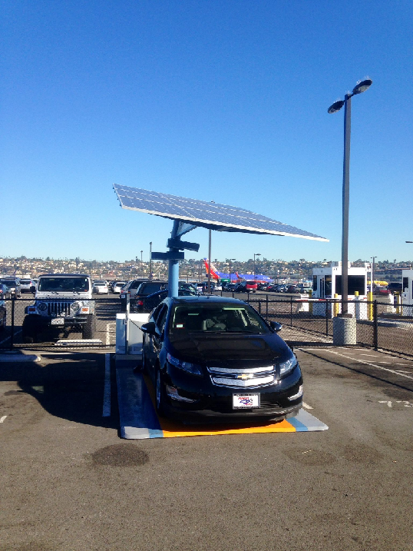
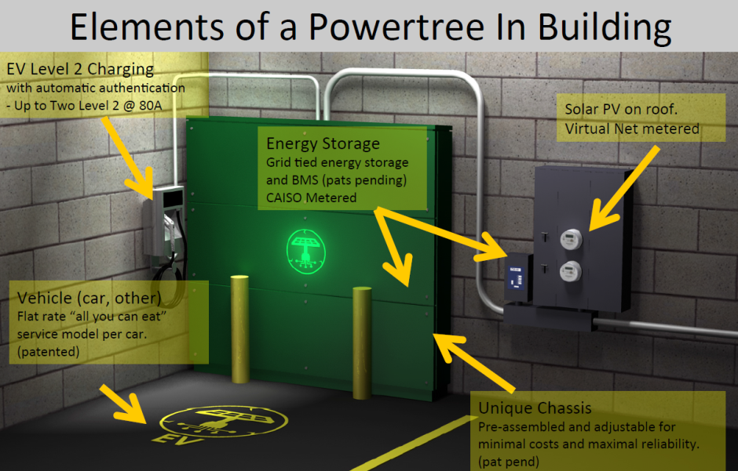
Other Concepts
Off-grid PV-storage-solar chargers (Envision/Zam)
Microgrid systems (PowerTree, TimberRock, SDG&E)

Slide 18
Obstacle: Rules and Standards
Rules for market participation
Minimum resource size
Telemetry requirements
Interconnection
Competing standards
Rooted in trust/control concerns?
Hardware is natively interoperable

Slide 19
Obstacle: Technical Issues
Technology integration (case-by-case basis)
V2G Battery life impacts
Revenue exceeds marginal cost, or don’t bid in
At $200/kWh and 1000 cycle life, $0.20/kWh breakeven
Pilot projects can tolerate lower value
Third-party aggregators would ideally disclose calculations and let EV owners modify bid price
Research continues on relative impacts of V2G compared to driving
Not an issue for one-way smart charging

Slide 20
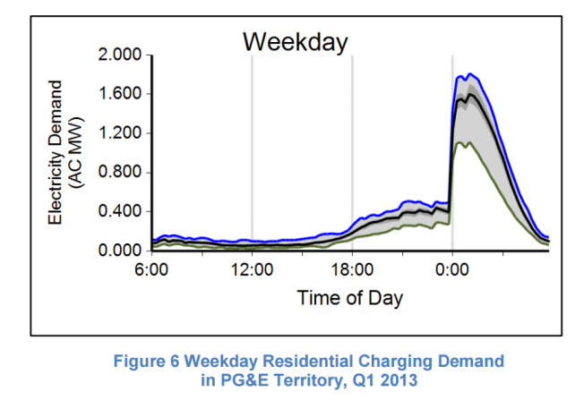
Obstacle: Value Proposition
TOU?
Easy, but misses daily variations
Day-ahead dynamic pricing?
SDG&E pilot
DR and ancillary services are technically proven, but:
Can’t extrapolate value from PJM regulation market
Cost of additional communication layer uncertain
TOU leads to “pre-emptive DR”
More EVs make it easier to predict availability
Most important issue: the use case
What do you want to accomplish?

Slide 21
What is the Value?
If grid integration is easy, don’t even need smart charging
If grid integration is hard, will have high value for both smart charging and storage
Value shows up in ancillary services prices
Options will compete
Know what service you are providing

Slide 22
When Will We Need Storage for VER?
Integration cost estimates generally low
Milligan et al. 2011, Mills et al. 2013, Cohen et al. 2015
Actual experience: easier than expected
Storage needed at 70-80% of energy from VER?
Models of high-RE California future show the state could deploy less storage and more flexible loads to accommodate RE at lower cost

Slide 23
Recommendations
Workplace Charging
Time-Varying Rates
Distribution Benefits
Ancillary Services
Storage Procurements/Policies and V2G
Define “Smart”
Pilot Projects
ucsusa.org/smartcharging

Slide 24
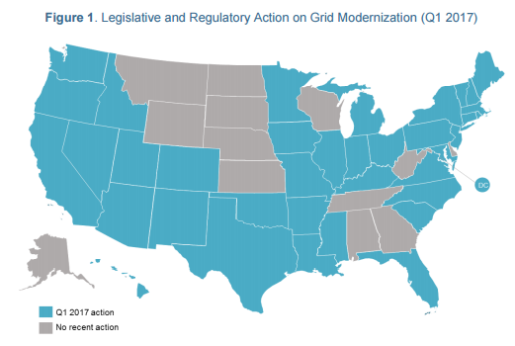
Grid Modernization

Slide 25
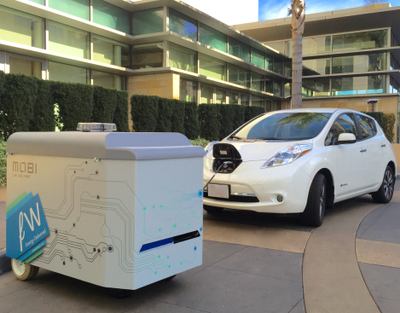
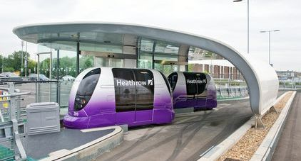
Game-Changers
Cheap stationary storage
Unlikely to entirely remove value of “smart charging”
Ancillary market access useful for both flexible loads and storage
Impacts business case for “battery second life”
How much retained value vs. new batteries?
Shared autonomous vehicles
Possibly far fewer vehicles on the road
Would want to charge as fast as possible
Home “smart chargers” as stranded assets
Dynamic wireless charging?

