Slide 1
Greenville A-Taxis, Automated, Connected, Electric, Shared Technologies, and ACES Mobility EVs and the SE Grid 2.0: Municipal Initiatives Panel
Chateau Elan
November 15, 2017
Fred Payne
Greenville County (SC) Councilman
Board Chair, Carolinas Alliance 4 Innovation

Slide 2
Carolinas Alliance For Innovation
Public Benefit Non-Profit Corporation
Founding Board Members
CU ICAR
City Council
County Council
IEEE
Int’l Real Estate
Create Sustainable Public Private Partnerships
Manage Projects
CA4I

Slide 3
Major CA4I Private Partners Global Autonomous Vehicle Partnership (GAVP)
Offered $2 million match
Goal: deploy autonomous vehicles on public streets in fall 2017 in automated mobility districts (AMD)
GAVP chose Greenville over 3 major competitors
“best mid-size Metro area” to accelerate adoption of AV technology
develop a “playbook” for AEV adoption around the world as soon as possible/ before 2040.

Slide 4
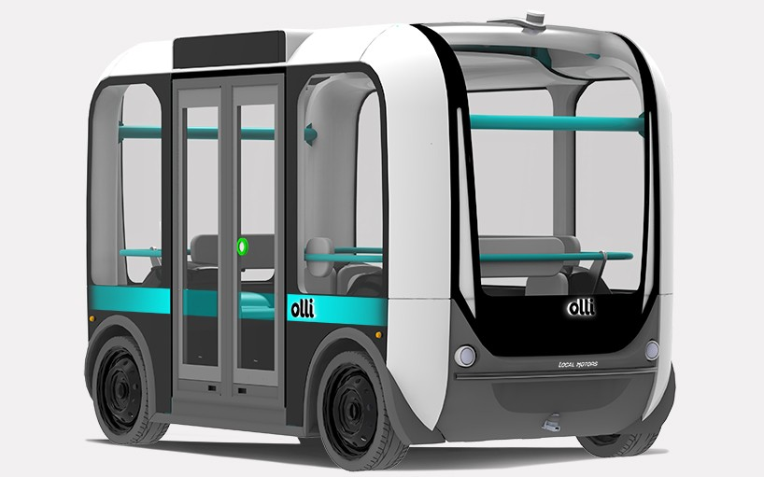
ACES Mobility and Greenville A-Taxis: Research Robotics
Robotic Research, LLC (RR) is our initial technology partner
RR’s goal is to
re-deploy proven military technology and
show a successful business case in a Greenville commercial setting
Re-deploy in September 2017 autonomous electric Cushman 6 passenger vehicles from Fort Bragg, NC to Greenville
Greenville could become an R&D/production center with EV OEMs

Slide 5
Greenville Seeks Innovative Public-Private Partnerships
Public Infrastructure on Rights Of Way (roads, sewer, etc.)
Public Planning regulations to accommodate
Increased Density awards for mixed income housing options
Lower Parking requirements for non-auto transport options
Private investments to Design, Finance, Build, & Operate
Automated shuttles at CU-ICAR, Verdae, Parker, & Downtown
Private Funding for Capital, Operations & Maintenance
Farebox: People pay for convenient, comfortable, cost-effective solutions
Sponsorships and Advertising (GAVP, Verdae, Spinx)
Data has value, and can be monetized
Federal Highway Administration Grant – $4 Million

Slide 6
Deployment Phases and Districts
Phase 2
Verdae District
Parker
CU-ICAR

Slide 7
Why Greenville? Differentiating Factors for Innovative A-Taxis and ACES Technologies
A Committed Community
A welcoming business environment
Critical Assets
Replicable, Scalable Solutions
Technical Talent
Workforce Development
Focus
Partnerships

