Slide 1
CTE in the Southeast: Regional Experiences
Medium- and Heavy-Duty Alternative Fuel Vehicle Deployment Highlights
Blake Whitson
November 16, 2017

Slide 2
About CTE
Mission: To improve the efficiency and sustainability of U.S. energy and transportation systems
non-profit, non-governmental, membership-based
$400+ million portfolio of RD&D projects
  alt. fuel and advanced vehicle technologies
  bridge the gap between laboratory and commercial product
  support early adopters after commercialization
national presence
  Atlanta, Berkeley, Los Angeles, St. Paul
Notes:
Project sponsorship
Federal Transit Administration
Departments of Energy, Defense, Interior, NASA

Slide 3
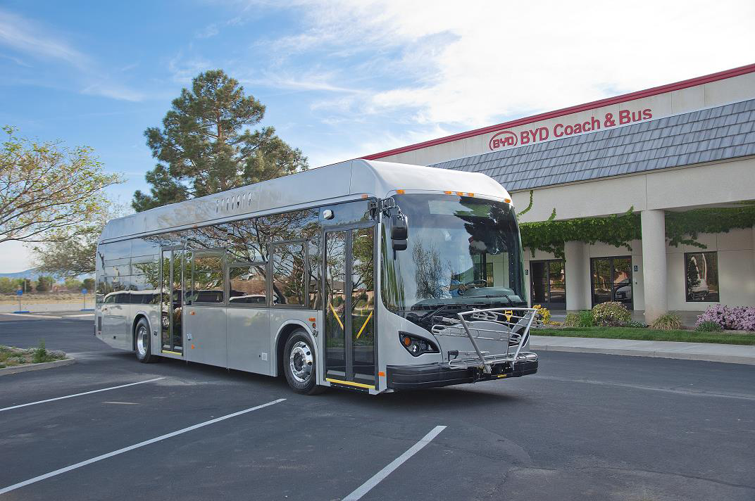
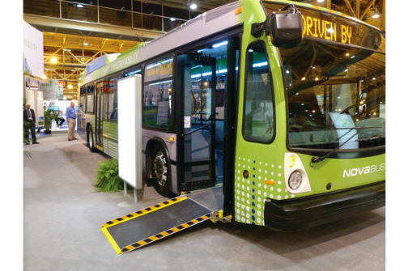
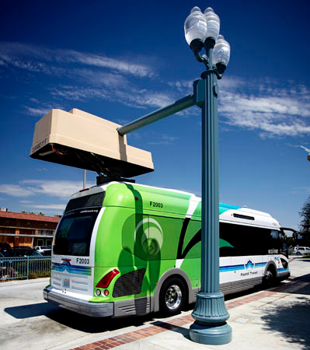
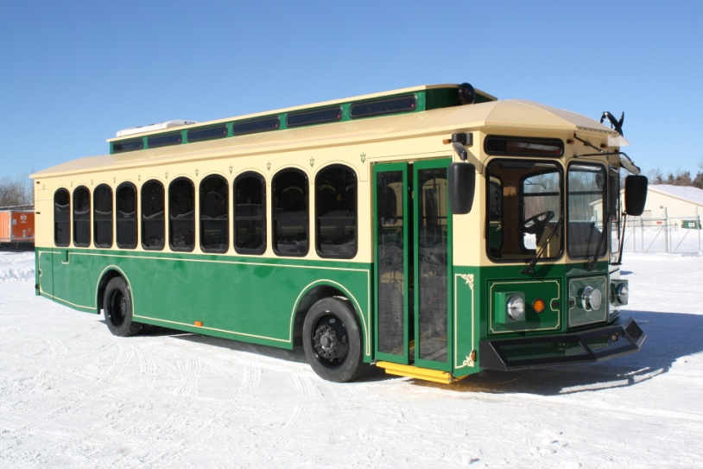
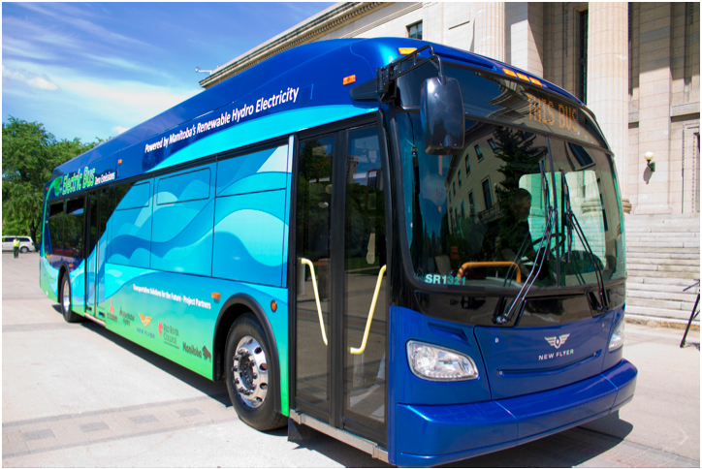
Southeast Project Highlights
Southeast Alternative Fuel Deployment Partnership (SEAFDP)
$4.6M award from DOE in August 2017
Electric Bus Deployments
more popular than ever
Notes:
…to accelerate the deployment of alternative fuel vehicles and infrastructure throughout the southeastern United States.

Slide 4
SEAFDP Overview
Objective: accelerate the deployment of alternative fuel vehicles and infrastructure throughout the southeastern United States.
14 team members from public, private, and non-profit sectors
200+ AFV to be deployed (CNG, PHEV, & EV)
CNG fueling and EV charging infrastructure
24-month data collection and reporting period
Notes:
focus on commercially available technology… deployment project, not development or demonstration... increasing volume of vehicle deployed
focus on three primary tasks:
1. Deployment of AFV Fleets and Infrastructure
2. Facilitate Development of Alternative Fuel Corridors
3. Development of Strategic AFV Fleet Partnerships

Slide 5

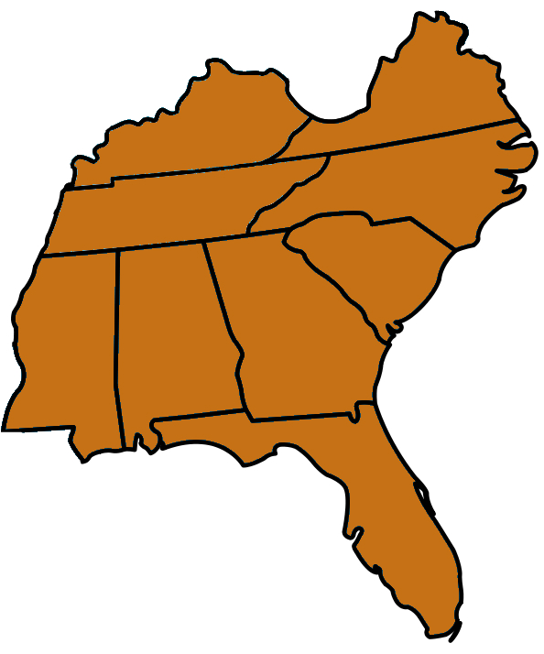









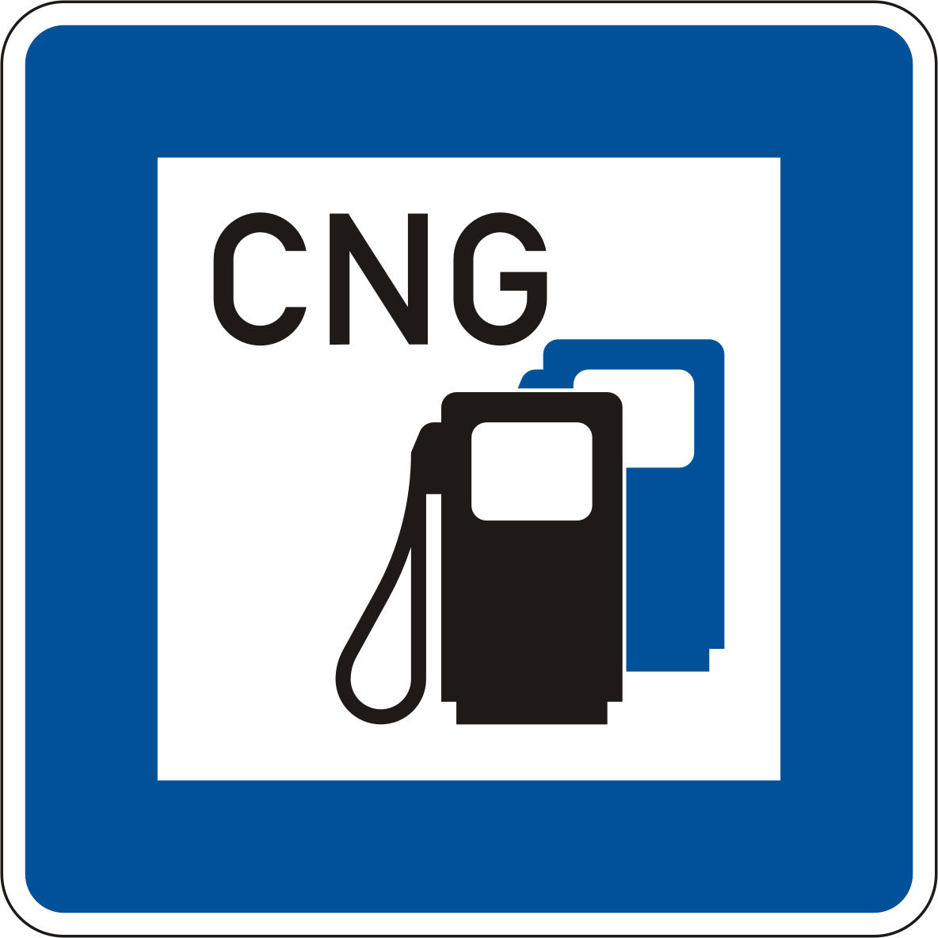

SEAFVDP Regional Footprint
McAbee
Trucking

Slide 6
SEAFDP Vehicles
200+ Compressed Natural Gas (CNG)
160 delivery trucks (Class 6)
70+ refuse trucks
5 tractors (Class 8)
27 Plug-in Hybrid Electric (PHEV)
20 delivery trucks (Class 6)
7 Chevrolet Volts
12 Battery Electric
4 delivery trucks (Class 6)
8 Nissan Leafs

Slide 7
SEAFDP Deliverables
  Real-world deployment data in fleet environment
  qualitative and quantitative comparison to existing gasoline and diesel fleet vehicles
  Help others interested in AFV replicate our success and learn from our failures.
  publish best practices, success stories, case studies, and lessons learned
  publish a Strategic Deployment Plan
  Assess costs and benefits of using CNG station locations for future H2 fueling sites.
Notes:
Strategic Deployment Plan… define methodology for identifying vehicles, infrastructure, and operating strategy

Slide 8
Electric Bus Overview
Different types of buses use electric-drive technology:
diesel-electric hybrid bus
trolleybus
fuel cell bus (FCEB)
battery electric bus (BEB)
Regional popularity of BEBs:
40+ BEBs deployed today in 6 fleets
20+ fleets will be operating BEBs by 2019
4 repeat adopters
Notes:
FCB bus and BEB are zero-emission and often referred to as ZEBs

Slide 9



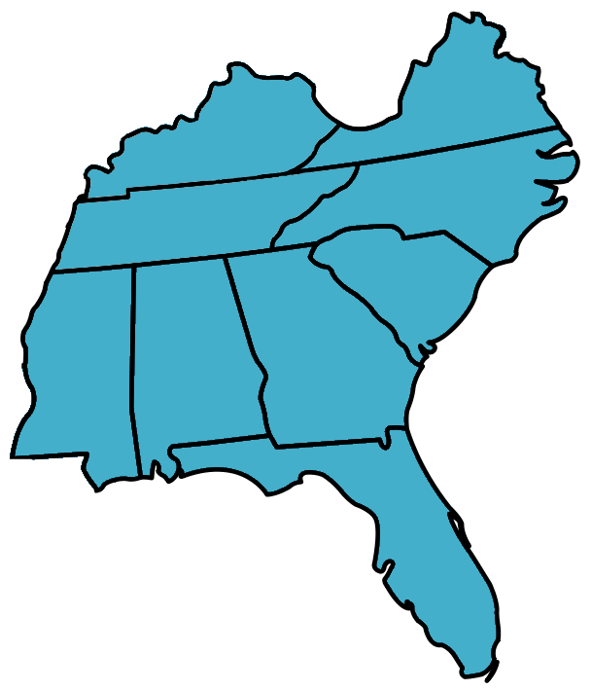



















Regional ZEB Adopters
– ZEBs in service today

Slide 10
Funding Opportunities
Federal agencies are the most popular source of funds for ZEB deployment.
No voucher programs available in SE and state grants are rare
Volkswagen Settlement may be a source of funding in near-future.
  Alabama: no lead agency to date
  Florida: Dept of Environmental Protection
  Georgia: Gov Office of Planning and Budget
  South Carolina: Dept of Insurance
  Tennessee: Dept of Environment & Conservation

Slide 11

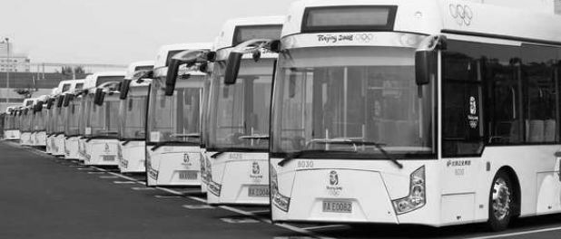
Blake Whitson
Technical Project Manager
Center for Transportation and the Environment blake@cte.tv
Chateau Elan
November 16, 2017

