Slide 1
EV Efforts in SC
Electrify the South
November 15, 2017

Slide 2

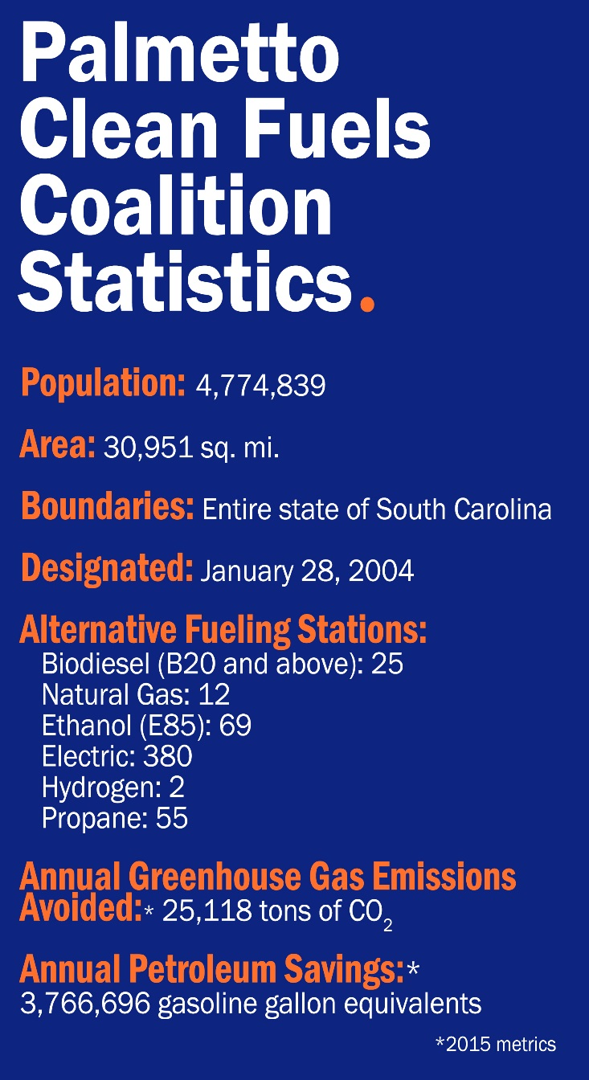
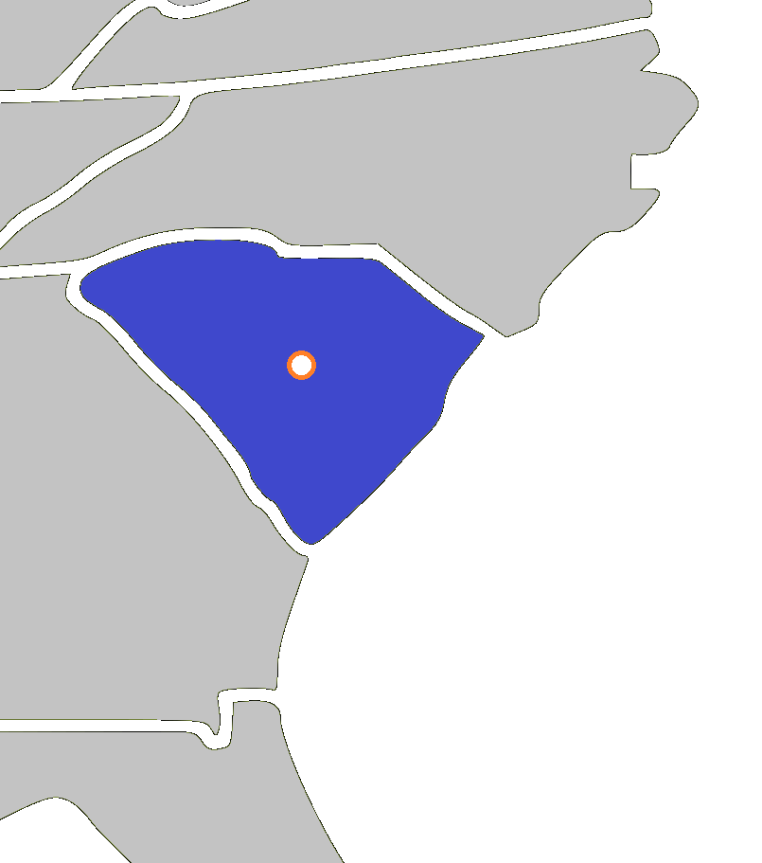
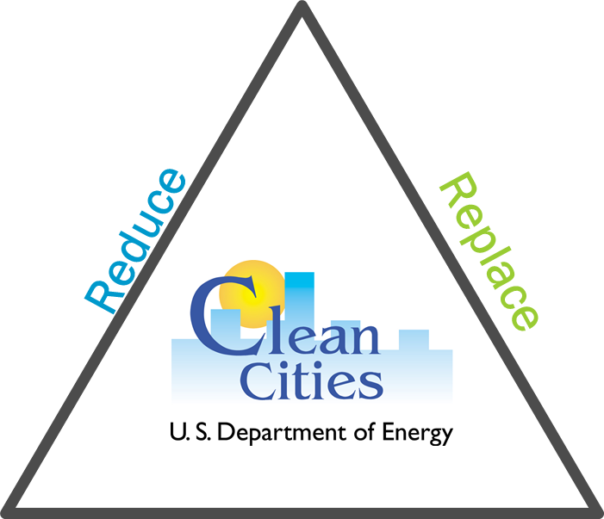
South Carolina’s Clean Cities Coalition
Eliminate
Notes:
National network of nearly 100 local coalitions
82% of the total U.S. population lives inside coalition boundaries
Nearly 500,000 alternative fuel vehicles (AFVs)
Coordinator may provide local examples of each of the following activities.
Clean Cities strengthens markets for alternative fuels and advanced vehicles throughout local areas in a variety of ways, including:
Creating formal and informal networking opportunities with fleets and industry partners. These opportunities can occur through coalition-organized or sponsored events, such as workshops and monthly meetings, or through personal introductions to key industry partners.
Sponsoring technical training, workshops, and webinars, as well as making publications and other information resources available about alternative fuels, advanced vehicles, idle reduction, and strategies that reduce petroleum consumption.
Offering individual consultation and fuel-neutral technical assistance. Coalitions have access to a broad set of industry experts who can help with projects, as well as identify and solve problems.
Supplying information about funding opportunities from federal, state and local agencies, and other private sources, as well as assistance with funding applications.
Providing public recognition for progress in cutting petroleum use. Once fleets have made the commitment to alternative fuels, coalitions help by publicly recognizing their efforts in coalition materials, press releases, and other announcements.
Offering assistance in collecting data to justify an investment or make improvements to a program.
Connecting fleets with fuel providers/industry partners
Offering training and information
Supplying access to technical assistance
Identifying funding
ConserFund +, mini-grants
Providing public recognition
Green Fleet Leader Award
Collecting data and tracking progress

Slide 3
AFV Corridor Designations
Lead Agency | EV Corridor | CNG Corridor | LPG Corridor
SC Energy Office | I-26: From NC border to Columbia; and from Orangeburg to North Charleston. I-20: From Florence to SC/GA border. I-95: From SC/NC border to SC/GA border. | I-20: Entire length of corridor. I-26: Entire length of corridor. I-77: Entire length of corridor. I-95: Entire length of corridor. | I-20: From Florence to Camden. I-95: Entire length of corridor. I-77: Entire length of corridor. I-85: Entire length of corridor.
Notes:
We received designations that were probably like most of your state’s designations, where each fuel was on a different roadway and some fuels were in smaller segmented off stretches of roadway.

Slide 4
EV Corridor Designations

Slide 5
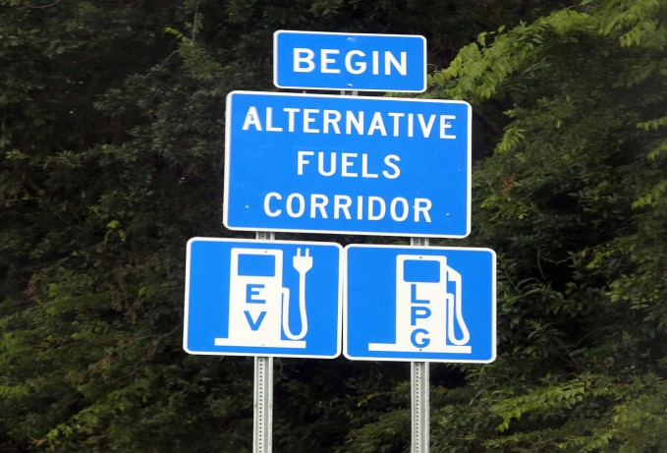
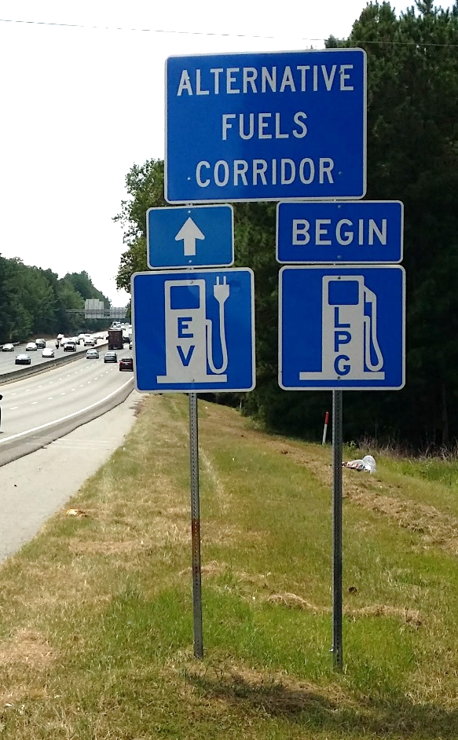
Charleston, SC: I-26
Columbia, SC: I-26
68 signs, 22 locations
Notes:
SCDOT handled all of the installation, and sent the signs to their regional site, where they were then put up.
Here is a picture of one of the signs placed in Charleston, SC along I-26.

Slide 6
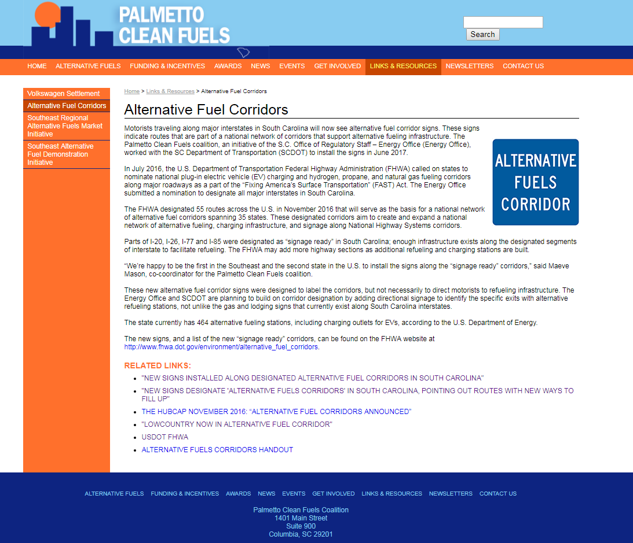
Dedicated Web Content
PalmettoCleanFuels.org/AFVcorridors
Notes:
We have created web content on Palmetto Clean Fuels. ORG where we have media related to the corridors and information on why they are important.

Slide 7
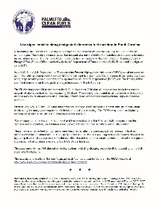
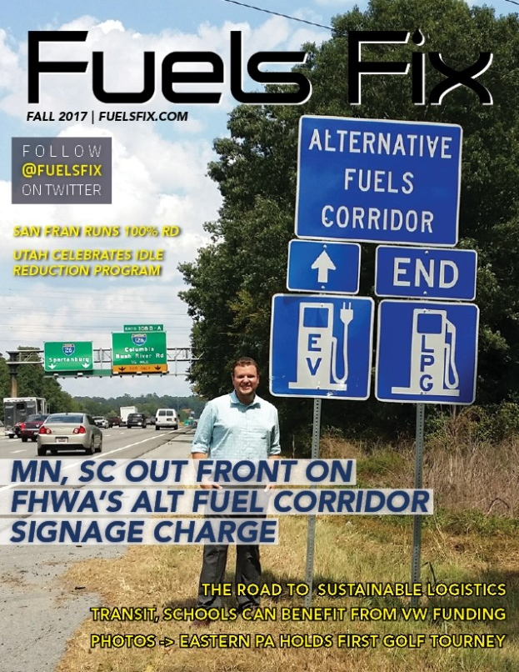
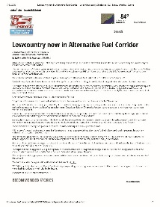
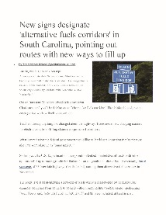
Media
New signs installed along designated alternative fuel corridors in South Carolina
  ORS Energy Office/Palmetto Clean Fuels
    http://www.regulatorystaff.sc.gov/Documents/News%20Archives/7-21-17%20New%20signs%20installed%20along%20designated%20%27alternative%20fuels%20corridors%27%20in%20South%20Carolina_FINAL.pdf
Lowcountry now in Alternative Fuel Corridor
  WCSC Live5News, Charleston, SC
    http://www.live5news.com/story/35838008/lowcountry-now-in-alternative-fuel-corridor
New signs designate 'alternative fuels corridors' in South Carolina, pointing out routes with new ways to fill up
  The Post and Courier, Charleston, SC
    http://www.postandcourier.com/business/new-signs-designate-alternative-fuels-corridors-in-south-carolina-pointing/article_69386a84-65a3-11e7-be1c-c3b0c46b17c7.html
Notes:
We put out an article from our agency and were contacted by two lowcountry media sources that ran the story.
It’s big news! And we’re happy to be the second state, first in the Southeast, to have these signs installed!
NEXT STEPS

Slide 8
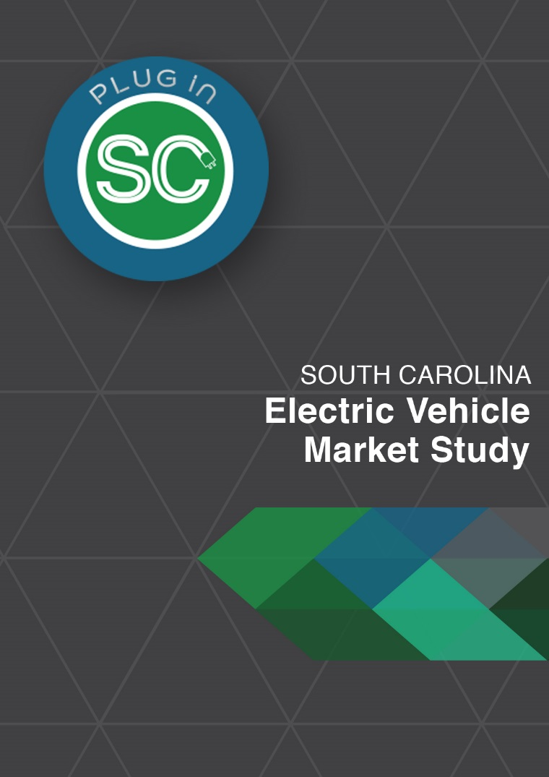
Plug-In SC
The Plug in SC Campaign is a product of the SC Electric Vehicle Market Study, which includes guidance and information on:
  Past research and efforts
  The current state of electric vehicles in SC
  Strategic “plug-in” partners across the state and nation
  Out of home and digital marketing and content
  Recommendations for standardized charging station parking signage, pavement markings, and directional signage
  Workplace charging expansion
  Infrastructure development and deployment

Slide 9
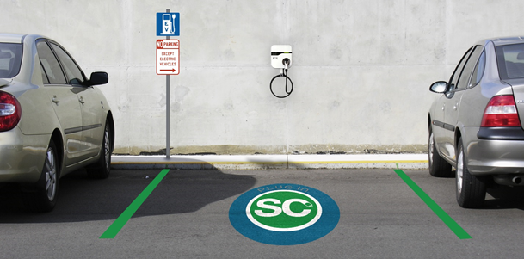
Signage

Slide 10

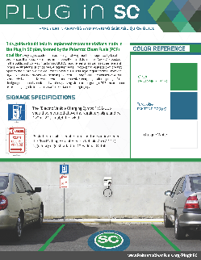
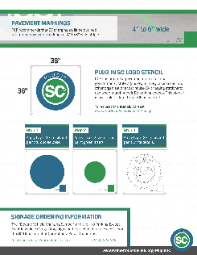
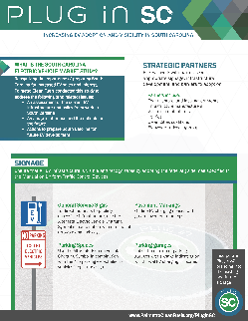
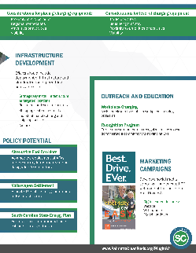
Marketing
One Page Handout
Pavement Marking and Parking Signage Quick Guide
Web Content
PalmettoCleanFuels.org/PluginSC

Slide 11
Transportation & Energy Plan

Slide 12
Policy Recommendations
State Lead by Example
Energy Upgrades
Challenge: Look for ways to increase the adoption of alternative fuels. Currently, only a small portion of state-owned or leased fleet vehicles are fueled by a Department of Energy established alternative fuel. As a result, South Carolina’s fleet lacks diversity, and fuel supply is vulnerable. These limitations compromise fuel efficiency and diversity in transportation.
Approach: Conduct a survey and convene a task force to 1) educate 2) identify barriers and 3) develop recommendations/state-wide goals
Challenge: Develop the necessary funds to advance energy efficiency, renewable energy, and alternative transportation opportunities that support policy goals. Currently, South Carolina lacks a revenue stream to support these efforts.
Approach: Study Committee to examine solution to problems with funding energy efficiency (on-bill financing, public benefit funds, low-interest loans) and transportation
Notes:
Phase II work to develop policy recommendations began in late summer/early fall and included feedback from the surveys and public engagement sessions.
Phase II work began by examining the baseline and looking to the future of energy use in SC. Things like examining newer technologies, economic development, and ways to address future challenges like natural gas infrastructure and the Integrated Resources Planning process.
Hence….the make up of the six subcommittees involved in Phase II was different than in Phase I. Phase I participants consisted of technical experts. Phase II subcommittee members focused their efforts on slightly different topics and participants consisted of policy perspectives and decision makers.

Slide 13
