Slide 1
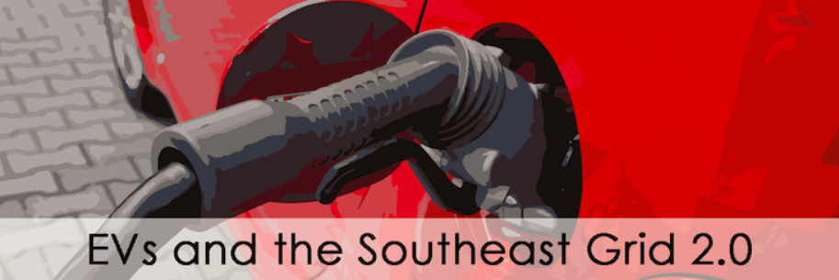
Utility Projects & perspectives
November 16, 2017
Alan Shedd, P.E., CEM
Touchstone Energy Cooperatives

Slide 2
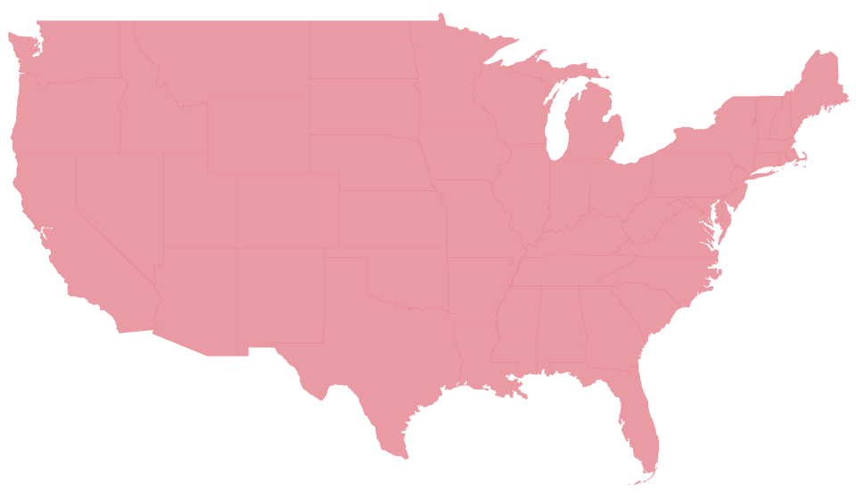
Who We Are
Are located in 80% of the nations counties
Are the largest electric utility network in the nation

Slide 3



Who We Are
Serve 75% of the
U.S. land mass
Total 742 local systems in
46 states
Have 32 million
member-owners

Slide 4


Who We Are
Own $113 billion in generation,
transmission and distribution assets
Distribute power over
2 million miles of line

Slide 5
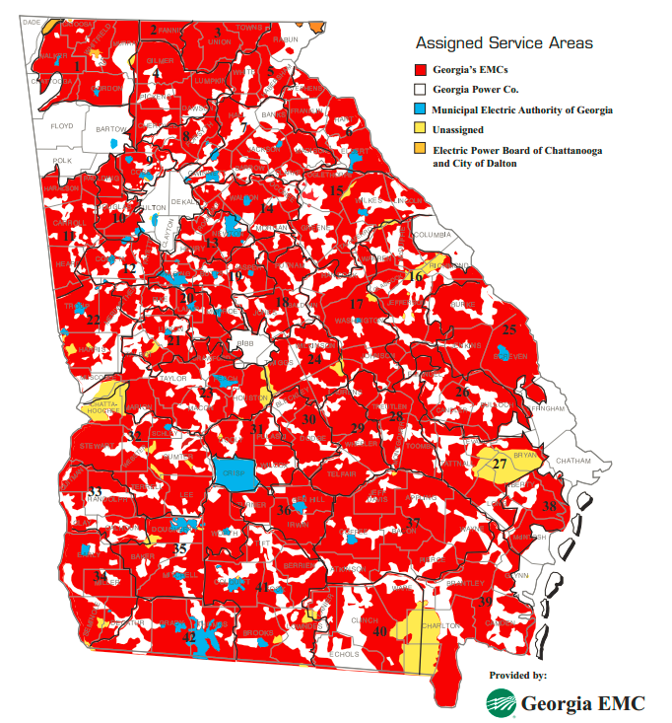



Slide 6
Environmentally Beneficial Electrification
Use high-efficiency electric technologies
Everybody wins
  Reduce operating costs
  Reduce CO₂ emissions
  Increase electricity usage

Slide 7
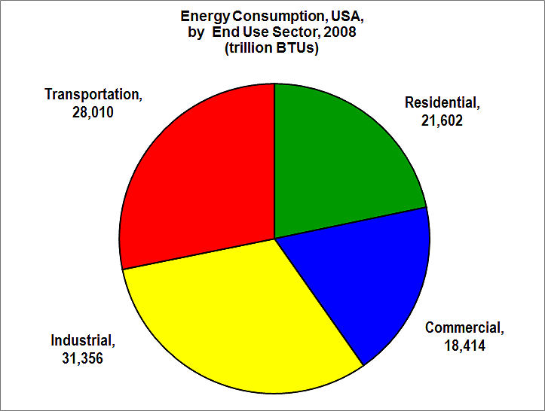
Opportunities – All Sectors

Slide 8
Transportation Sector
Electric Vehicles
Largest opportunity for load growth since air conditioning
Lower cost for members
Lower total emissions now, even better in future
Over 697,000 highway-legal EVs in US
  37 different models, more on the way
  Chevy Bolt: 240 mile range, $30k

Slide 9
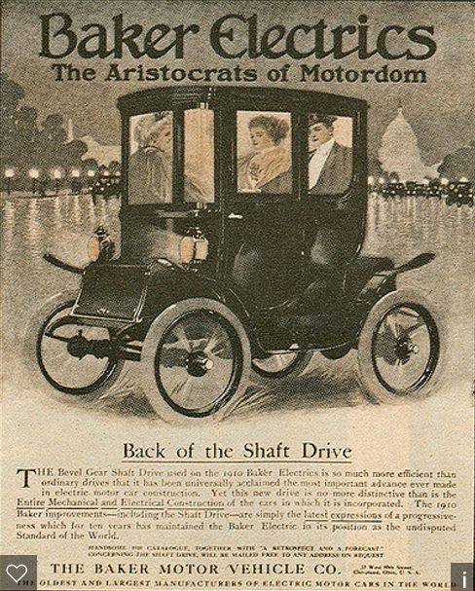
Electric Vehicles
Long history
1890’s – offered simplicity & reliability
1970’s – alternative to oil
1990’s – clean air & fuel economy
Now – fuel economy, performance, economics

Slide 10
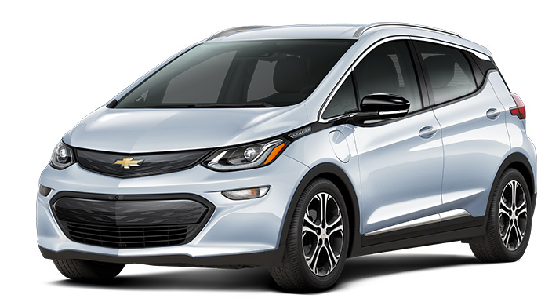
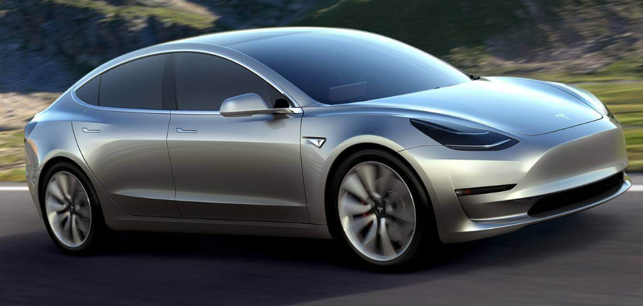
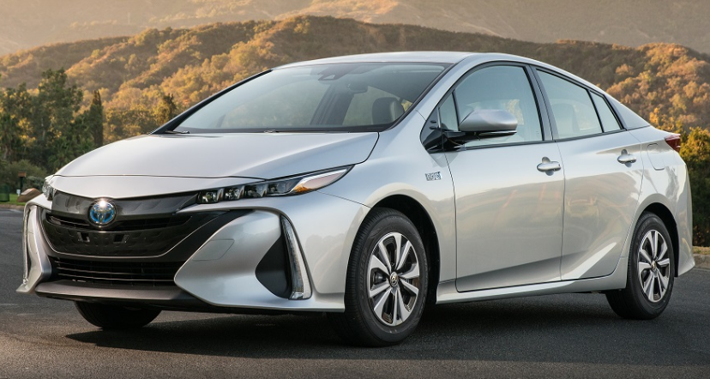
Electric Vehicles
What’s changed?
Better range
More charging stations
Electric vehicles are cool
Economics

Slide 11
Electric Vehicles
Charging
Home
Workplace
Public
  Destination
  Transportation Corridor

Slide 12
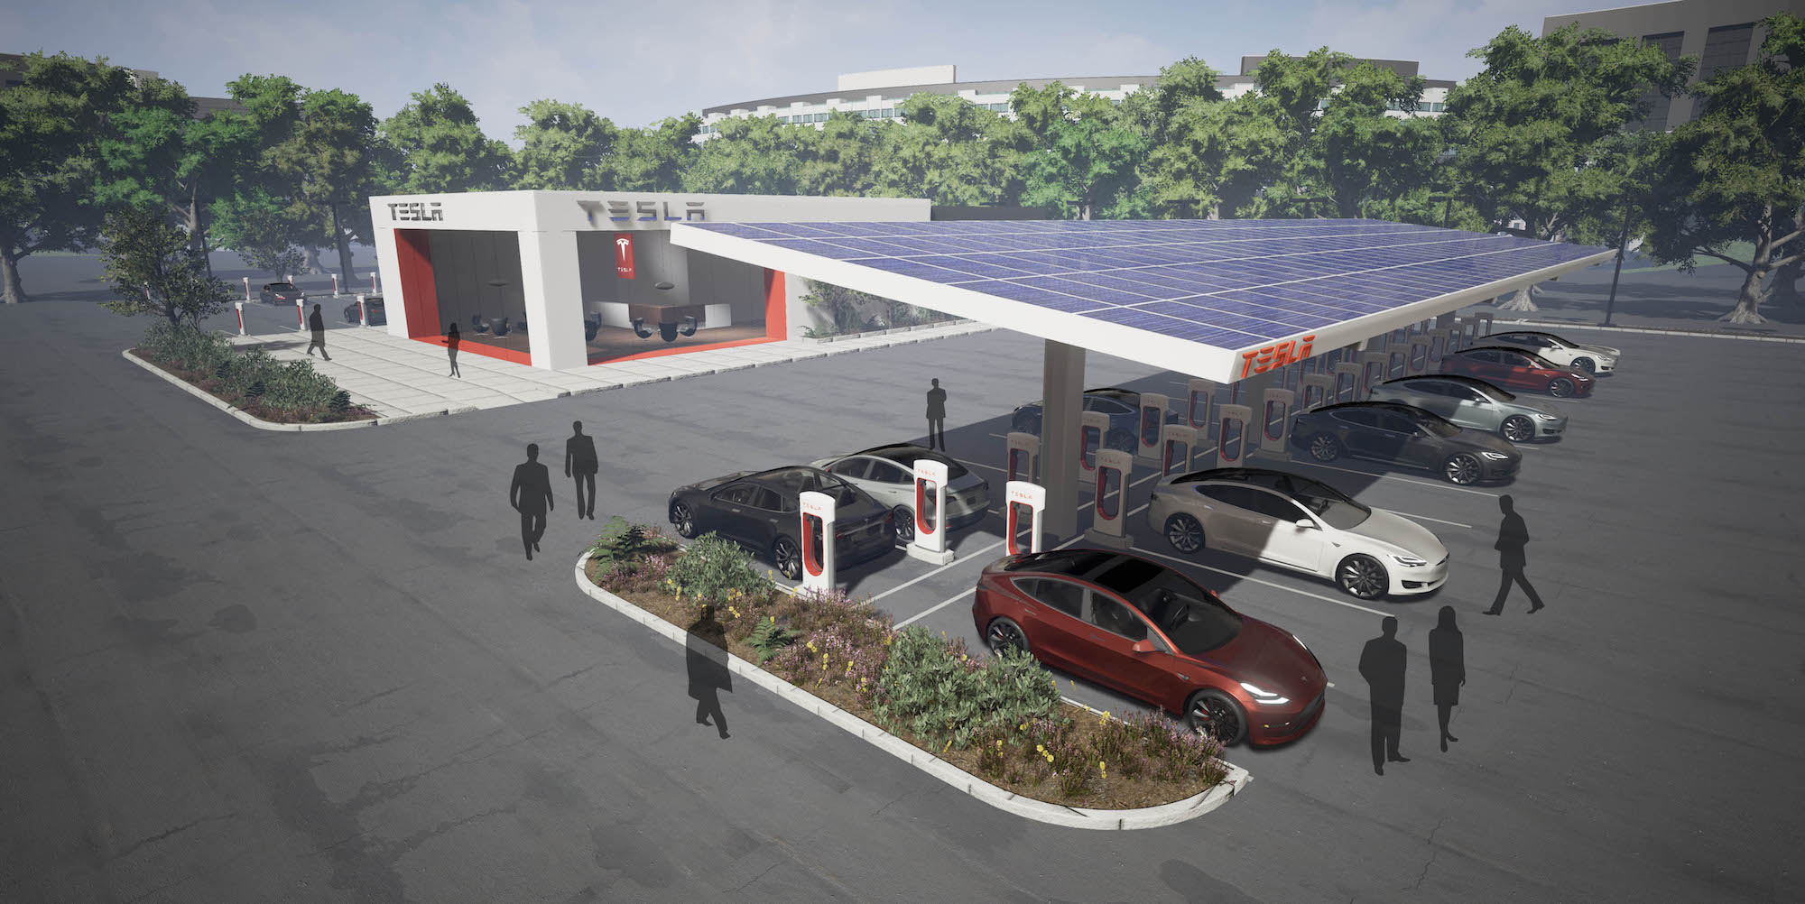
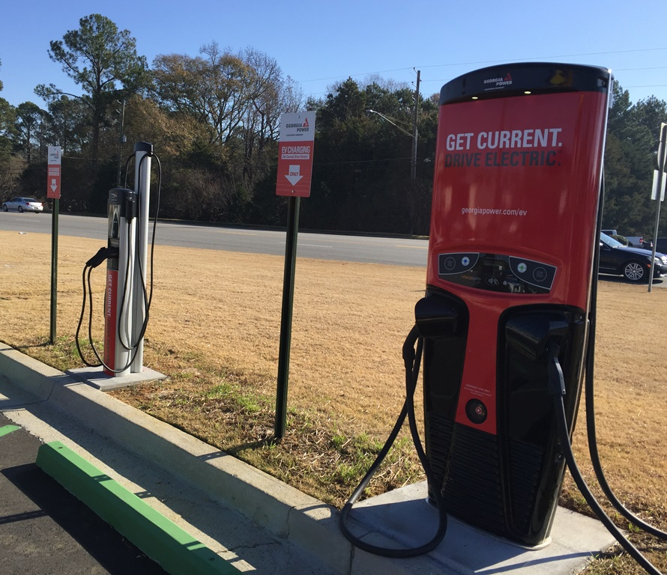
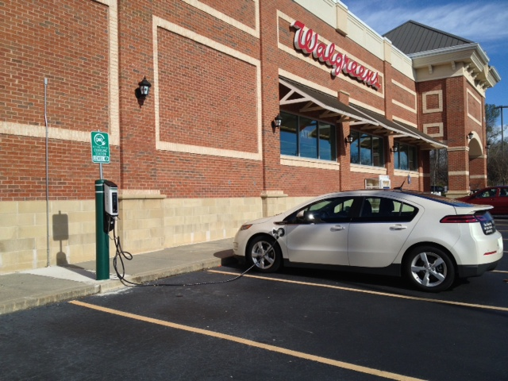
Electric Vehicles
Public Charging
Tesla Superchargers & Solar Canopy
Level 2 & DCFC – Dublin, GA
Level 2 at Walgreens

Slide 13
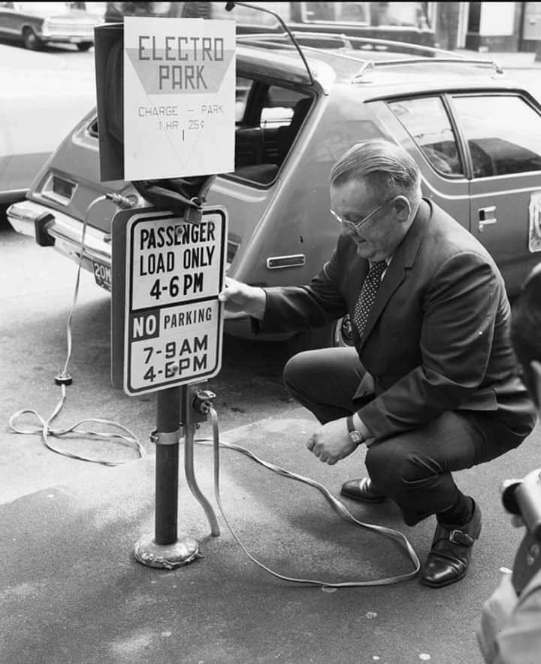
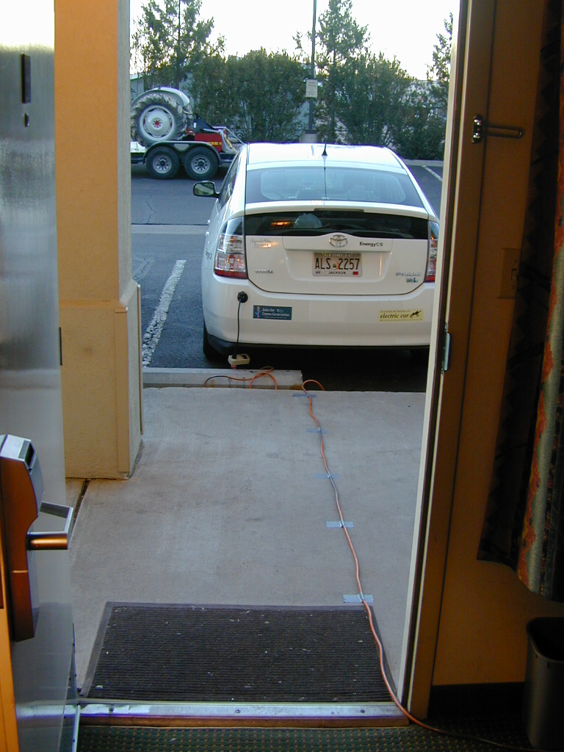
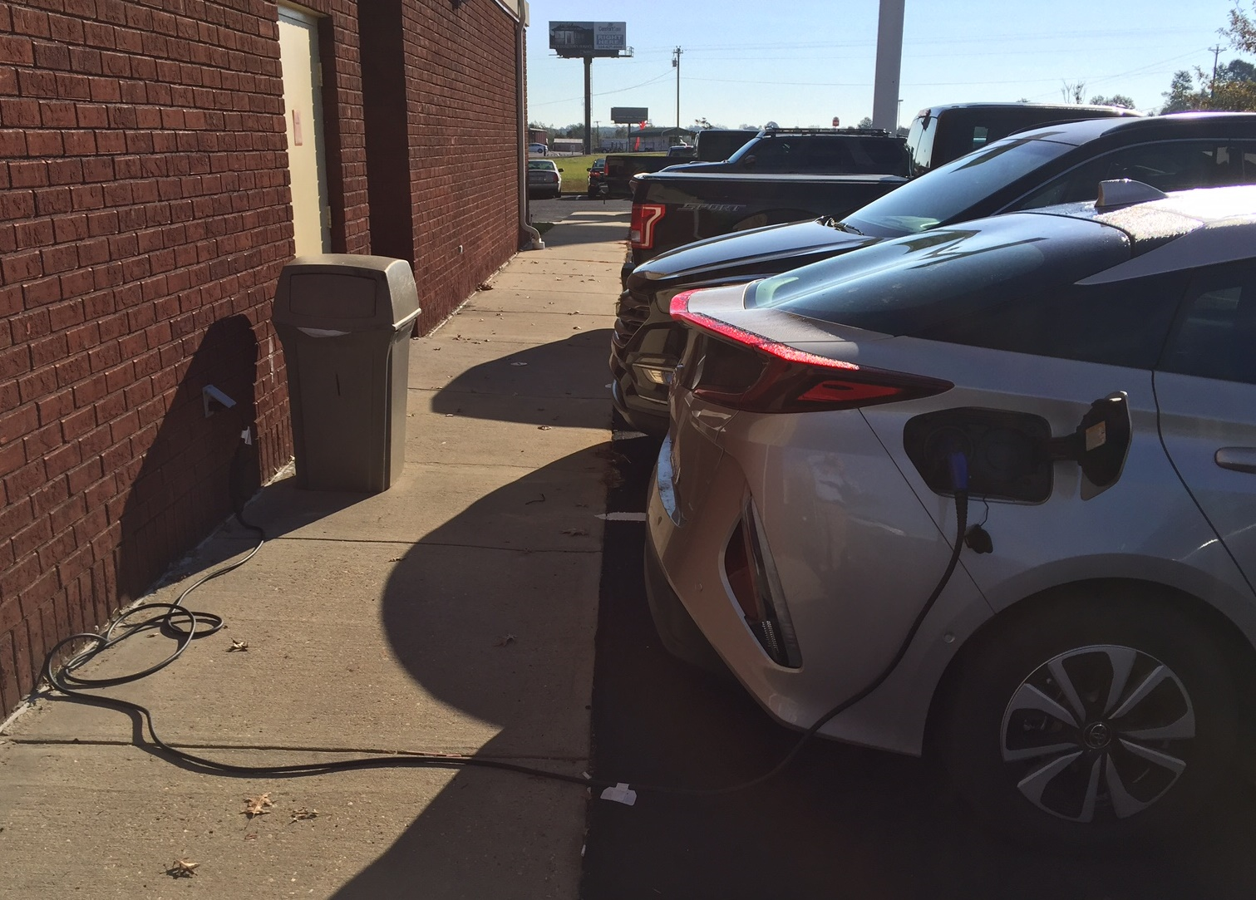
Electric Vehicles
Public Charging
1970’s
February 2007
November 2017

Slide 14
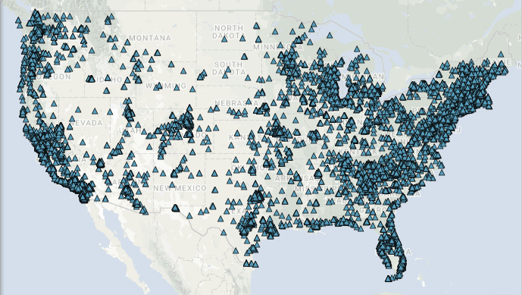
Electric Vehicles
From Alternative Fuels Data Center

Slide 15
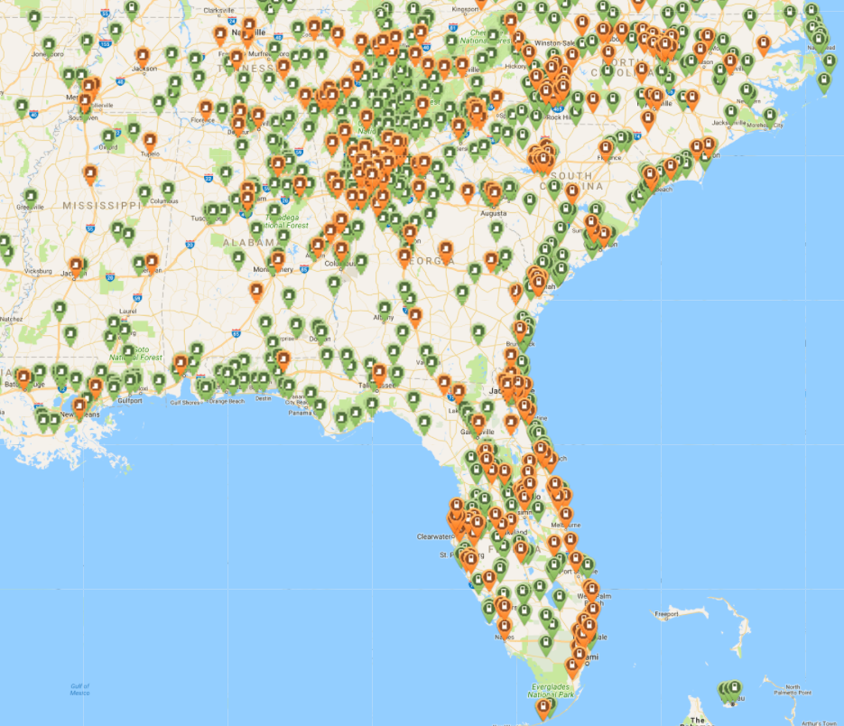
From PlugShare.com

Slide 16
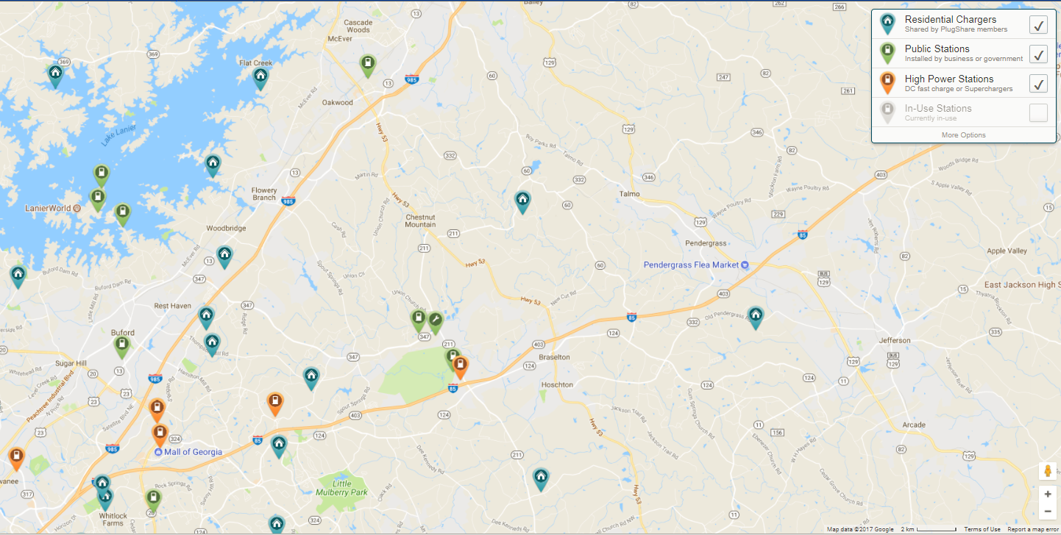
From PlugShare.com

Slide 17
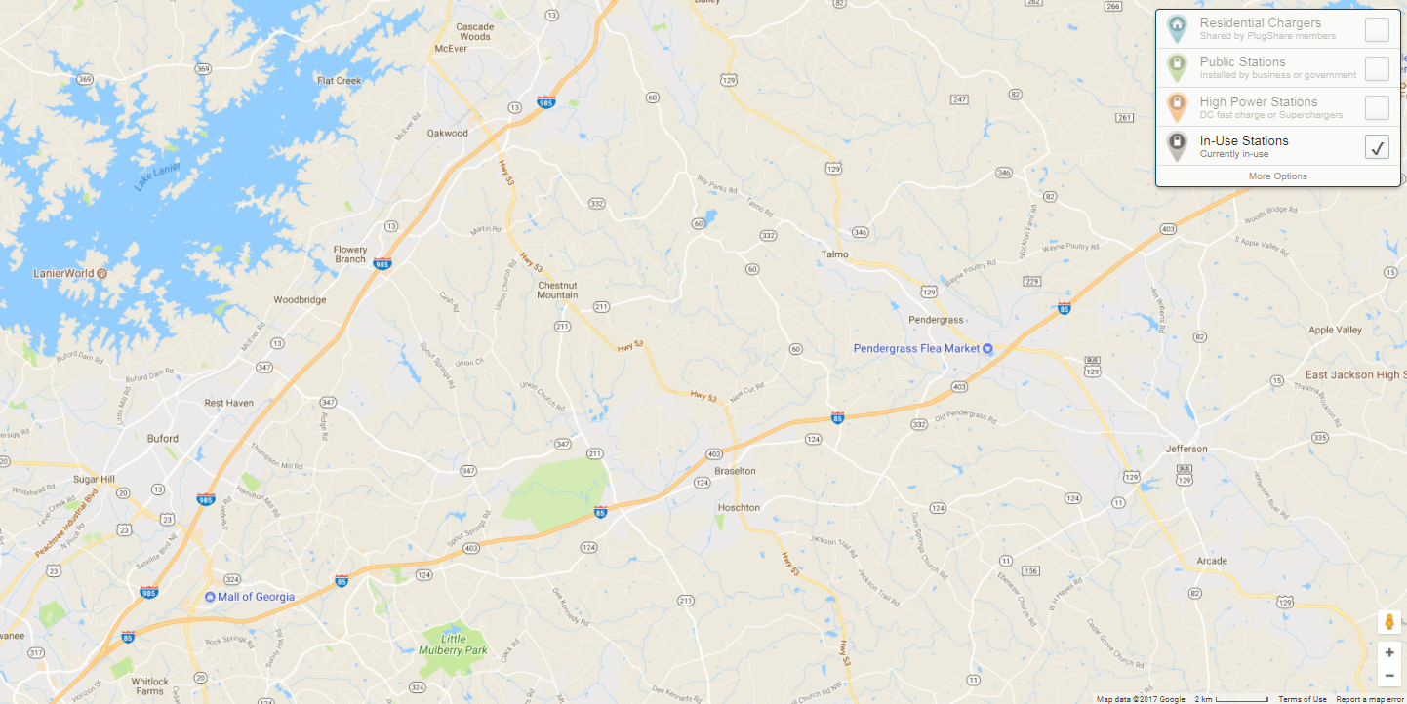
From PlugShare.com – 8:30 AM, November 15, 2017

Slide 18
Where Are the Cars?
Notes:
This is based on the National Household Travel Survey, 2001
Vehicle location vs. arrival times, several weeks, separated days, >50,000 vehicles, >200,000 travel days
Basis of multiple charge per day studies
Most vehicles spend most of their time parked – most at home and to a lesser extent, at work.
Home is where most charging will occur.
Public charging is a safety net and reduces range anxiety. Total amount of energy used is small but demand can be high.
8/11/09
B. Gross, Plug-in 2009

Slide 19
Electric Vehicles
Charging
Public charging is important but…
Range anxiety is over-hyped
Emphasis on Home & Workplace
Urban might not be the place to focus

Slide 20
Electric Vehicles
Energy Use
Electric WH, family of 4 uses 3,310 kWh/year
  Enough energy to drive 11,000 miles/yr.
EV with $1 of electricity = car on 1 gallon of gas
  Based on $0.13/kWh, 25 mpg
Notes:
Some cost of use numbers
Electric car energy use about like an electric water heater
EV can travel as far on $1 of electricity as a typical gas-powered car on 1 gallon of gasoline. (That’s less than ½ the cost per mile)

Slide 21
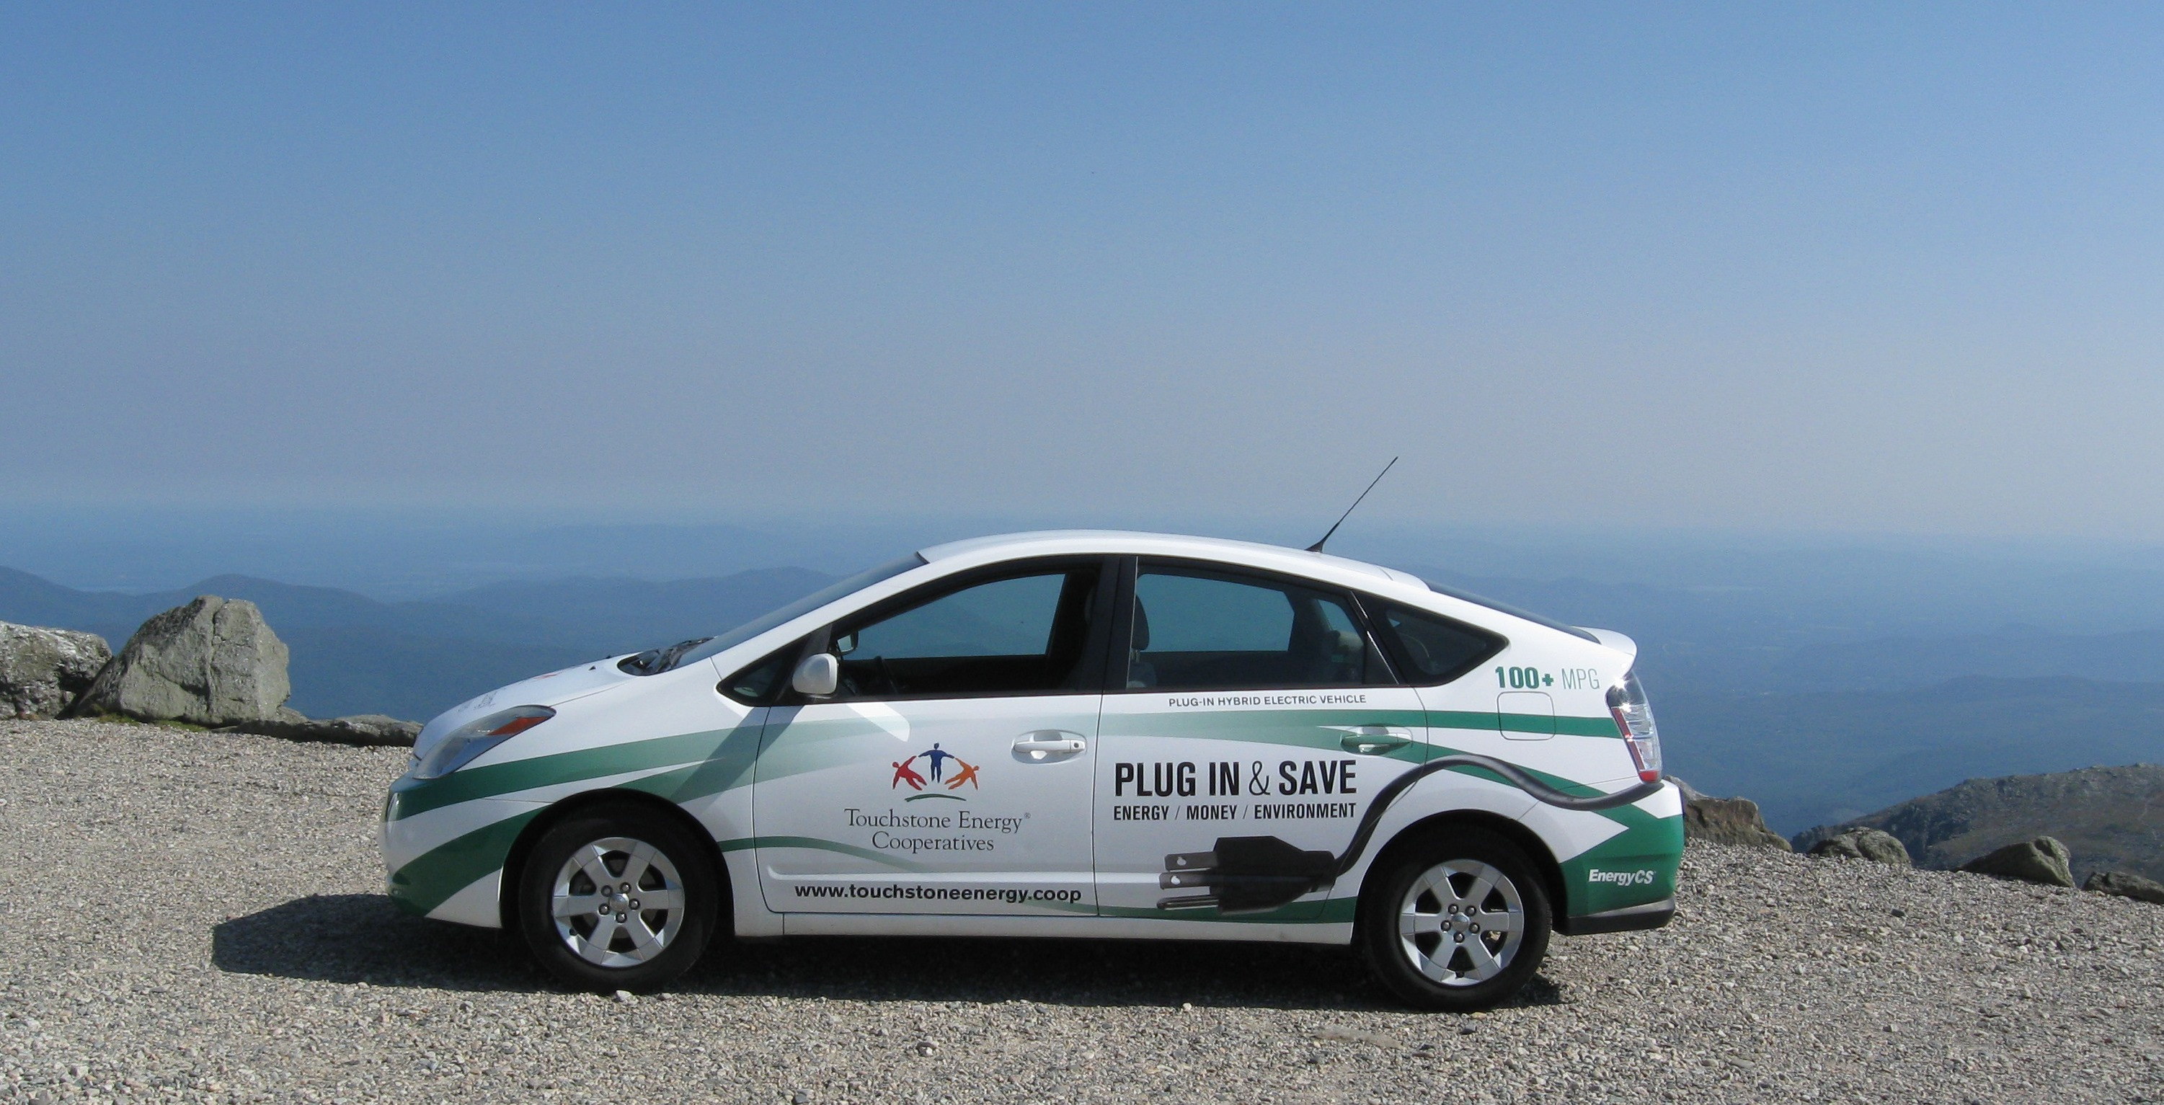
Electric Vehicles
Economical
Fun to drive
Practical
Green
Education is Job 1
Mount Washington, 2009

Slide 22
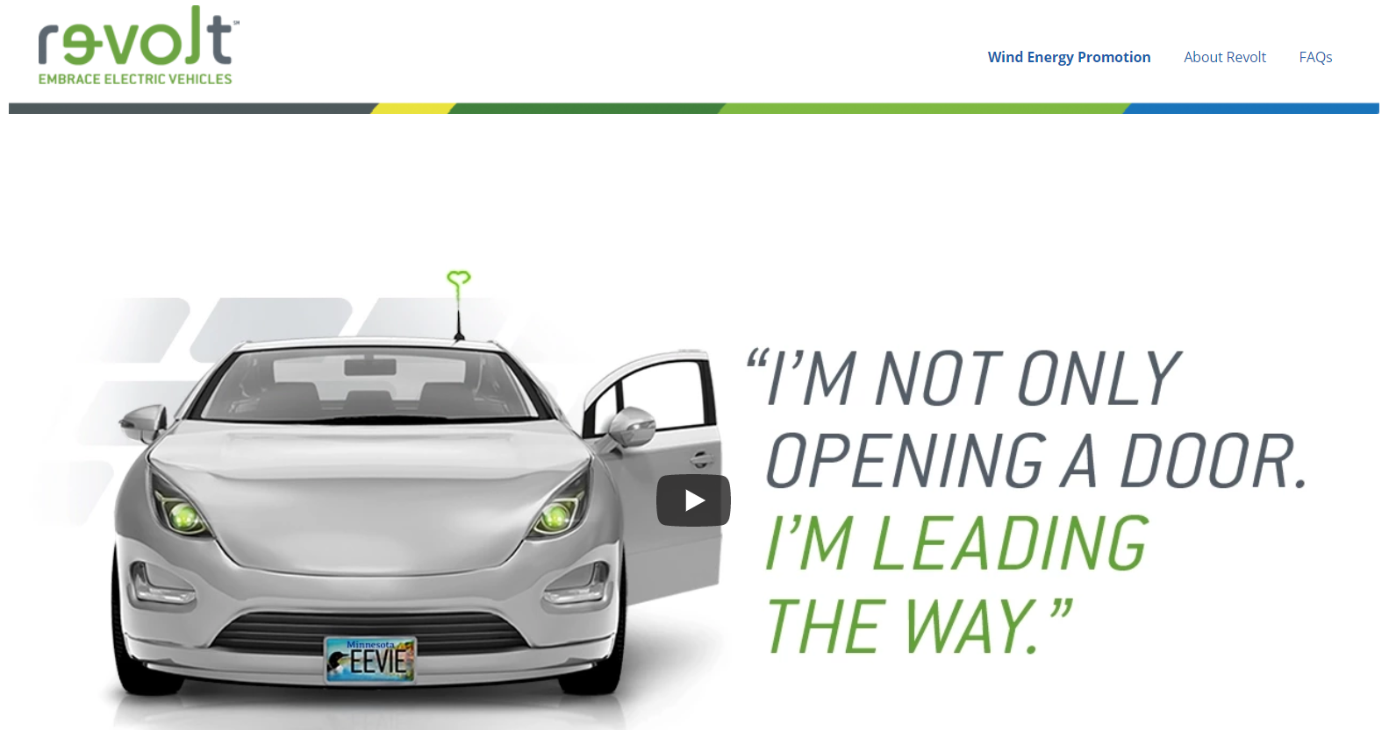
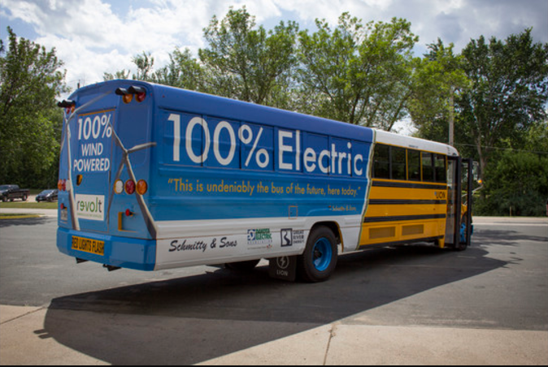

Electric Vehicles
Great River Energy & Dakota Electric Co-op, MN
Notes:
The co-op retires, wind energy Renewable Energy Certificates for each kWh used by the bus so the bus is not only 100% electric but 100% wind-powered.

Slide 23
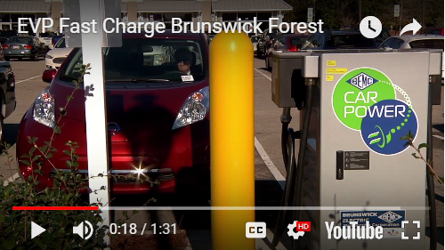
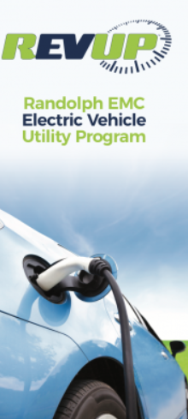
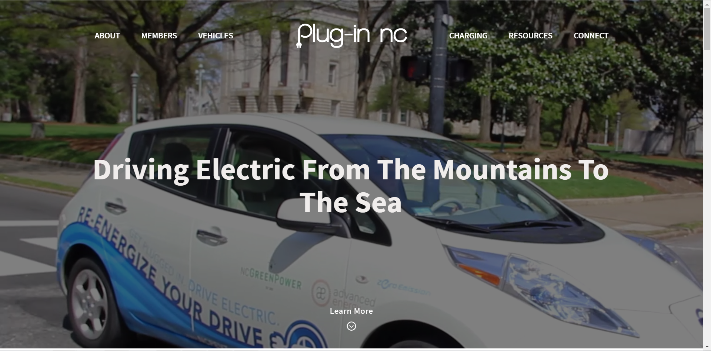
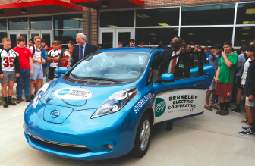
Electric Vehicles
North Carolina
EV loaned to school driver’s ed program
Notes:
The co-op retires, wind energy Renewable Energy Certificates for each kWh used by the bus so the bus is not only 100% electric but 100% wind-powered.

Slide 24


Questions or more information contact:

