Slide 2
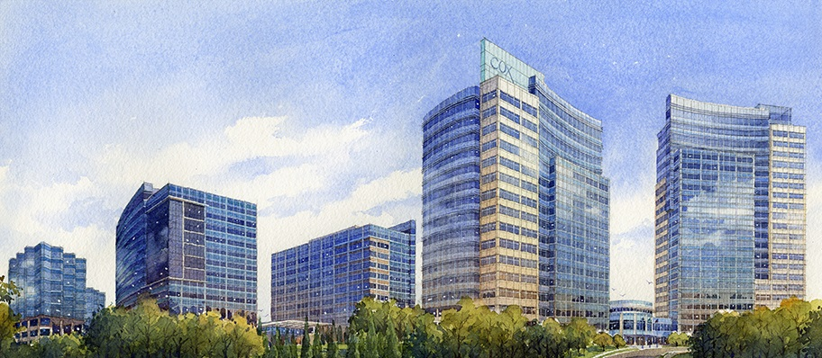
Our Heritage
1898
2017
119 YEARS OF INNOVATION AND CHANGE
Notes:
Cox Enterprises, Inc. was founded in Dayton, Ohio, in 1898 by former schoolteacher and news reporter James M. Cox, whose ambition was to own a newspaper. At the age of 28, he borrowed $26,000 from friends and family and purchased the Dayton Evening News (now the Dayton Daily News).
James Cox's success with the newspaper led him into public service. He subsequently became Ohio's first three-term governor and the 1920 Democratic nominee for president of the United States. After losing the election to Warren G. Harding, Gov. Cox focused his attention on growing his media business.
In 1935, Gov. Cox started Ohio's first radio station, WHIO, just as radio was gaining widespread popularity. In 1939, Cox acquired The Atlanta Journal newspaper and WSB, the South's oldest and most powerful radio station. Cox's innovation continued in 1948 when WSB-TV in Atlanta became the South's first television station; WHIO-TV in Dayton began broadcasting later that year.
Following Gov. Cox's death in 1957, his son, James Cox, Jr., assumed leadership of the company and continued its expansion until his death in 1974. During his tenure, Cox Enterprises became one of the first major players in the cable television industry. Cox Communications began with the acquisition of three small cable systems in rural Pennsylvania in 1962.
Today, Cox Communications is among the largest broadband communications companies in the country and serves more than 6 million customers in 18 states.
Cox demonstrated its foresight again in 1969 by acquiring Manheim Auto Auction in Manheim, Penn. Manheim has grown to be the world's leading provider of used-vehicle and remarketing services, and a marketplace for almost 10 million used vehicles that change hands every year.
Cox's next auto-related innovation was launched in 1998. AutoTrader.com is the Internet's leading auto classifieds marketplace and consumer information website that attracts about 17 million unique monthly visitors.
Meanwhile, Cox's traditional media operations - newspapers, radio and television - continue to be major players in their industries.
Cox employs more than 50,000 employees in 300 separate businesses, and its employees are active in every community where the company operates.
James C. Kennedy, Gov. Cox's grandson, is chairman of Cox Enterprises. Under his direction, Cox has engaged in a major conservation effort, "Cox Conserves," across the company. It's part of a legacy that began more than a century ago.

Slide 3
Cox Enterprises: A Diversified, Private Company
Cable television distribution, high-speed Internet access, home security, telephone, commercial telecommunications and advertising solutions
Television and radio stations, digital media, newspapers and advertising sales rep firms
Vehicle auctions, repair and certification services and web-based technology products; digital automotive marketplace and software solutions
Notes:
Here are a couple of fun facts:
Cox Communications serves approximately 6 million residences and businesses.
Autotrader has 4.2 million average daily vehicle listings.
Kelley Blue Book provides valuations for 443 million vehicles annually.
Manheim has sold more than 100 million cars since 1945.
Cox Media Group operates in more than 20 media markets and reaches approximately 52 million Americans weekly
Cox Automotive touches 3 out of 4 vehicle transactions in the U.S.

Slide 5
2024
GOALS
2044
zero waste to landfill
carbon & water neutral

Slide 6
Cox Conserves – Employee Electric Vehicle Program
First charging stations installed September 2012
Today
40 charging ports
381 EV drivers (6,500 corporate employees)
Since September 2012
165 tons of green house gas avoided
38,120 charging sessions
352 MWh’s of electricity
46,200 gallons of gasoline saved

Slide 7
Cox Conserves – Employee Electric Vehicle Program
Lessons Learned
To charge or not to charge?
How much?
Recover just operation cost or capital?
How many charging stations are enough?
How do you discourage camping?
What policies do you need?
How do you enforce policies?

