Slide 1

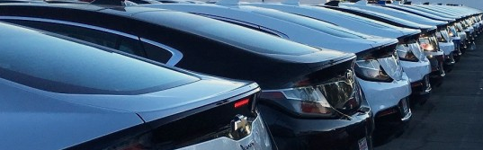
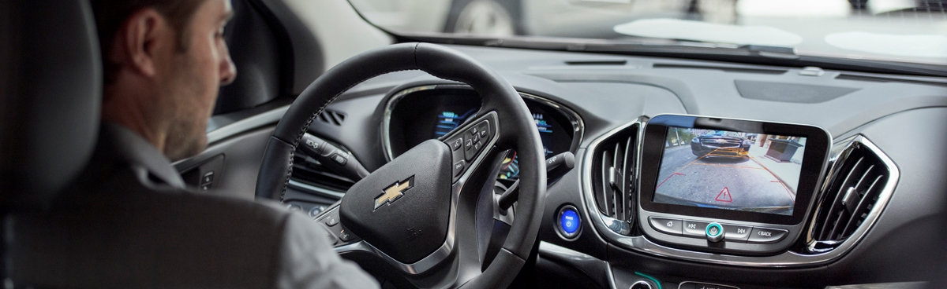
EVs & the Southeast Grid 2.0
Château Élan, Braselton, GA
15 November, 2017
Britta K. Gross
GM, Director Advanced Vehicle Commercialization Policy

Slide 2
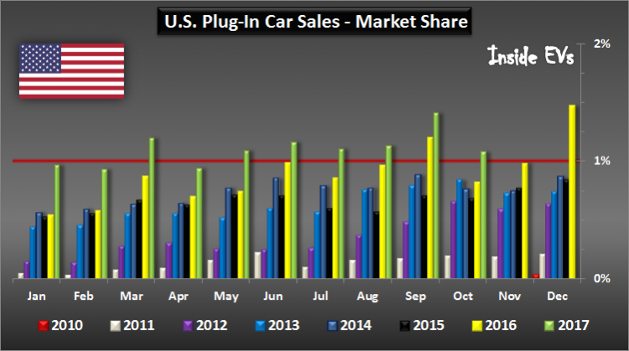
Year over Year Sales Growth in the U.S. EV Market
EV sales in the US have risen YOY for 25 consecutive months
30% EV sales growth in 2017 over 2016 (YTD)
U.S. Plug-In Car Sales (data through October 2017) – insideEVs.com

Slide 3
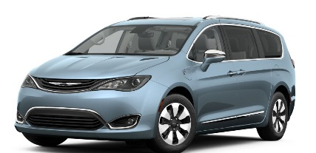
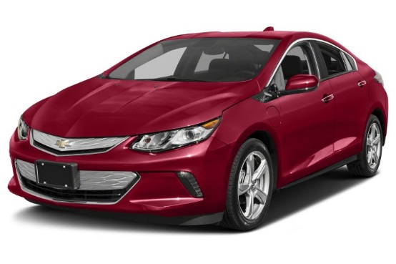
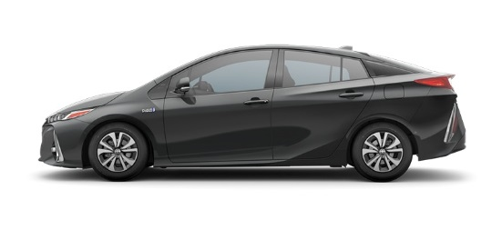
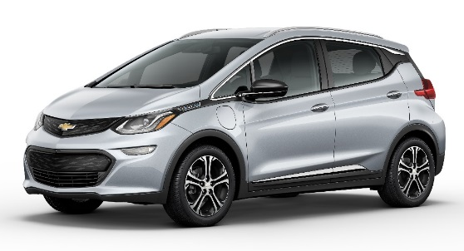
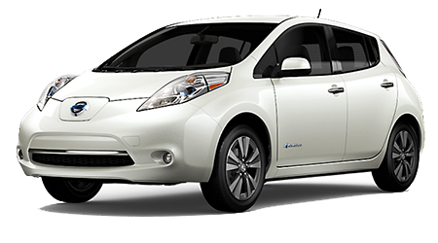


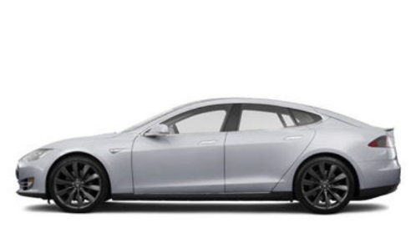

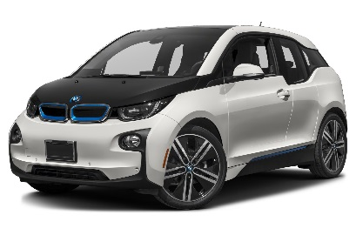
Plug-in Electric Vehicles (PEVs):
Includes PHEVs, EREVs and BEVs
PHEV
EREV
BEV
Plug-in Hybrid
Electric Vehicle
Electric Vehicle with “Extended-Range”
Battery Electric Vehicle
    Chrysler Pacifica Hybrid
    Prius Prime
    Chevrolet Volt
    Chevy Bolt EV
    Nissan Leaf
    Ford C-MAX Energi
    Ford Fusion Energi
    Cadillac CT6
    Tesla S
    BMW i3
10-30 EV miles 40-60 EV miles 80-250 EV miles
Notes:
GM’s Chevrolet Volt and Cadillac ELR occupy a unique place in the PEV market – with their approximately 40-mile EV range, they are the only 2 PHEVs/EREVs in the market that can satisfy most Americans’ daily driving with electricity. See DOE’s EV Project results slide.

Slide 4
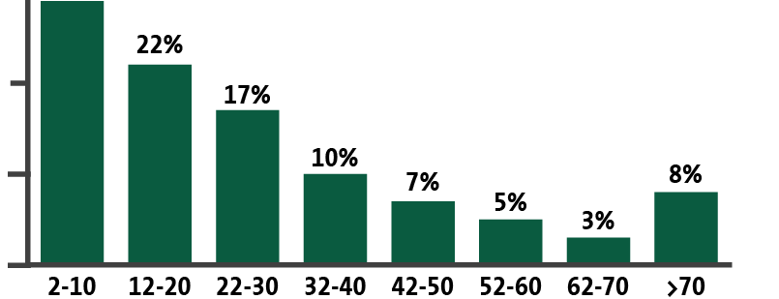

The Importance of 40 miles of Daily Electric Driving
78%
of customers
commute 40 miles
or less daily
Based on U.S. Department of Transportation 2003 Omnibus Household Survey
Why Target 40 Miles? 40 Miles Is the Key to Daily Driving

Slide 5

1st to 2nd Generation BEV Improvements: Chevrolet Bolt EV
1st Gen EV (Spark EV) | Metric | 2nd Gen EV (Bolt EV)
82 miles | EV Range | 238 miles
19 kWh | Battery | 60 kWh
4 | Passenger Capacity | 5
86.3 ft³ | Passenger Volume | 94.4 ft³
3 sec | 0 to 30 | < 3
7.2 sec | 0 to 60 | < 7
3.3 kW | Charger | 7.2 kW
3 states | Availability | 50 states
Chevrolet Spark EV
Chevrolet Bolt EV

Slide 6
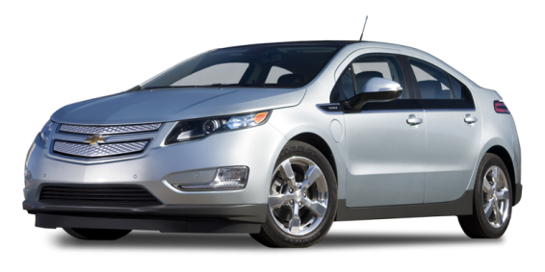
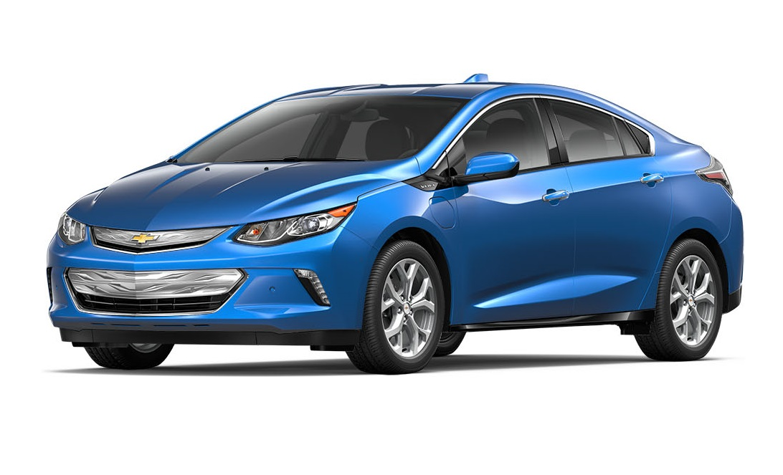
1st to 2nd Generation EREV Improvements: Chevrolet Volt
1st Gen Volt | Metric | 2nd Gen Volt
38 | EV Range (miles) | 53
382 | Total Range (EV+gas miles) | 420
37 | Fuel Economy (gas mpg) | 41
16.5 | Battery (kWh) | 18.4
4 | Passenger Capacity | 5
3.4 sec* | 0 to 30 | 2.6 sec
9 sec | 0 to 60 | 8.4 sec
273 | Torque (ft-lb) | 294
3.3 | Charger (kW) | 3.6
80% | EV-only Trips | 90% (exp)
900 | Miles between gas fill-ups | 1000 (exp)
Gen 1 Volt
Gen 2 Volt
* Edmunds

Slide 7
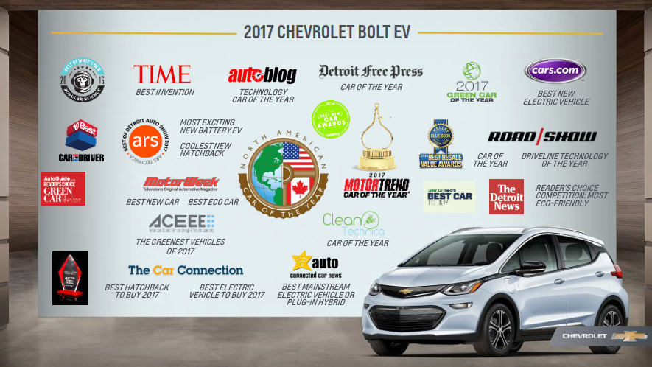

Slide 8
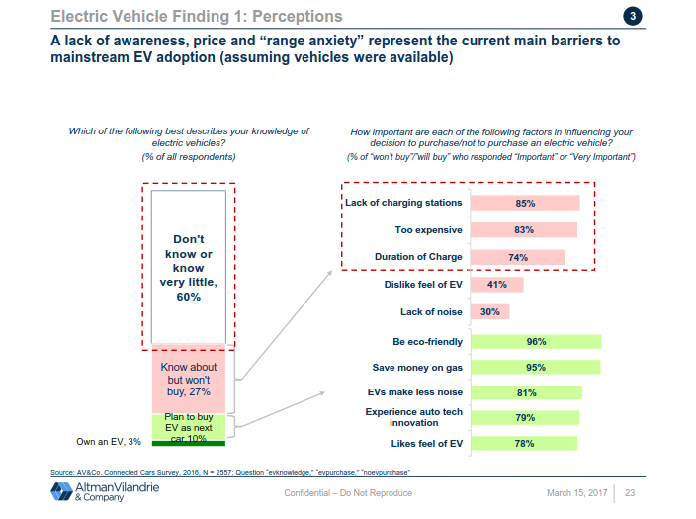
EV Awareness – 2 Key Findings
July 2016 Market survey of 2,562 respondents (nationwide)
2 Key Findings:
60% know little/nothing about EVs
Of the 27% that know something about EVs, 85% would not consider an EV because there is not enough EV infrastructure
(Next reasons were expense and time-to-charge)

Slide 9
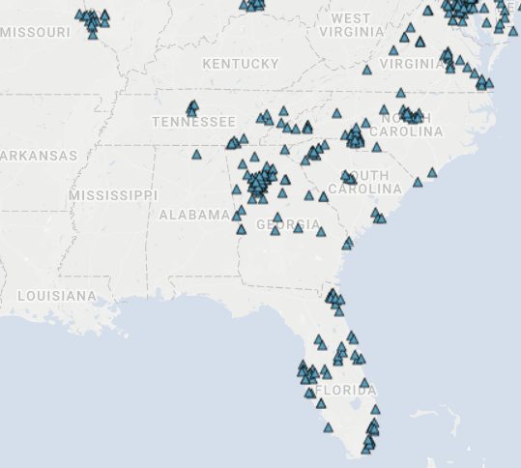
Southeast States and Infrastructure Opportunity
DC Infrastructure Needs:
Raise consumer awareness (national and regional story-telling thru DC corridors)
Improve redundancy
Opportunities:
Electrify America – national network of 300+ DC highway corridor stations
50-state “Appendix D” funds - $435M opportunity (15% of $2.9B)
358 miles
SAE DCFC Network in U.S. Southeast – Major Gaps (public, nonproprietary chargers)

Slide 10
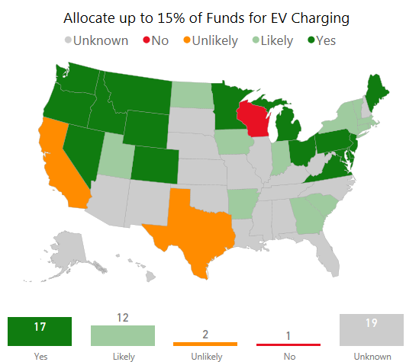
Appendix D: Current outlook of States funding EV Charging Infrastructure
Max 15% allowed for EV Infrastructure
12/1/17 deadline for states to file beneficiary status for the funds
To ensure funds are applied effectively, each state should develop a thoughtful infrastructure plan that considers highest-impact EV charging needs (e.g. DC corridors, MDU, workplace, key destinations)
Source: AtlasPolicy.com/EVhub

Slide 11
EV Infrastructure – Where, What, Why Guidance
GM – BKGross
March 2017
 | Home |  | Work | Public |  |  | Commercial | Commuting | Road Trips
 | Single Family Home | Multi-Unit Dwelling | Workplace Charging | Short-dwell public | Mid-dwell public | Long-dwell public | Urban high-mileage applications | Urban-to-Urban Corridors | Long-distance Highway Corridors
Parking/ Charging description … e.g. | Overnight | Overnight … condos, apartments | Work shift | 1-2 hours … retail | 4-8 hours … parks, beaches | 1-X days … airports | High-use stations … “shared”, autonomous | (<200 miles) | (>200 miles)
Near-term | L1 or L2 (L2 recom’d) | Neighborhood L2 and DC (50kW) | L1 or L2 | L2 | L2 | L1 or L2 | High-speed DC 50-150kW (mega-stations) | High-speed DC 50-150kW | High-speed DC 150kW
Long-term | L1 or L2 (L2 recom’d) | L1 or L2 at Multi-Unit Dwelling | L1 or L2 | L2 | L2 | L1 or L2 | 150-320kW | 150-320kW | 150-320kW
Importance to Consumers | Where most charging is done | Need to grow EV market to these consumers | Where many consumers see EVs for the 1st time (EV Showcase) and most used charging after “home” | Nice perk (and retailers benefit from increased in-store dwell time) | Increases practicality of EVs (the number of places an EV can go) | Increases practicality of EVs (especially among early adopters/ professionals) | Enables commercial EV business cases (e.g. Lyft/Uber car-hailing services) | Increases practicality of EVs (especially among early adopters/ professionals) | Increases consumer confidence in EVs (perception of endless EV range)
R
R
R
R
R
R
Note, Professional installation of L1, L2 and DC is always recommended
Note, Future 150-350kW SAE fast-chargers will be backward compatible, allowing 50kW EVs to charge
R
Station redundancy is especially important

Slide 12
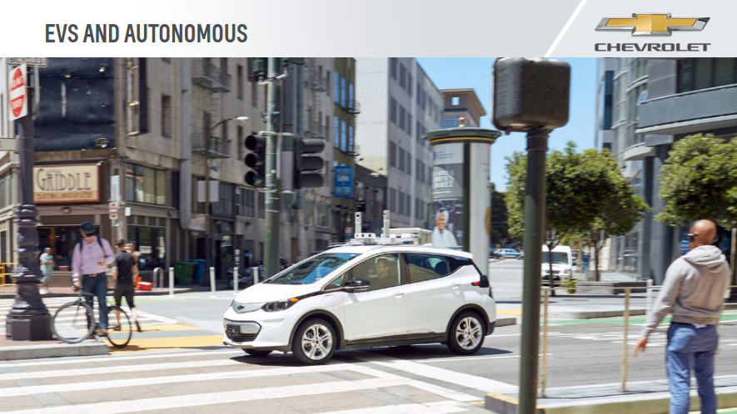
$14mil investment in Cruise Automation
Fleet of 180 Bolt EV self-driving vehicles being tested today on public streets
Operating in San Francisco, Scottsdale, AZ, and in the Detroit area – and NYC in early 2018

Slide 13
A Robust EV Market Benefits Everyone … at scale
Individual Benefits
  Quiet and exciting ride & handling
  Fuel savings
  Ability to “fill up” at home
Societal Benefits
  Economy (local spending, local jobs)
  Environment (local air, climate)
Utility / Grid Benefits
  Load growth that’s “flexible”
  Renewable energy integration
  Downward pressure on rates
Scale Matters

Slide 14
Where should Utilities engage?
1. Engage actively in home, workplace and DC fast-charging
Most charging at home, so this is a way to reach all consumers (including those in multi-dwelling units)
Workplace charging is key to growing EV awareness and corporate relationships are key to utilities
A visible strategy of DC fast-chargers tells a big story to consumers and grows EV adoption among fence-sitters
2. Ensure electricity is cheaper than gasoline (residential and commercial) – incl. demand charges
3. Engage actively in PEV outreach and education
Utilities are trusted 3rd parties and operate at a local level – key for building awareness
Utilities need to be active participants in growing the PEV market
This is a “learning” transition requiring hands-on experience to shape next steps
The PEV market will not escape “niche” unless utilities (and regulators) get involved

Slide 15

Bolt EVs at GM’s Lake Orion Assembly Plant (MI)

Slide 16
Backup Slides

Slide 17
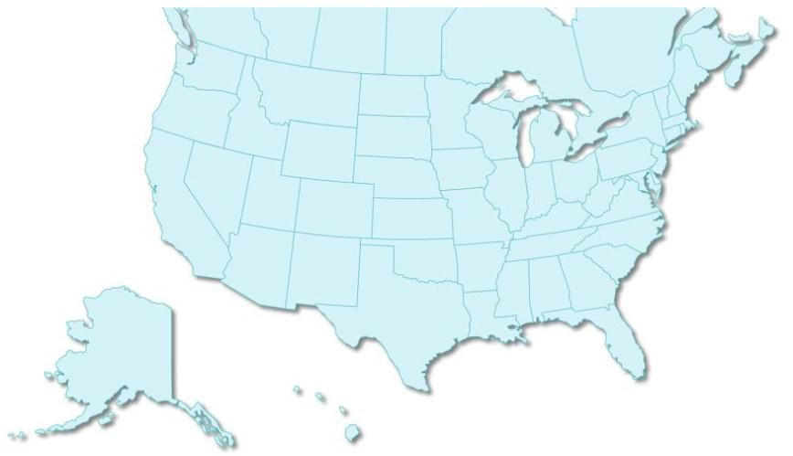
GM / EPRI / Utility Collaboration:
  Largest existing auto-utility collaborative effort -- formed in 2007
Over 50 utility members and the Electric Power Research Institute (EPRI)
Focus areas: Aligned Messaging and Policy Priorities, Customer Outreach and Infrastructure, Vehicle-to-Grid Technology, New Business Opportunities
BC Hydro
Manitoba Hydro
Snohomish County PUD No. 1
Seattle City Light
Hydro-Québec
Avista Corp.
Portland General Electric
PacifiCorp
NY ISO
Great River Energy
Central Hudson
UPPCO
Hydro One
Northeast Utilities
Dairyland Power
LBW&L
Rochester G&E
United Illuminating
We Energies
CMS
EnWin
NYPA
ConEd
NStar
Nebraska Public Power Dist.
Madison G&E
DTE
PJM
National Grid / LIPA
WPS
I&M
FirstEnergy
PSEG
NV Energy
Lincoln Electric
ComEd
AEP
PECO
Exelon
Constellation Energy
Hetch Hetchy W&P
SMUD
Tri-State G&T
Great Plains Energy
Hoosier
Appalachian Power
Pepco
PG&E
Ameren Services
IP&L
Dominion
Kentucky Power
Duke Energy
LADWP
SCE
Salt River Project
Progress Energy
Arizona Public Service
OGE
Tennessee Valley Authority
SDG&E
PSO
Arkansas Electric Coop
Southern Company - Georgia Power
TEP
Mississippi Power
Oncor
SWEPCO
Alabama Power
JEA
Austin Energy
Entergy
Gulf Power
Progress Energy
Golden Valley Electric Assn.
CenterPoint Energy
TECO
OUC
CPS Energy
FPL
Hawaiian Electric Co.

Slide 18
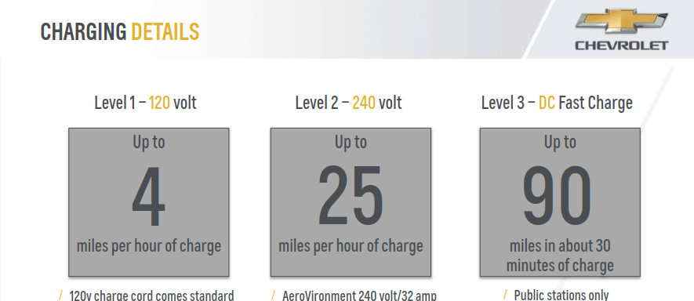

Slide 19
What will it take to Grow the PEV Market?
Drive Consumer Demand!
      Keep a Laser-like Focus on the Vehicle (don’t get distracted by other “metrics”)
      Build Awareness through:
          Promotional Campaigns (that really get to new car buyers)
          Ride & Drives (“Butts-in-Seats”)
    Install Charging Infrastructure at a faster pace (incl. role for utilities)
      Address the “Perception” that there isn’t enough infrastructure
          Public DC Corridors (SAE Combo)
          Workplace Charging
    Affordability/Incentives
      Help make these vehicles more affordable for mainstream consumers:
          Through incentives, help make this an easy choice, until OEMs can get more cost out of the technology
          Stay steady until we reach a meaningful tipping point
Notes:
USDRIVE36

Slide 20
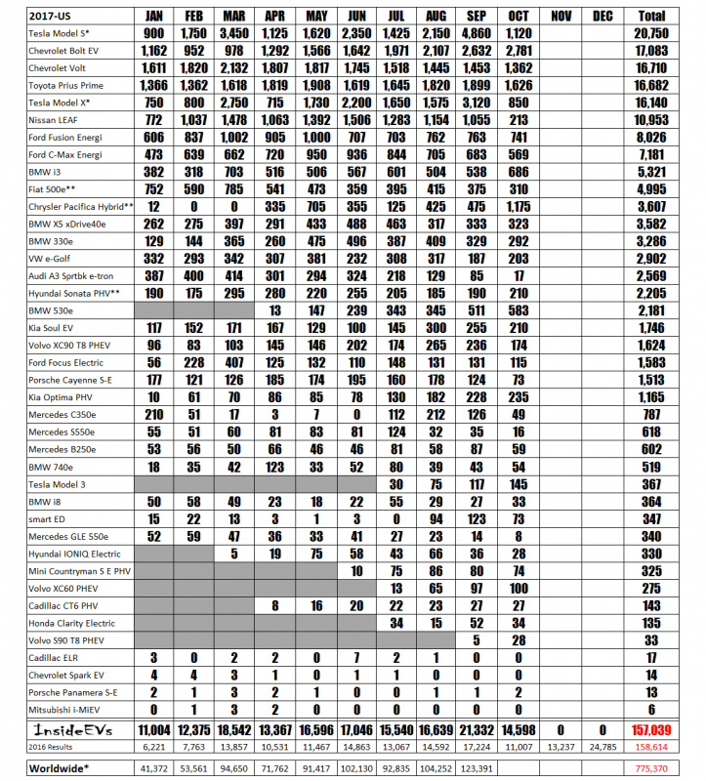

Slide 21



MAVEN CITY
MAVEN HOME
MAVEN GIG
Round-Trip Car Sharing
Exclusive closed-community car-sharing
Solutions for the Gig Economy – Ridesharing, Delivery Services.
Short-term rental includes vehicle, maintenance, insurance.
NUMBER OF CITIES
14 and counting
AVAILABLE IN
Residences in DC, San Francisco + growing.
(Multiple non-exclusive properties as well)
AVERAGE TRIPS
~14 Hours
~80 Miles
AVAILABLE IN
AVALIABLE TO
11 Cities
FAVORITE CARS
> 8,000 Residents and counting
Chevrolet Volt
Chevrolet Tahoe
MILES DRIVEN
200 Million

Slide 22

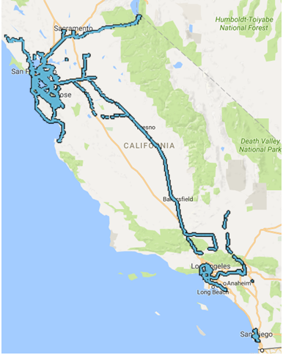
CITY | HOME | BUSINESS
190 Bolt EVs deployed in Maven fleets in 6 markets (LA, SF, SD, Boston, Baltimore, and DC
Program designed, in part, to help new drivers and new riders get exposure to EVs
Ride-sharing drivers typically do not have charging at home, so they must leverage public charging
Building confidence through the infrastructure network (among other things) is critical for long-term success
GIG / BOLT EV MILEAGE
>2.5 million miles driven
10%
> 238 MILES IN A DAY (Battery Capacity)
64
INSTANCES >400 MILES IN A DAY
GIG / BOLT EV CHARGING
Total DCFC Events | >25,000
Total kWh* | >400,000
GIG / BOLT EV RIDERS
~250,000
20 Oct 2017
Since Early Feb 2017

