Slide 1


Smarter
Smart Charging
EVs & the Southeast Grid 2.0
Thomas Ashley
VP, Policy

Slide 2
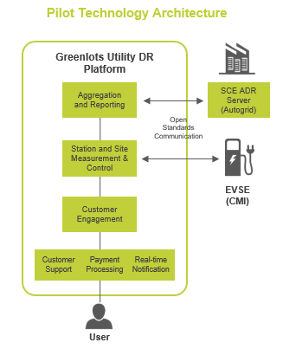
SCE Workplace Demand Response Charging Pilot
SCE deployed 80 Level 2 EVSEs across 9 facilities (expanding to 195 @ 40 buildings) with Greenlots:
Time-of-Use and multi-tiered premium pricing to simulate Critical Peak Pricing scenarios
Day-ahead and day-of dispatch and curtailment of charging stations
Post-charging occupancy fee for space management
Web-based platform with real-time data, reports and analytics
Real-time messaging to communicate with drivers
Applying standard DR message protocols for the first time on PEV charging
Key Takeaways:
PEV charging is an effective addressable load for demand response:
  High average curtailment: 3.4 kW from each Level 2 station (nearly 3x residential A/C load)
  High participation: 72-76% drivers consistently opted-in
  Participation did not vary significantly from peak to off-peak times
  Timing of workplace charging overlaps with peak grid use
Workplace charging is key enabler for EV adoption
  PEV ownership jumped by 490% from employees surveyed before and after pilot
  Charging equivalent to reducing significant CO2 emissions
Proprietary and Confidential © Greenlots

Slide 3
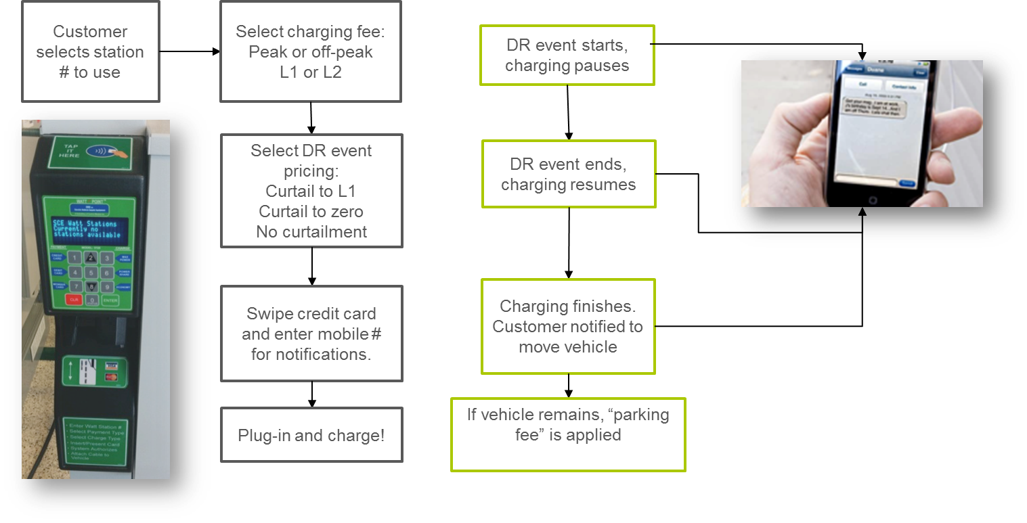
SCE Workplace Demand Response Charging Pilot
Proprietary and Confidential © Greenlots

Slide 4
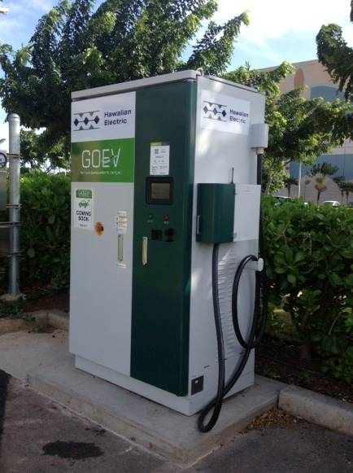
Hawaiian Electric EV Charging + Storage
DCFC with integrated storage to limit demand on grid, and need for capacity upgrade. Greenlots provided the network management and software integration, including monitoring of battery data
Objectives
Deploy a storage supported 50kW DCFC with max 23kW grid demand
Observe performance of DCFC under real world use
Assess applicability of overall solution as strategy for demand charge reduction
Proprietary and Confidential © Greenlots

Slide 5



Wind Integration with EV Charging
German Ministry of Energy Project for Smart Charging
Objective
Managed (scheduled) charging to absorb excess wind energy at night
Timing
Successfully completed: August 2011 through March 2012
Greenlots was selected in 2011 to work with Vattenfall, BMW, and Daimler on a landmark smart grid project for the German Government in Berlin and Hamburg.
The project was a commercial demonstration of using EV battery capacity to absorb excess wind power at night, a growing grid issue in Germany. 65 Daimler Vito E-Cell and 25 BMW ActiveE vehicles were connected to the Vattenfall backend and would charge according to
the forecast wind energy generation for that night.
Greenlots provided the HomePlug AV-enabled EVSE and played a key role in system integration and testing, while Vattenfall provided control and grid software. When an EV plugged in, a real-time association between the EVSE to EV was performed over power line communications (PLC), and a charging instruction profile was downloaded to the EV. In 0.5A increments, the charging could be adjusted up or down. This project contributed to the formation of the HP-GP (HomePlug GreenPHY) standard now used for the CCS connector standard and ISO/IEC 15118.
Proprietary and Confidential © Greenlots

Slide 6
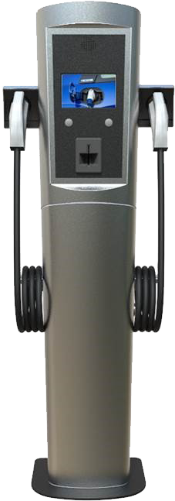






Avista EV Charging + Demand Response Pilot
120 AC Level 2 at Home
45 AC Level 2 in Public
Integrated Network
100 AC Level 2 at
Work/Fleet/MUDs
7 DC Fast Chargers
Driver
App
User Web
Portal
Utility Web
Portal
Proprietary and Confidential © Greenlots

Slide 7
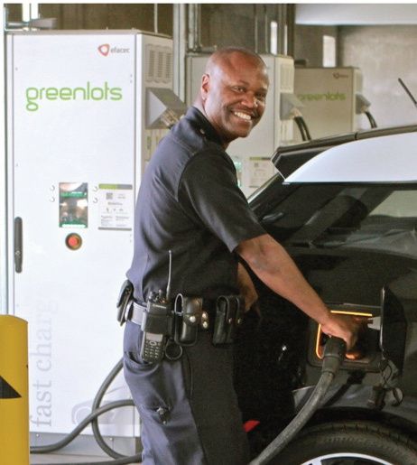
LAPD EV Charging + Load Management
100 L2 and 4 DC fast chargers at downtown LAPD parking facility
Supports charging needs of initial fleet of 100 EVs, that has since grown to 150
Load management avoids expensive electrical infrastructure upgrades and reduces demand charges
Responds to real-time electricity demand of building
Charge optimization and prioritization ensures vehicles are charged when they are needed
Fleet reporting tracks fleet data, operating cost and efficiencies of an all electric fleet.
Deploying charging infrastructure across 25 satellite facilities around the city
Proprietary and Confidential © Greenlots

Slide 8

Dynamic Pricing + Distribution System Integration
San Diego Gas & Electric VGI Rate
Variable commodity component based on CAISO day ahead hourly rate
Dynamic pricing signal incorporating commodity capacity costs
Distribution circuit conditions and local capacity costs
Proprietary and Confidential © Greenlots

Slide 9
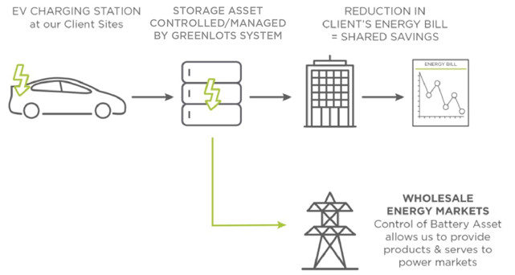
EV Charging + Storage Integration
Charging control monitors power in real-time and coordinates demand interval
Activates storage to provide supplementary power to shave peak demand from grid
Recharges the battery when EV charge drops below threshold or when charging complete
No impact on charging time
Proprietary and Confidential © Greenlots

Slide 10



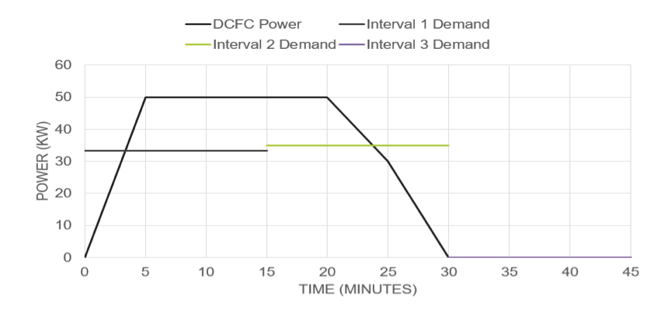
Storage Optimization
Demand charges are time dependent. When a session starts can have more of an impact on the monthly demand charge than the maximum DCFC power.
Energy storage can be used to reduce the demand charges from the DCFC. Reliable savings requires the battery system and DCFC to be operating from the same platform.
Actual Peak 50kW
Utility Peak 35kW
Proprietary and Confidential © Greenlots

Slide 11






Open Standards Maximize Flexibility Competition
Optionality for future software/platform changes
Optionality for hardware & software selection during site hosts’ initial investment
Proprietary and Confidential

Slide 12
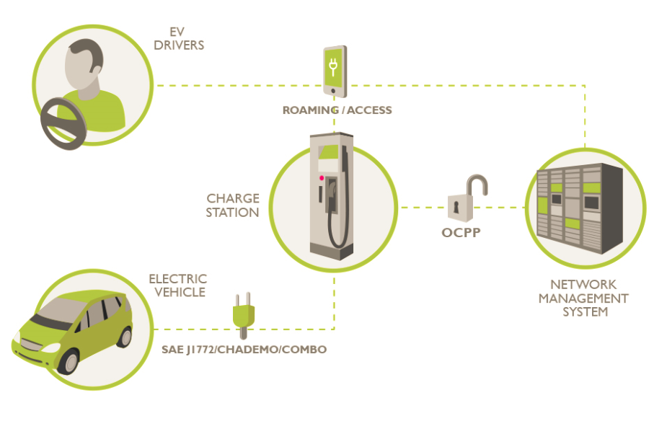



EV Charging Interoperability Ecosystem
Utility / ISO
Open ADR 2.0b
SEP2
ISO 15118
Proprietary and Confidential

Slide 13
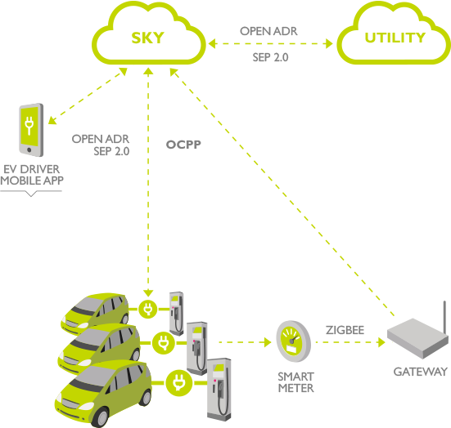
EV/EV Charging as DER
Communications Simplicity
Utility communicates via standard protocols
Software Innovation & Differentiation
Driver experience
DER aggregation
Competition
Proprietary and Confidential

