Slide 1
Insights on EV Market Trends
K.C. Boyce
Senior Product Director
@kcboyce
NOVEMBER 2017

Slide 2
Sales trends – and consumer perceptions
Sources: U.S. Department of Energy, InsideEVs, Cogent Reports by Market Strategies
Notes:
Market share is now consistently over 1% on a monthly basis vs <0.25% in 2011
In 2017, nationally 11% say they had a PHEV vs 1.79% BEV; South 10% PHEV, 1.88% BEV
Growth since 2015: 15% PHEV, 60% BEV (nat’l) 22% PHEV, 68% BEV
0.4% of US fleet is PEV (based on ~183M light-duty vehicles reported by FHWA), 1.9 vehicles/household

Slide 3
Location matters
Urban
- 3% EV
- 16% PHEV
Suburban
- 1% EV
- 8% PHEV
Rural
- 1% EV
- 11% PHEV

Slide 4
PHEV Owners
BEV Owners
AGE
AGE
18-35
45-64
18-44
<$25k
>$75k
HS
PhD
Notes:
Gender: overall split is 45% male/55% female. PHEV @ 64% female, BEV @ 59% male
Age: 40% 18-44 overall, 79% BEV (PHEV slightly more than overall in 18-35); 39% 45-64 vs. 44% PHEV
HH income: 25% overall <$25k, 58% PHEV. 29% >$75k, 47% BEV
Education: 20% HS or less overall, 31% PHEV; 16% graduate overall, 26% BEV
Blacks more likely to own both BEV & PHEV (22%, 35% vs 17%), Asians & Hispanics more likely to own BEV (hisp 22% vs 13%)
BEV more likely to be early adopters than overall pop, much more likely than PHEV owners (“I’m usually the first to adopt” + “Owning the latest is important”); 3rd party recommendations are also important for them

Slide 5
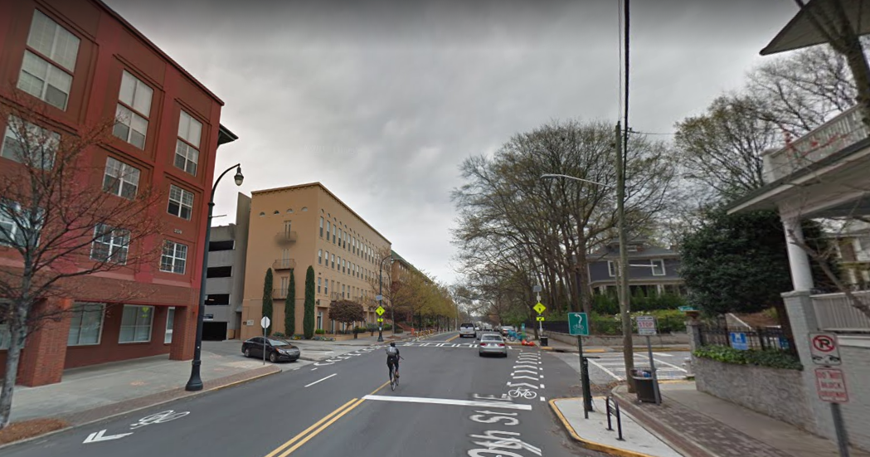
PHEV
BEV
Notes:
31% of PHEV owners live in apartments (vs 14% of overall population), and 61% rent (vs 30% overall)
74% of BEV owners own their home (vs 65% overall)

Slide 6
Impact of PEV ownership on fuel preference

Slide 7
Impact of PEV ownership on fuel preference

Slide 8
Impact of PEV ownership on fuel preference

Slide 9
Impact of PEV ownership on relationship with the utility
All
BEV
PHEV
All
BEV
PHEV
All
BEV
PHEV
All
BEV
PHEV

Slide 10
MORE LIKELY TO SWITCH

Slide 11
PHEV owners are much less likely to be aware of or use utility EV offerings
Have/Use | Aware of Utility Offering

Slide 12
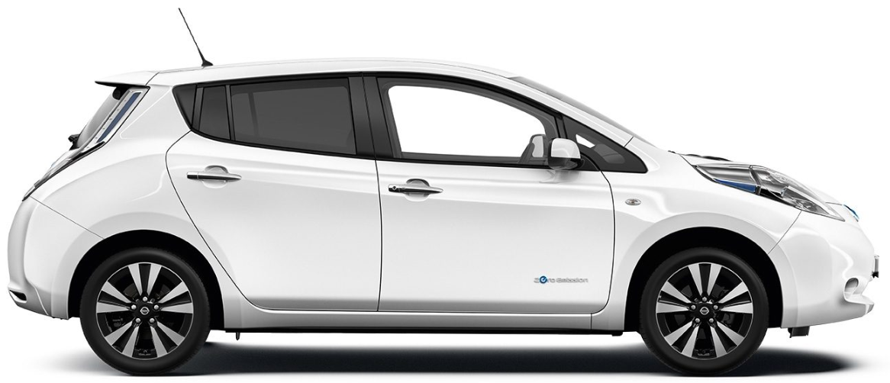
Co-Adoption Opportunities
Adoption Among Those Who Own…
 | Overall Adoption
Rooftop Solar
Community Solar
Battery Storage

Slide 13
Don’t forget to look at the impact of EV ownership on other programs!

Slide 14
Bonus: Workplace Charging Trends
Provide Charging
Interested in Providing Charging
Notes:
Ownership up from LY (85% own in provide); down for interested (79% LY)
Move to urban (60% LY); big drop in suburban (from 36% LY); jump in Rural (4% LY)
But urban is showing captured demand (57% LY); rural growing interest (up from 8% LY)
Big growth in interest (from single-digits LY) in smaller businesses

Slide 15
K.C. Boyce Senior Product Director 404.601.9570
kc.boyce@marketstrategies.com
@kcboyce

