Slide 1

Georgia – Formerly Growing EV Market
EVs and the SE Grid Conference
November 15, 2017
Don Francis
Executive Director
Clean Cities-Georgia
Notes:
Coalition and coordinator introduction.
This presentation will provide an overview of electric-drive vehicles, a category that includes plug-in hybrid electric vehicles (PHEVs), hybrid electric vehicles (HEVs) and all-electric vehicles (EVs). Recent developments in battery technology and in the marketplace have made these options more viable and attractive than they were just a couple of years ago.
During the past several years, the number of hybrid electric vehicles (HEVs) in the U.S. has grown to more than 1 million. In 2008 alone, Clean Cities contributed 12 million gasoline gallon equivalents (GGEs) of petroleum displacement from HEVs and heavy-duty hybrids.
The federal government has set a goal for 1 million plug-in hybrid electric vehicles (PHEVs) on the road by 2015.
Nissan and GM both announced national roll-outs of electric drive models – the Leaf and the Volt – by the end of 2011.

Slide 2
Barriers To Plug-In Vehicles in Georgia
Initial Barriers
  Vehicle model availability
    Tesla (2009), Nissan LEAF and Chevrolet Volt (2011), Ford PEV (2013), BMW i3 (2014), Kia Soul EV (2015), Chevrolet Bolt (2017), Tesla Model 3
  Charging station availability
  Capital cost: vehicles & infrastructure
  Lack of DC charging standardization (CHAdeMO / SAE / Tesla)
Georgia eliminated two incentives to these barriers
  Low / Zero Emission Vehicle Tax credits:
    LEV 10% of cost of alternative fueled vehicle – up to $2,500
    ZEV 20% of cost of battery electric vehicles – up to $5,000
  Alternative Fuel Vehicle License Plate
    $200 Annual Highway User Fee ($208.13 in 2017)
  Still in place
    Single Occupancy HOV and HOT Exempt Vehicle Peach Pass

Slide 3
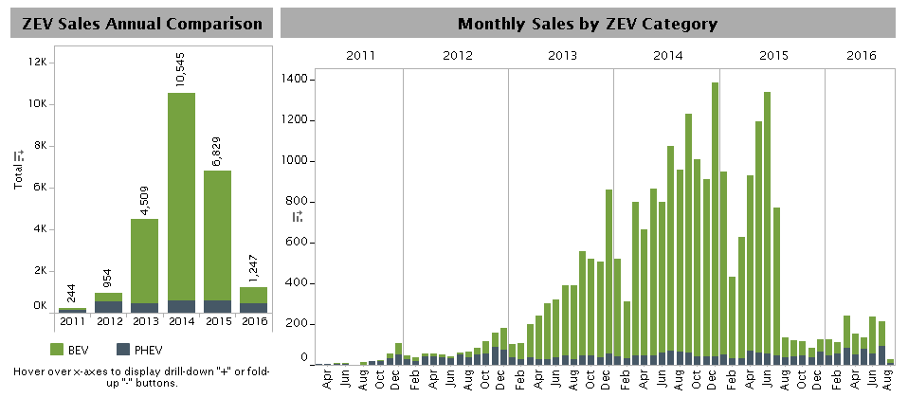
Georgia PEV Sales
Includes content supplied by R.L. Polk & Co; Copyright R.L. Polk & Co, 2015. All rights reserved

Slide 4
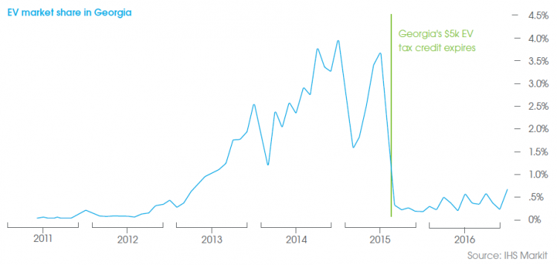
Electric Vehicle Market Share in Georgia

Slide 5
Electric Vehicle Sales by Model in Georgia
0
2011 2012 2013 2014 2015 2016

Slide 6
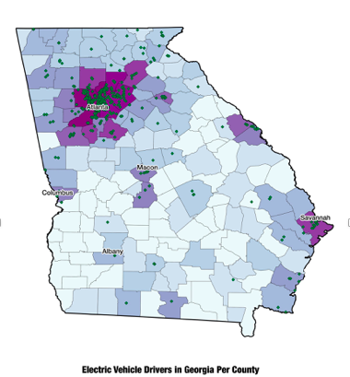
Electric Vehicle Sales by Area in Georgia
  Metro Atlanta
  Savannah
  Athens
  Columbus
  Macon
Notes:
Looking ahead, Georgia needs new EVs policies that are supportive of growing the EV markets, drive EV adoption in other parts of the state this is current date 2016 – POLK Policies both drive adoption and will contribute to economic development.
Currently, the highest concentration of EVs (80%) in 5 counties in metro Atlanta. However, as you can see, EVs are growing in Savannah. But as you can see there is huge growth potential in the state. Moving in the the future, as noted, there is legislator interest in new policy, but prospects are unclear.
To respond to some of the questions raised in the 2017 session. SACE, with City of Atlanta and Plug In America and other local partners, commissioned a report by the Green Link Group on the economic opportunities and/or impacts of new polcies. We elected two options for consideration in the analysis.

Slide 7
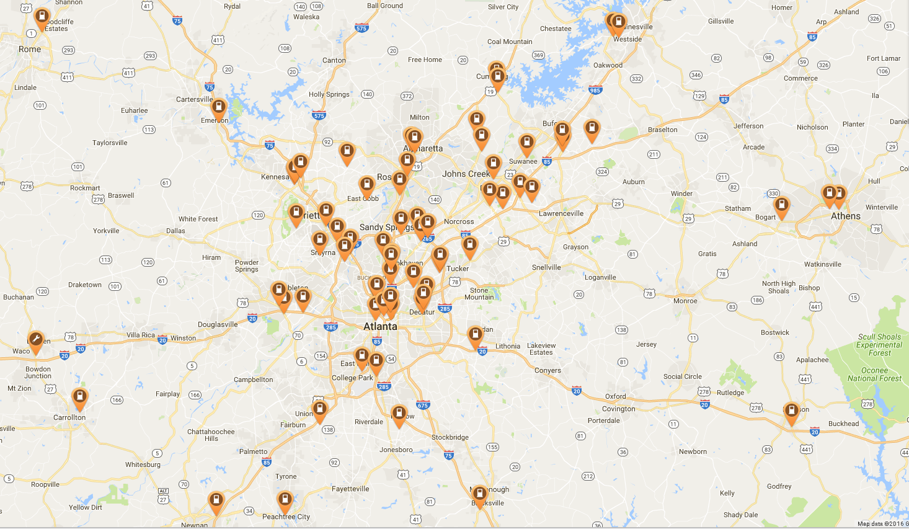
DC Fast Charging – Metro Atlanta
109 DCFC Stations
233 Connectors
600 Public Stations
1,609 Connectors

Slide 8

Contact Information
Notes:
Thank you and I invite any questions.
Please let me know if you need the Web site addresses or any additional information regarding the information I presented here today.

