Slide 1
Notes:
I’m here to talk to you about the future of transportation. Obviously I don’t have a crystal ball, and I’m not one to make predictions for what, exactly, the future will look like – but I can talk about 3 emerging trends in the transportation sector that should be of interest to you – especially if you’re looking for a job in transportation.

Slide 2
Millions
EVs = 1% national sales and 3% in California.

Slide 3
Thousands
32% growth rate in past 4 years
70% growth in year-to-year monthly sales in 2017
Notes:
Despite the decline in 2015, EVs in the U.S. have grown at a 32% compound annual growth rate (CAGR) over the past four years

Slide 4
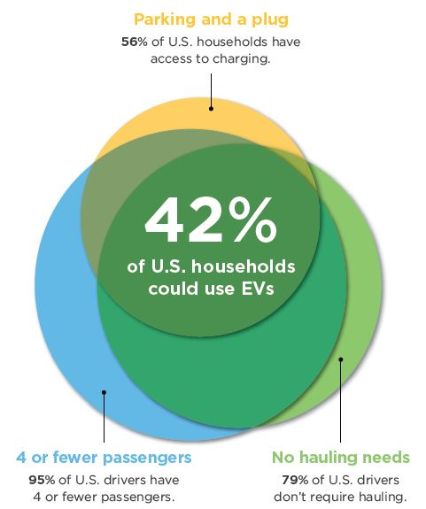

Slide 5
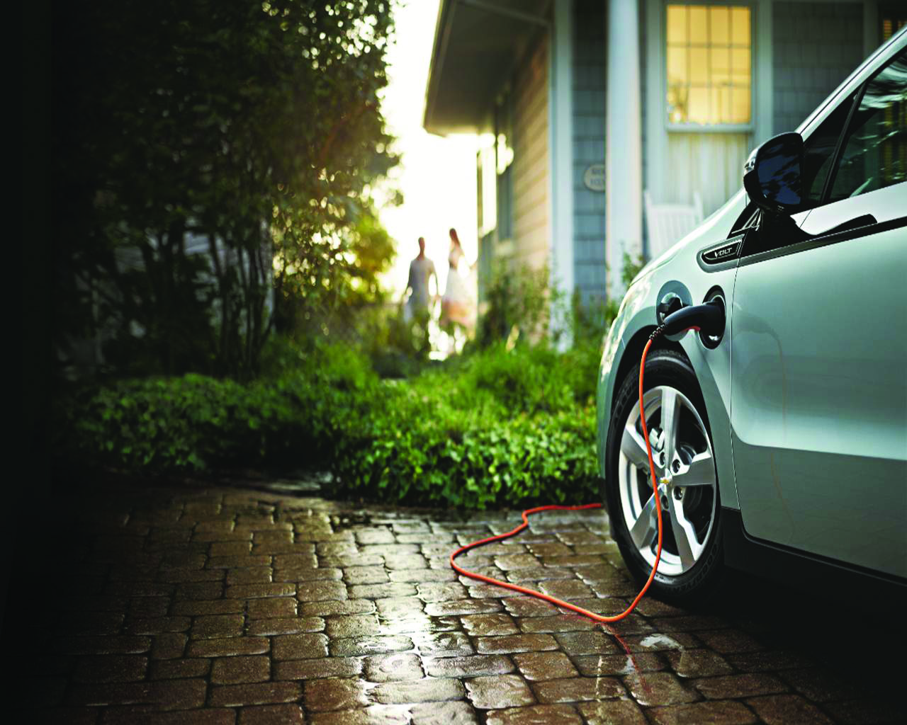
Cheaper to own
Notes:
There are a couple important drivers behind this trend. First, EVs are cleaner than gas vehicles – they produce about half the GHG pollution than a comparable ICE over lifetime. Second, they are cheaper to fuel – even with low gas prices. And third, they are simply fun to drive. Ppl love their EVs and are some of CR highest rated vehicles.

Slide 6
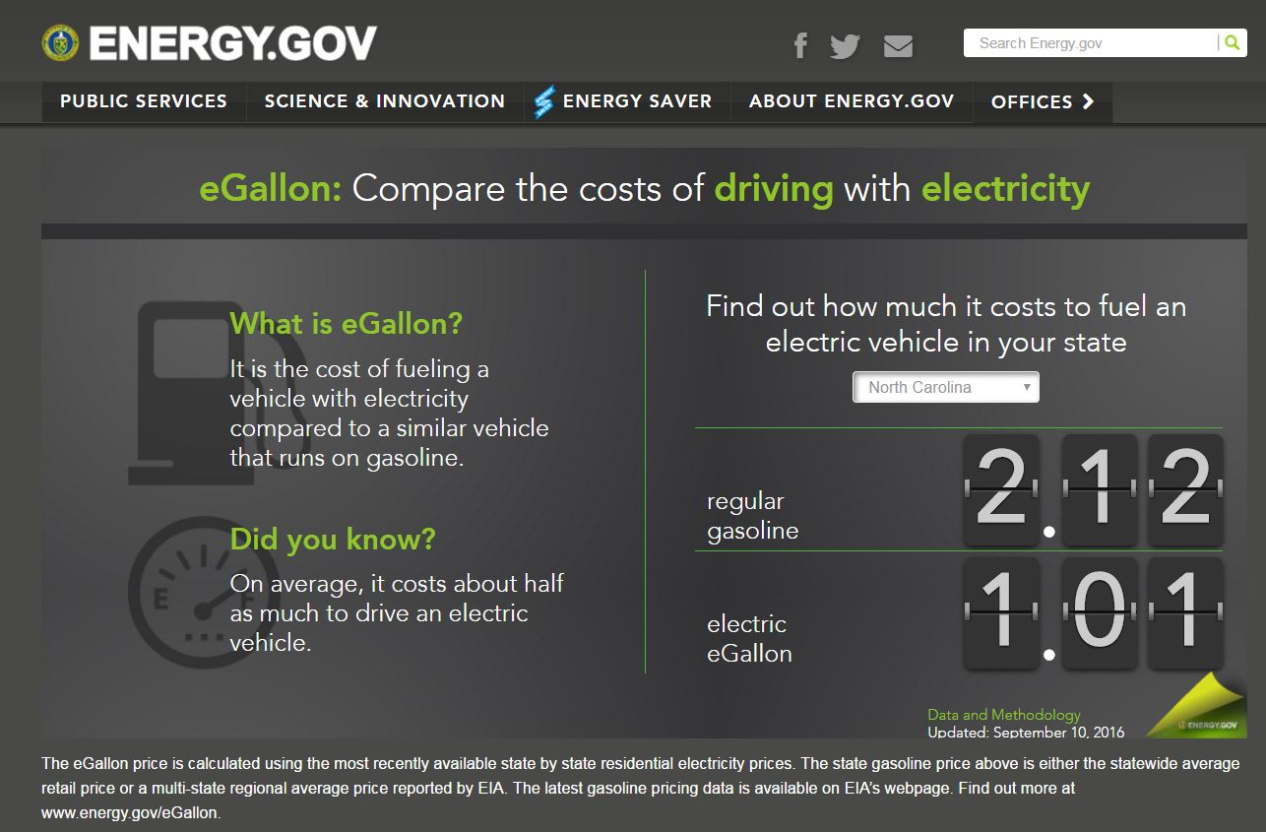
Notes:
But climate change isn’t the only driver behind EV adoption. Cash money is too. Despite today’s low gas prices, driving on electricity is still very cheap. I just pulled this last week, and driving on electricity in NC costs the equivalent of paying $1.00 gas.

Slide 7
In 50 largest U.S. cities, off-peak, time-of-use rates vary from $.03 per kWh to $0.21 per kWh, resulting in gasoline equivalent costs ranging from $0.25 per gallon to $1.78 per gallon.

Slide 8
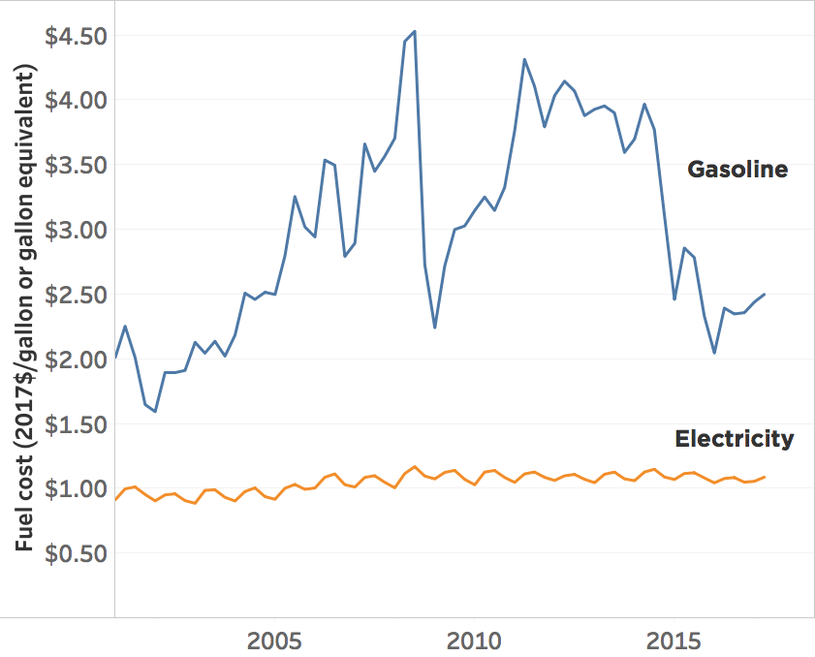

Slide 9
Service | Frequency (per 150,000 miles) | Cost per Occurrence | Cost for Chevrolet Bolt EV | Cost for Chevrolet Sonic
Tire rotation | 20 | $30.00 | $600 | $600
Engine oil and oil filer replacement | 20 | $45.00 | - | $900
Cabin air filter replacement | 6 | $45.50 | $273 | $273
Engine air filter replacement | 3 | $69.00 | - | $207
Spark plug replacement | 2 | $219.50 | - | $439
Coolant flush and replacement | 1 | $110 | $110 | $110
Total |  |  | $983 | $2,529

Slide 10
Cheaper to own
Less polluting
Notes:
There are a couple important drivers behind this trend. First, EVs are cleaner than gas vehicles – they produce about half the GHG pollution than a comparable ICE over lifetime. Second, they are cheaper to fuel – even with low gas prices. And third, they are simply fun to drive. Ppl love their EVs and are some of CR highest rated vehicles.

Slide 11
Other Renewables
Hydro
Biomass
Coal
Nuclear
Natural Gas
Notes:
When you add it up, an EV charged in NC is responsible for the emissions equivalent of a gasoline powered vehicle that gets 63 mpg. That’s actually pretty amazing – I challenge you go to find a 63mpg gas vehicle anywhere in the market today.
Explain well to wheels

Slide 12
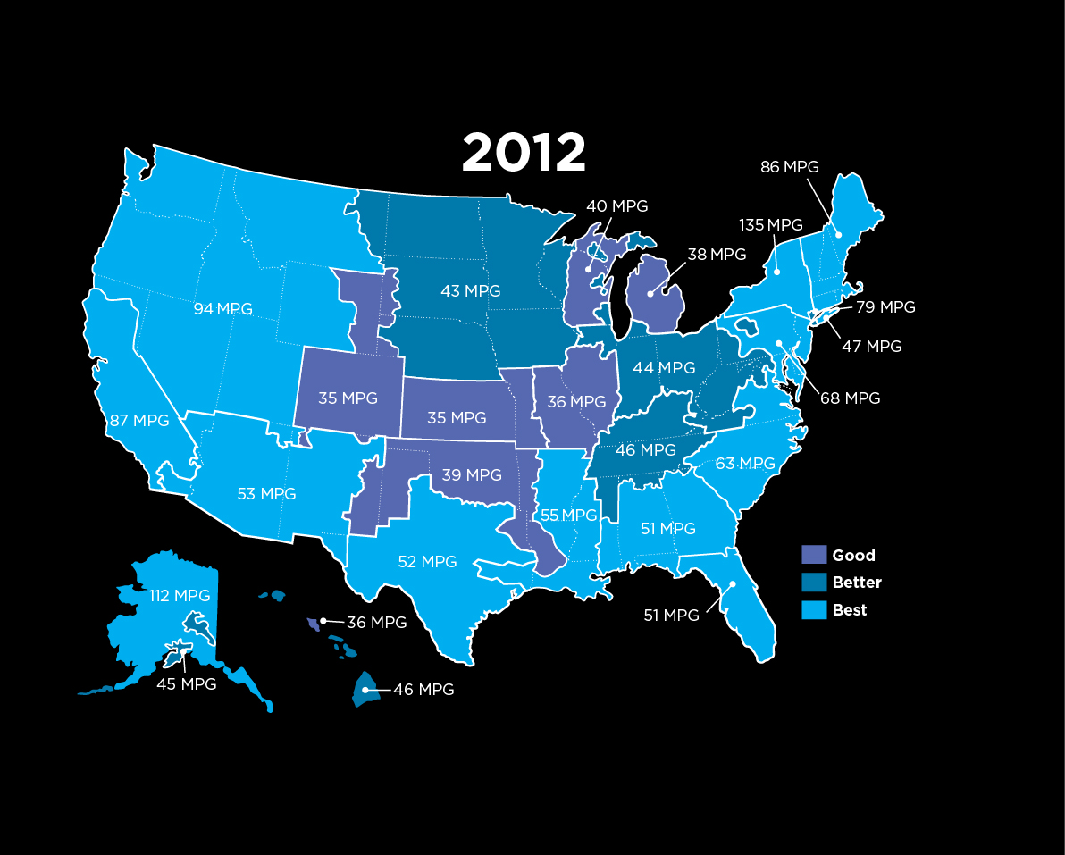
Notes:
And here is how that performance varies across the country, in 2012. Note that 2/3^{rds} of country lives in area where an EV is better than almost every gas vehicle on the road & that performance is only getting better.

Slide 13
Driving the average EV in the United States produces emissions equivalent of a gasoline car that gets 73 mpg, considering total emissions from gasoline and electricity production and distribution

Slide 14
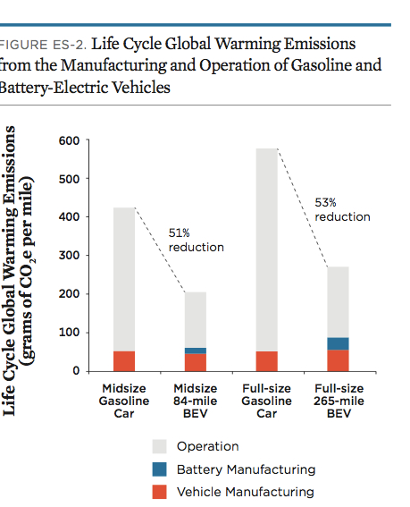

Slide 15
Coal
Nuclear
Natural gas
Non-hydro renewable
Notes:
Thanks to policies like the clean power plan, renewable energy is on the rise in the U.S., meaning that EVs are getting cleaner all over the country. Also, you can either pair EVs with rooftop PV, or enter into an agreement with your power producer to purchase renewable energy. So even though EVs in some area are less clean that other areas, the future for all EVs looks bright.

Slide 16
Cheaper to own
Less polluting
Supportive policy
Notes:
There are a couple important drivers behind this trend. First, EVs are cleaner than gas vehicles – they produce about half the GHG pollution than a comparable ICE over lifetime. Second, they are cheaper to fuel – even with low gas prices. And third, they are simply fun to drive. Ppl love their EVs and are some of CR highest rated vehicles.

Slide 17
California Zero Emissions Vehicle (ZEV) Program
Notes:
And perhaps the most important driver behind the EV trend is the California ZEV Program.
This policy requires major automakers to obtain increasing numbers of ZEV credit through either selling EVs or buying require less than 8 percent of sales by 2025, enough to put over 1.5 million Evs on the road in CA and 3.
⁴

Slide 18
California Zero Emissions Vehicle (ZEV) Program
Notes:
In 2018, this policy is set to expand beyond California to 8 additional states. One such policy opportunity is to help UCS ensure that this policy extends beyond CA, which is why you should join the UCS SciNet and get connected with Eleanor and Justin. 3.3 million EVs.

Slide 19
California Zero Emissions Vehicle (ZEV) Program
28% of U.S vehicle sales in 2015.
8% required to be EVs in 2025.
Notes:
Combined, those 8 states made up 28 percent of vehicle sales in 2015, so that’s a big deal and will really spur EV sales in the U.S.

Slide 20
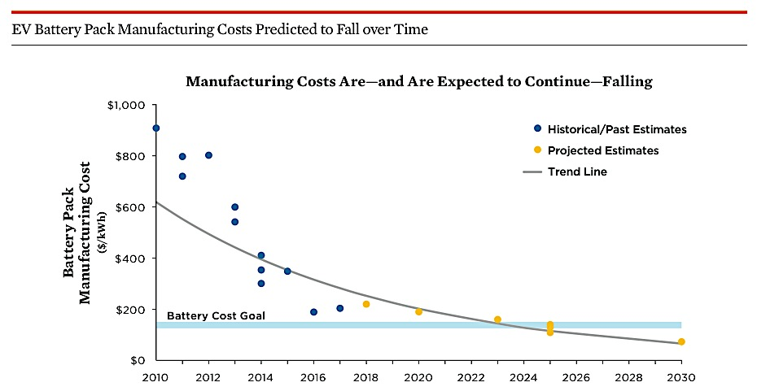

Slide 21
EVs will effectively compete with conventional gasoline vehicles when the price of battery packs falls to between $125 and $150 per kWh.

Slide 22
A Chevrolet Bolt battery pack currently costs $12,500 per vehicle to produce. If battery pack cost reductions predicted for 2025 are realized, the cost of the Bolt would drop by around $8,000.

Slide 23
What’s Next?
Protect the federal EV tax credit in the Senate
Strengthen the requirements of California ZEV
Work to make home charging easier, especially in multi-unit dwellings and workplaces.
Expand public charging in key corridors

