Slide 1
Analysis of EV Charging on The University of Georgia Campus
Julian Moore
Sierra Hovet¹, Blair Farley², Jason Perry³, Kevin Kirsche³, Michael Jerue⁴, Don Walter⁵, Zion Tsz Ho Tse^{1*}
¹College of Engineering, The University of Georgia, Athens, GA
²Southern Company Services, Inc., Birmingham, AL
³Office of Sustainability, The University of Georgia, Athens, GA
⁴JuiceCar LLC, Athens, GA
⁵Transportation and Parking Services, The University of Georgia, Athens, GA

Slide 2
Background
From 2011 to 2017, yearly sales of all-electric vehicles and plug-in hybrids have risen from 0.14% to 1.09% of total vehicle sales in the US
Government promotion with tax credits and subsidies
Driving range may be a source of concern when considering an EV

Slide 3
Case Study Introduction
Supporting Partners
UGA Population = 35,000
Athens Population = 120,000
Able to manipulate rules and fees for EV users
Variables considered:
Geolocation of users
Charging behavior
Charging Station Occupancy

Slide 4
Case Study Introduction
18 level 2 charging stations located in Athens and on the UGA Campus
Analyzed 3,204 charging events from April 10, 2014 to June 20, 2017
Variables considered:
Geolocation of users
Charging behavior
Charging Station Occupancy

Slide 5
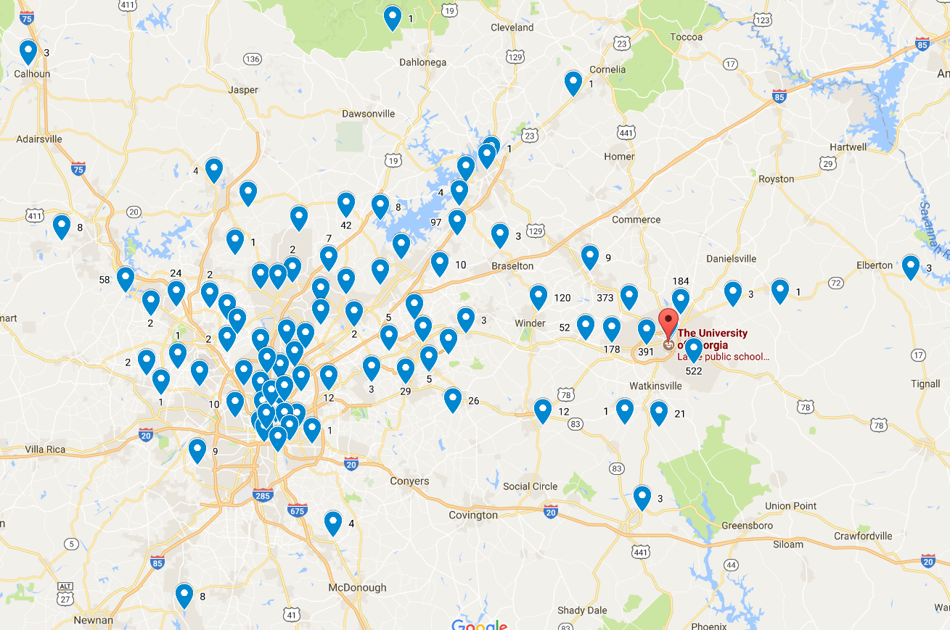
Number of registered Athens users per zip code
Most users are in the Athens Area
70 miles between Athens and Atlanta

Slide 6
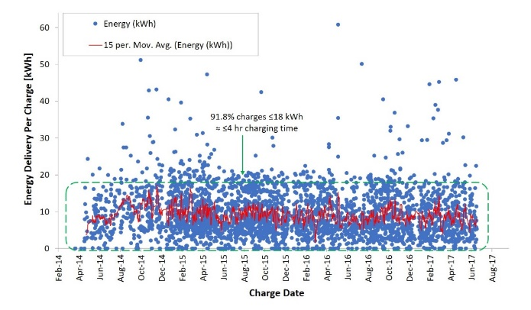
Average kWh per charge
91.8% charges <18kWh

Slide 7
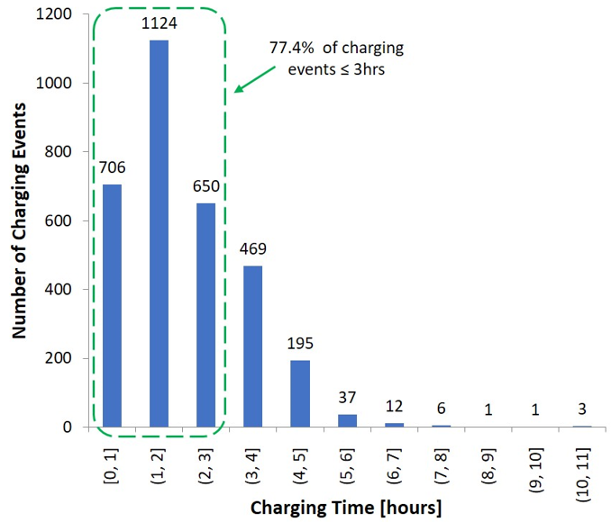
Length of charge
77.4% charges in 3 hours or less

Slide 8
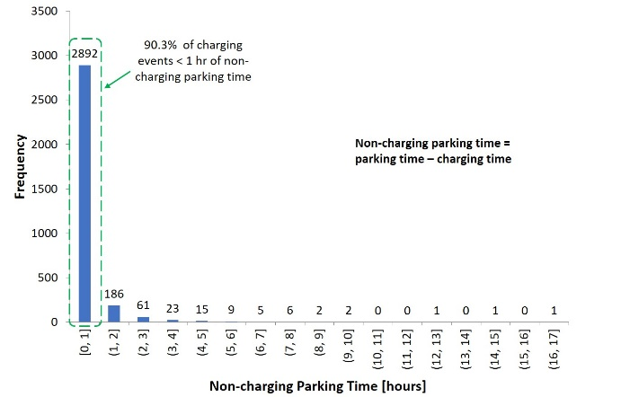
Non-Charging Time
Cars moved within 1 hour of a complete charge

Slide 9
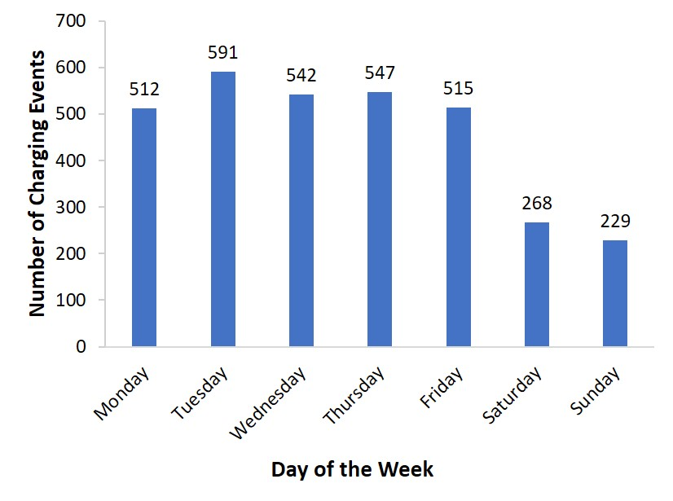
What days do people charge?
Mostly during the weekdays

Slide 10
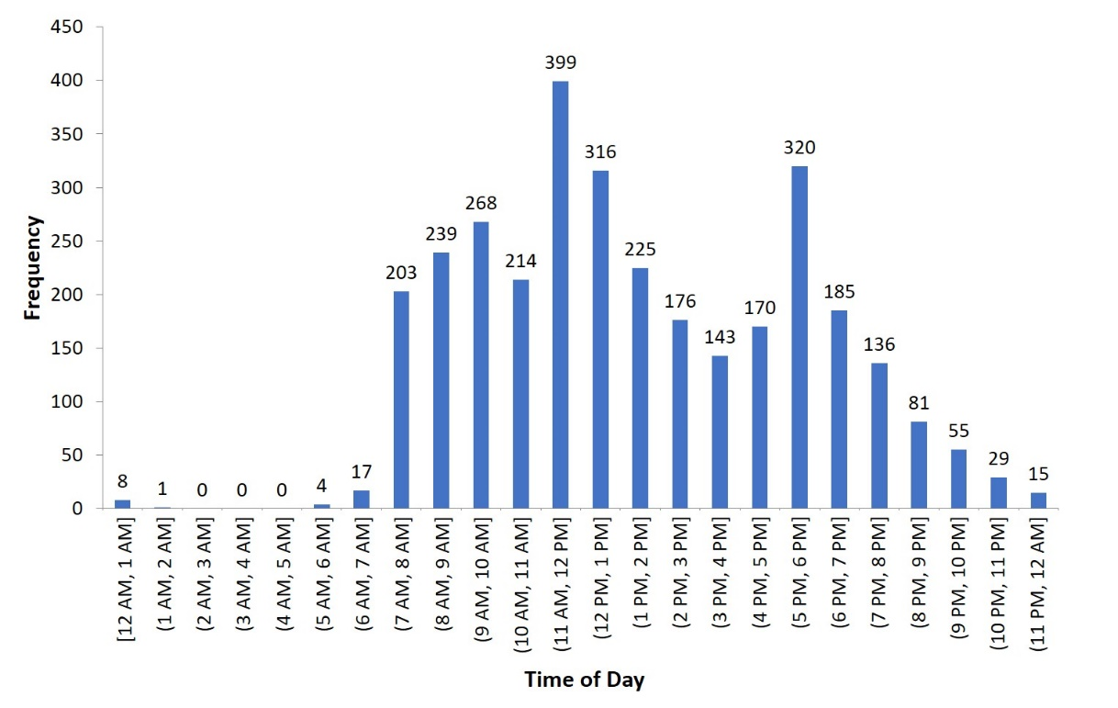
At what time do people charge?
Business Hours: 7am – 6pm
Price changes after 2 hours

Slide 11
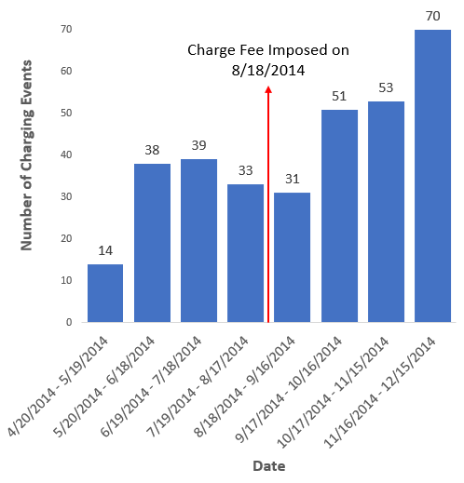
Fee introduced
Started at the beginning of the 2014 Fall semester
First 2 hours: $0.75/h
>2 hours: $1.5/h
Fee did not lead to less charging on campus

Slide 12
Conclusion
EV Charging & Driving Patterns have been analyzed in UGA & Athens Community.
The methods used in this study are reproducible for other cities and college campuses in the U.S.
This project is a pilot study for Southern Co. to understand Better EV Designs.
“Introduction of Electric Vehicle Charging Stations to University Campuses: a case study for the University of Georgia from 2014 to 2017”

