Slide 1
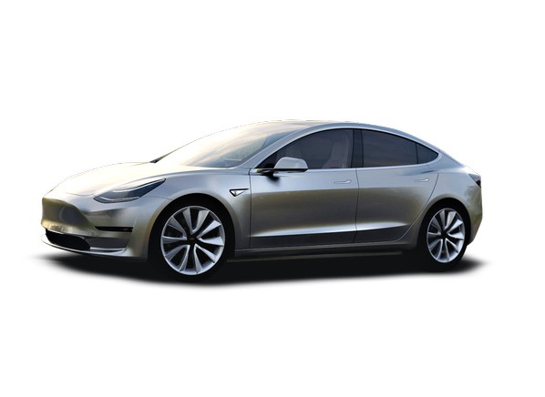
11/14/2017

Slide 2
Overview
EV Marketplace:
Consumer benefit
EV Market development
Growth Anticipations
Controlled dispatch value
Consumer economics - challenges
Environmental considerations (inc’l TVA data)
Current EPB Programs
Competitive Landscape
Value Propositions
Insights, Challenges & Incentives
TVA EV Strategy

Slide 3
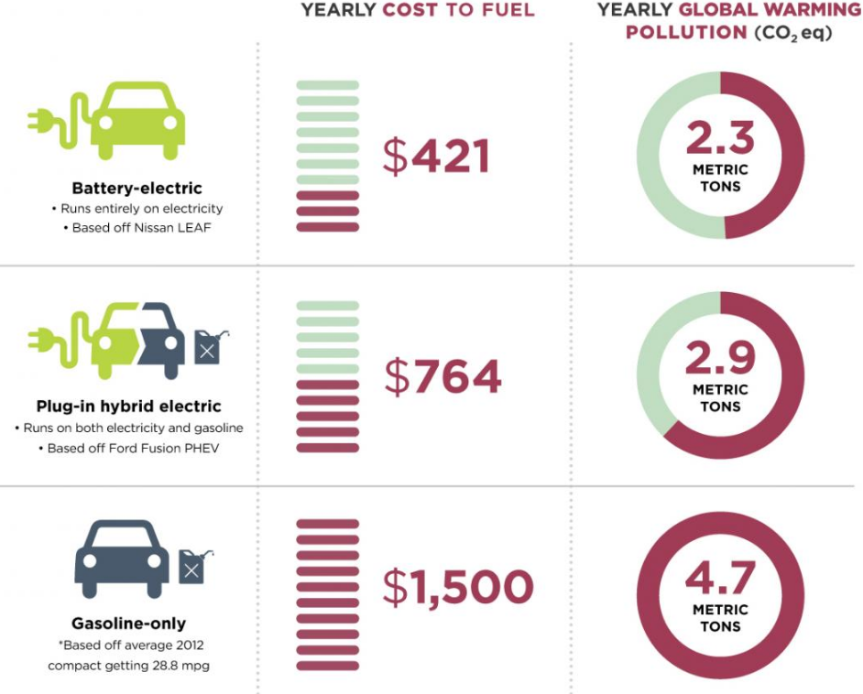
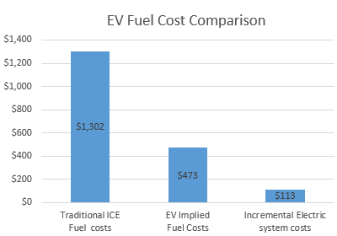
Consumer benefits First and foremost, why are we doing this?
Consumers – TCO is less, instant torque
Utilities – Increases load factor, downward rate pressure
Manufacturers – Increased sales potential, performance improvements to meet regulations
Environmental – Electric vehicles produce ~1/3 the carbon emissions of their similar ICE counterparts
Other benefits:
Over $450M in consumer benefit over 20 years, based on projections
Fuel cost volatility stabilization
Downward rate pressure for all customers due to higher utilization of electric system assets
Customer Benefit
Electric System Benefit

Slide 4
Compelling options

Slide 5
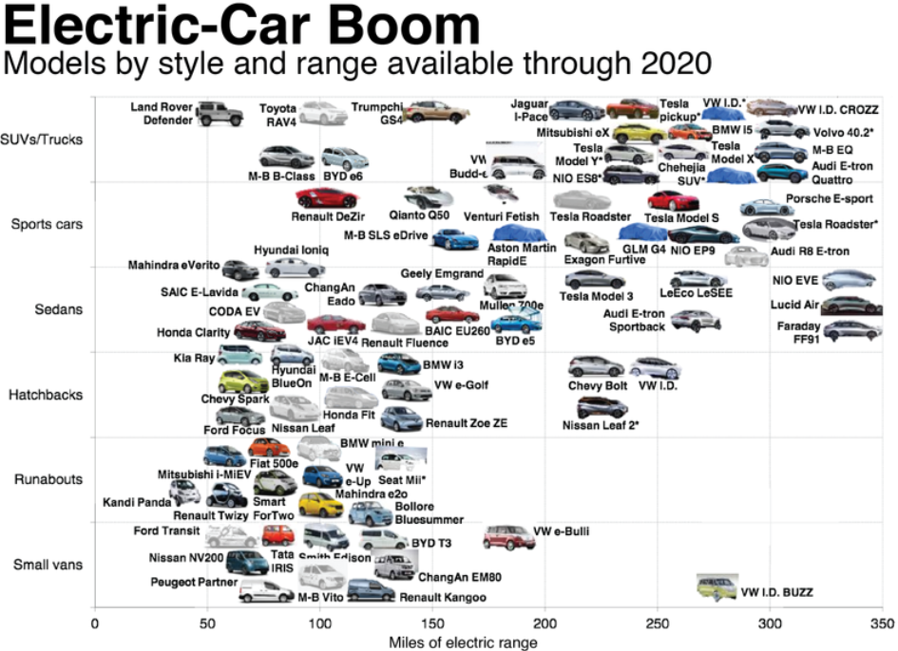
Customer Choice (2017-2020)

Slide 6
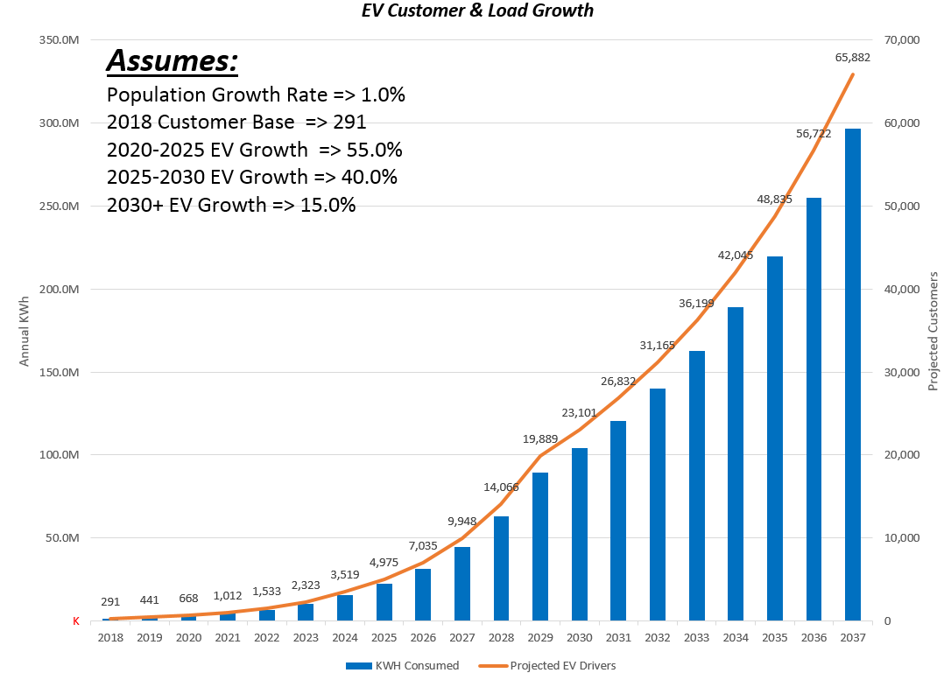
Customer/Load Projections
*Each EV Roughly equivalent to 4 electric clothes dryers

Slide 7
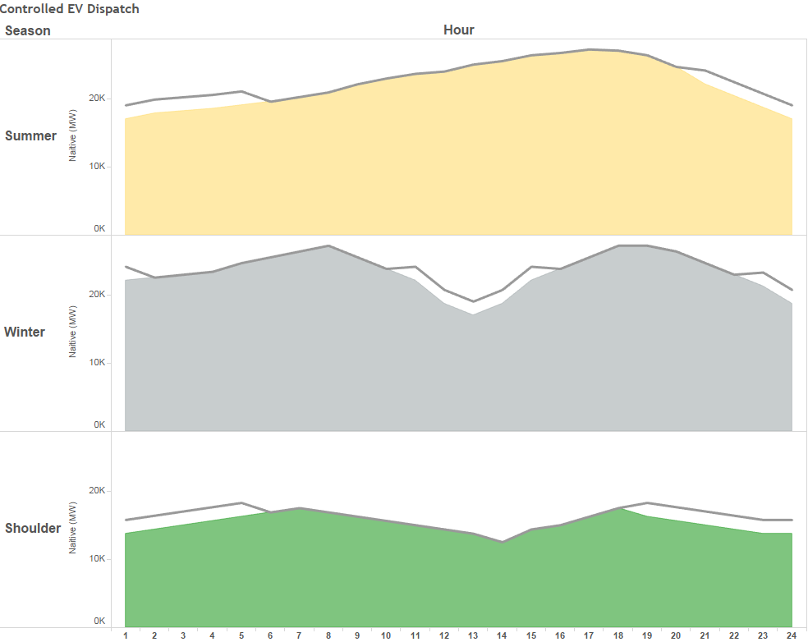
Controlled EV Dispatch Important, but customer convenience primary goal

Slide 8
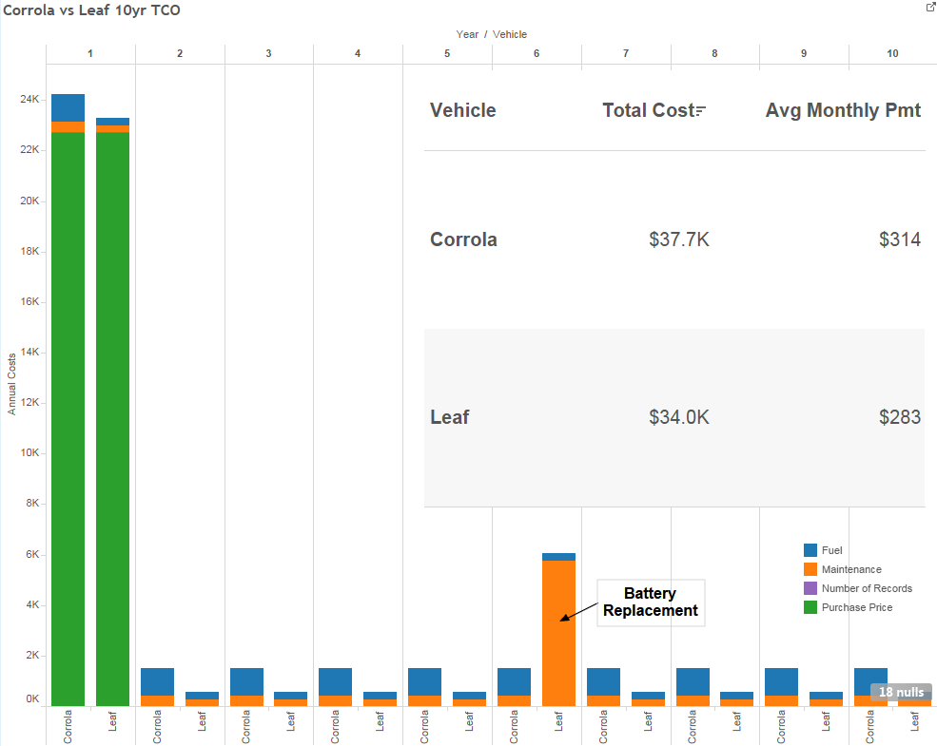
There are challenges…
*Lower consumer TCO is absent battery replacement costs
*Dealing with OEM’s is difficult (used car dealer effect)

Slide 9
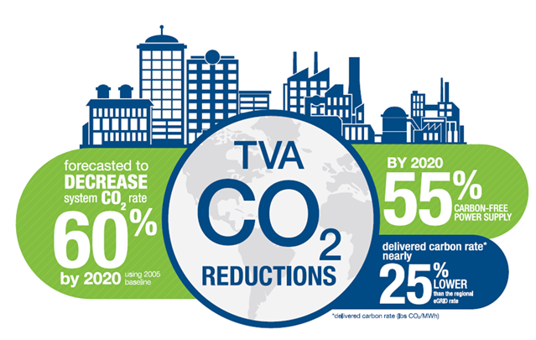
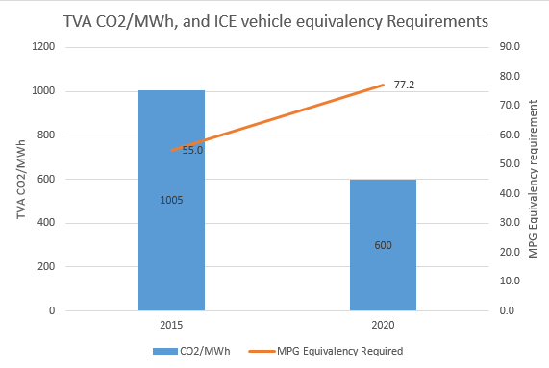
Environmental Considerations
CO₂ lbs/MWh emissions rates are down over 30% since 2005 and are on track to be about 60% below 2005 levels before 2020.
The 2020 forecast is on track to be approximately 40% below 2016 actuals.
This 2020 performance forecast is driven, in large part, by the addition of Watts Bar Unit 2 delivering 1,150 MWh of safe, reliable, clean and low-cost energy on a 24/7 basis. (More clean energy, every hour, of every day).
The current business plan forecasts a system CO₂ rate of below 600 CO₂ lbs/MWh before 2020.
Rates still low – TVA provides an attractive combination of price ($/MWh) and carbon content (CO₂ lbs/MWh).

Slide 10
Newer, Cleaner, Lower Cost Power Supply
FY07
179 TWh
FY18
168 TWh
FY20
171 TWh
FY18 and FY20 are based on the FY18 Budget.
EE includes all energy efficiency impacts (codes/standards/behaviors and TVA programs) on a Net Cumulative Realized at System basis, 2007 base year.

Slide 11
TVA’s Renewable Portfolio
~7,400
MW Nameplate Capacity
| 11

Slide 12
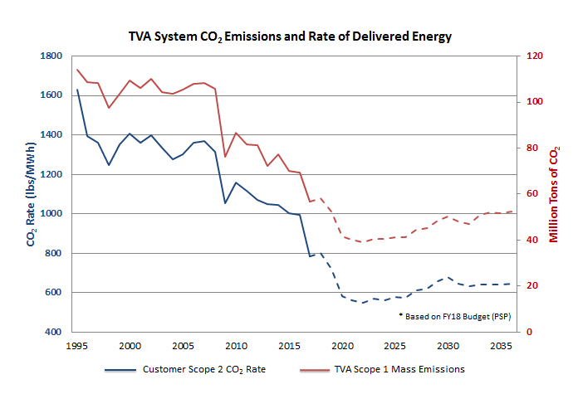
The Valley’s Carbon Future
TVA’s carbon emissions are down dramatically making electricity a clean energy choice.
TVA’s carbon emissions profile can attract capital investment and power a strong clean energy economy.
Emissions are down over 30% and are on track to be about 60% below 2005 levels before 2020.
The 2020 forecast will be approximately 40% below 2016 actuals driven, in large part, by the addition of Watts Bar Unit 2 providing 1,150 MW of safe, reliable, clean, and low-cost energy.
Electricity delivered to our customers contains ~1000 lbs/MWh and will improve to below 600 lbs/MWh before 2020.
TVA provides an attractive combination of price ($/MWh) and CO₂ content (lbs/MWh).
TVA’s diverse generation fleet, lower gas prices and efficient use of electricity are cost-effectively enabling this progress.
Note: Prior to 2015, the LPC average was considered the TVA system number. See page 12 in the Appendix for graph values.
Notes:
Tips:
Slide title should be Arial font, 32 points
Title should be kept short and on a single line if at all possible
To change the image, right click on it and click Change Picture.

Slide 13
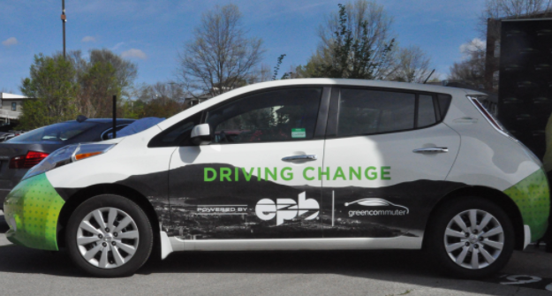
Current EPB Programs
DriveShare
5 Program Participants, displacing ~$75 monthly cost per employee and giving EV experiences, creating EV champions
Leverages existing investment in GreenCommuter Marketing
Working towards LEED certification credits
Community
Continue to look for partnerships with Mitsubishi EV Canter Fuso
Strategic Partnerships:
TVA (Drew Frye)
CARTA
TennSMART
VW
Nissan
ChargePoint
Sustainability Programs
City of Chattanooga
Enterprise Center

Slide 14
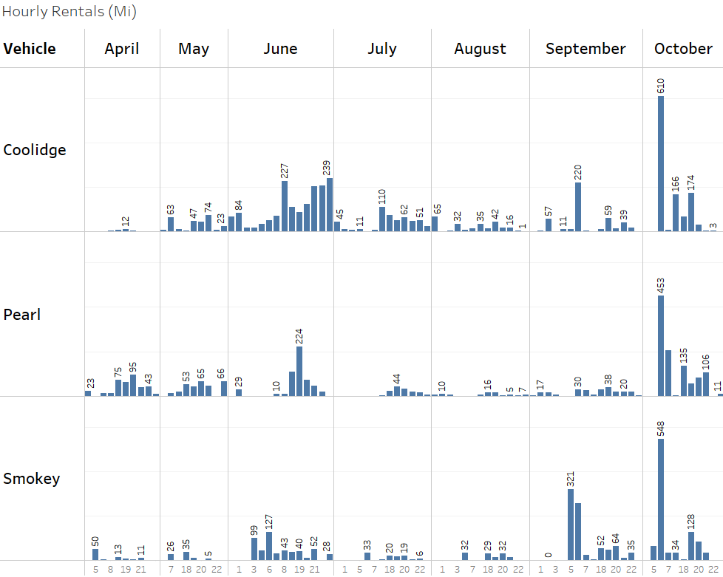
GreenCommuter Visibility
DriveShare

Slide 15
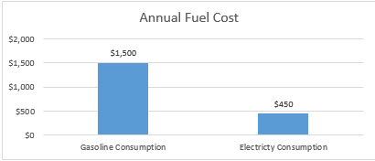
Value Proposition – EPB Customer
Key Points:
$1K+ fuel cost savings annually
$.67 Gas Price equivalent due to low power rates in our area
Payback in as little as 6 months
These calculations do not include public (or workplace) charging benefits readily available to consumers

Slide 16
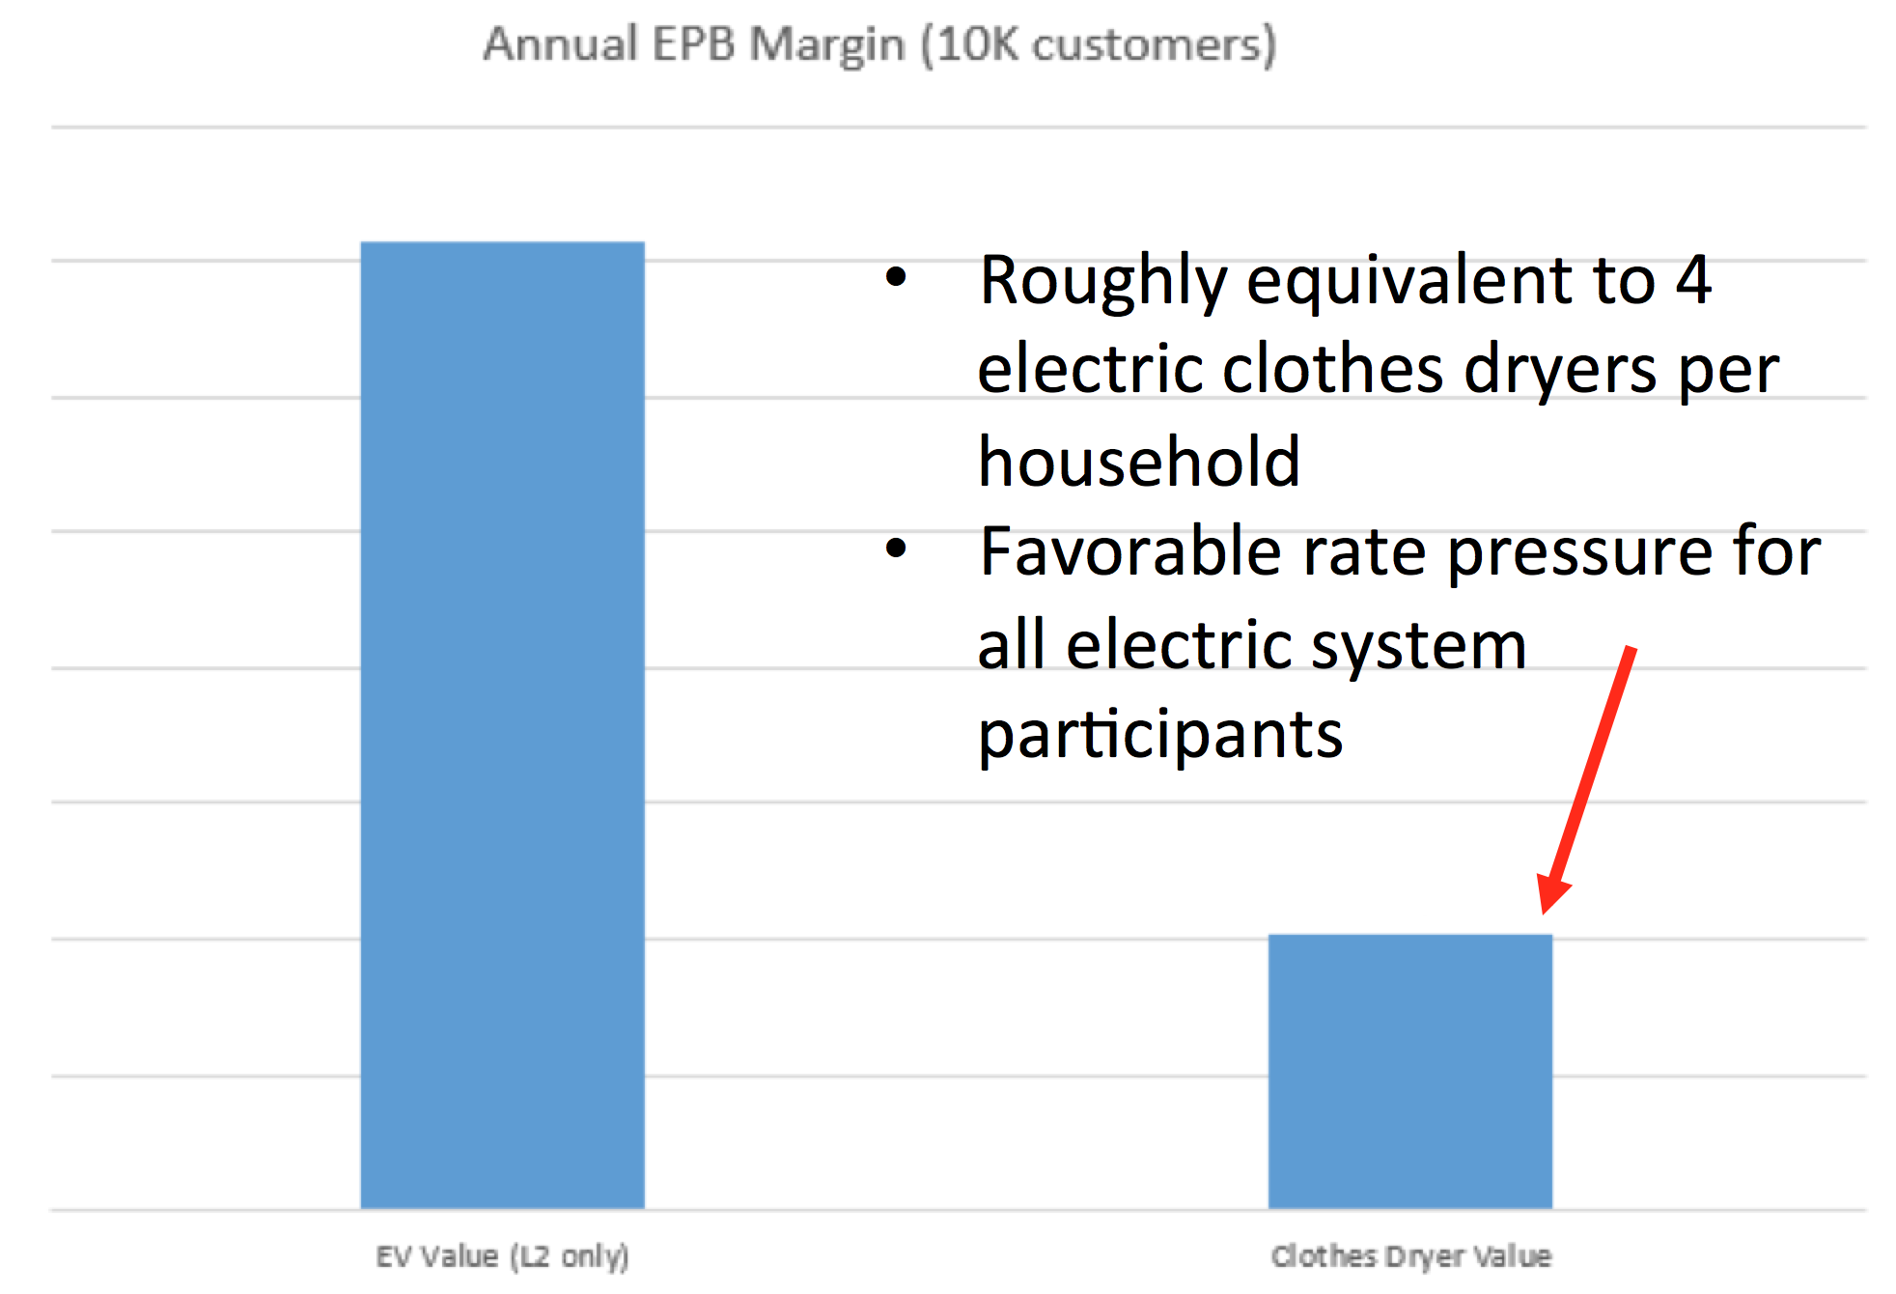
Value Proposition – Distributor Economics

Slide 17
Charging infrastructure challenges
Residential is the easiest – DriveShare program is proving that Level 1 chargers are adequate for most drivers
Retail & MDU’s – who bears the cost of the infrastructure?
Workplace charging:
Many employers are receptive
Margin associated with fueling justifies cost of charging infrastructure for certain customer classes, if access fee is present
Reasons to charge for EV access at the workplace:
Equity among employees
Creates a self managed availability environment
Free reduces availability and potentially shifts EV load to peak hours
No one-size-fits-all approach, pricing correctly is key

Slide 18
TVA’s EV Strategy – “Big Picture”
Phase I
Get Ready
( $ )
Phase II
Market Stimulation
( $$$)
Phase III
Sustainable Investment
( $$ )
Leadership
Valuation
Partnerships
Strategize
Infrastructure Build
Rates & Incentives
Marketing
Brand Enhancement
Trusted Partner
Sustainable Programs
Resource Integration (DER)
Reap Rewards ($)

