Slide 1
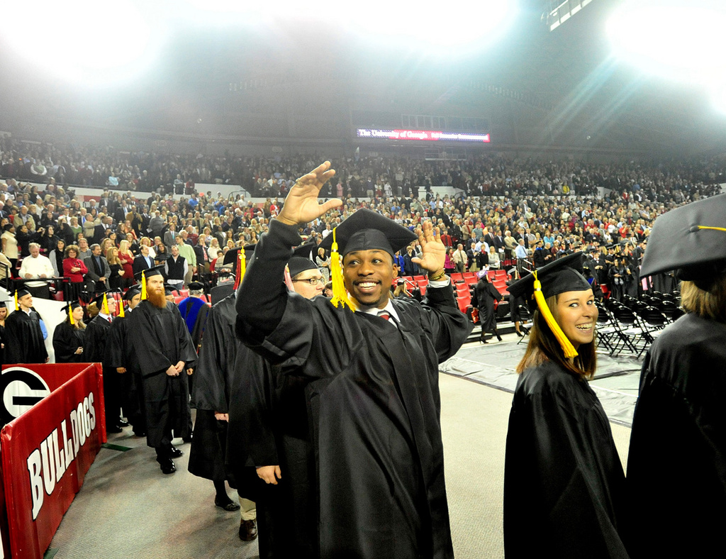
Electric Buses at UGA
$10M SRTA Grant + $5M UGA match
Charging station being built for 60 buses
Sustainability and the environment
Reduced support and life-cycle costs
Charge during night, off-peak times
Reduced operation during summer peak charging

Slide 2
Electric Buses at UGA
EV ride: build life-long public transit users
Research/engineering field work
Bi-directional energy for emergencies
Promote Georgia and UGA
Shape future of transit industry

