Slide 1
The Importance of Policy and Utility Involvement
Presented by Katherine Stainken, Policy Director
Thursday, November 16, 2017

Slide 2
EV Policy Goals Nationwide
National goal of 1 M EVs by 2020
State targets:
ZEV Mandate: credit program, likely to achieve 15% of new vehicle sales to be ZEVs by 2025 (CA, NY, NJ, CT, OR, VT, ME, MD, RI, MA) = 40% of the car market
CA Governor Goal: 1.5 M ZEVs on the road by 2025
Northeast ZEV MOU: 3.3M ZEVs by 2025

Slide 3
EV Policy: State level
AchiEVe: Transition to EVs Policy Toolkit provides examples of states and cities with these effective policies

Slide 4
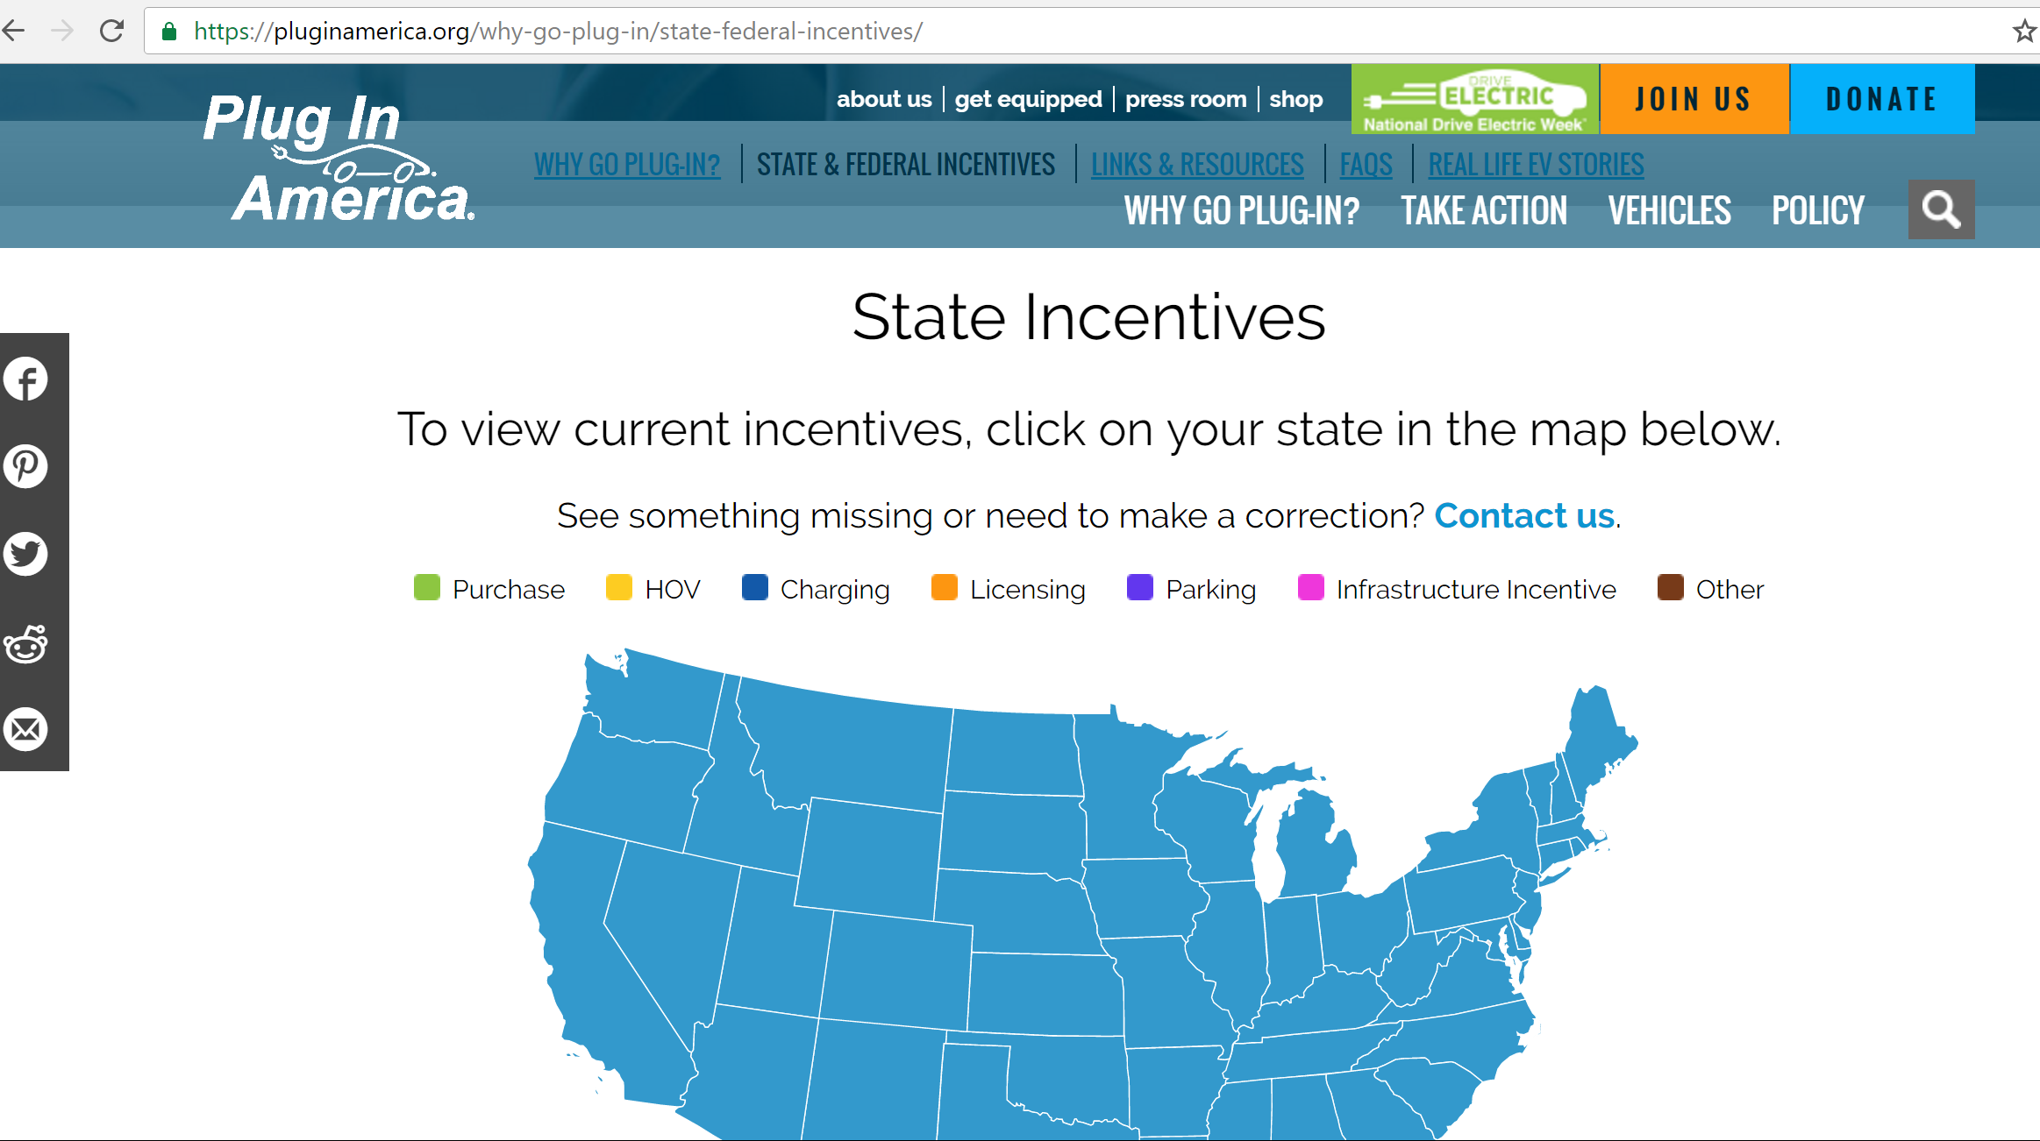
EV Policies
Most current set of incentives on our website

Slide 5
Snapshot of Utility Involvement, Commission Activity
CA: PG&E, SCE, and SDG&E approved pilots, additional TE proposals pending
WA: Avista approved pilot; commission policy guidance for future proposals
MA: Eversource, National Grid proposals pending
OR: Portland General Electric, PacifiCorp settlements
MD: Public Conference 44 stakeholder process
MI: Aug. 9, 2017 Technical Conference leading to guidance
OH: AEP settlement, Commission approval pending; new stakeholder docket in Jan.
UT: Rocky Mountain Power approved for incentive program
NV: NV Energy may propose incentive programs
NJ: BPU stakeholder process
RI: “beneficial electrification” discussion
FL: Duke Energy settlement
NY: part of REV process
AL: stakeholder discussions in January
NARUC ongoing discussions

Slide 6
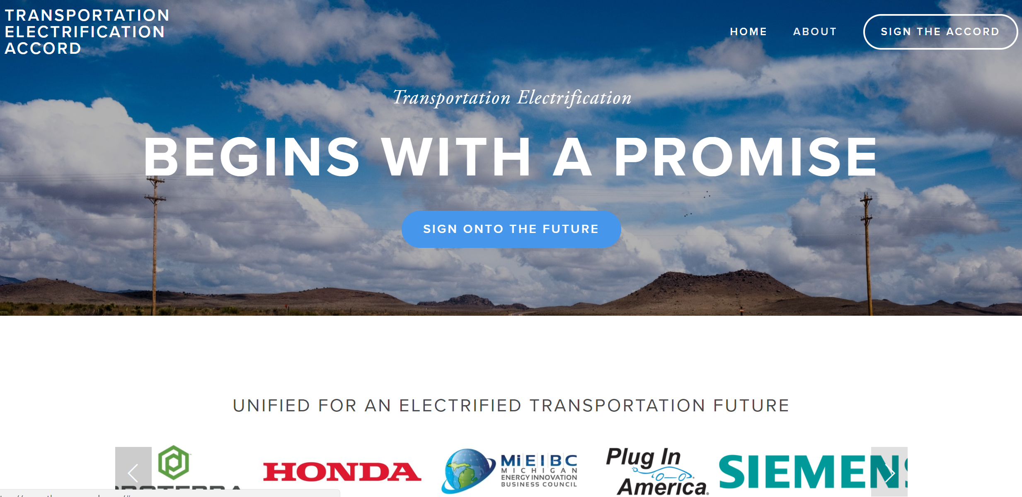
The Transportation Electrification Accord
Guiding Set of Principles!
“The Accord outlines how transportation electrification can be advanced in a manner that benefits all utility customers and users of all forms of transportation, while supporting the evolution of a cleaner grid and stimulating innovation and competition for U.S. companies.”
https://www.theevaccord.com/
Initial signatories:
Advanced Energy Economy, Energy Foundation, Enervee, Honda, Illinois Citizens Utility Board, International Brotherhood of Electrical Workers District Nine, Natural Resources Defense Council, Plug In America, Proterra, Siemens, and Sierra Club.

Slide 7
Optimal Utility EV Program
6 Main Components
EVSE Deployment
Vehicle Grid Integration (VGI)
Education and Outreach (E&O)
Partnership and Stakeholder Engagement
Fleet Targets
Other products and services

Slide 8
Optimal Utility EV Program
EVSE Deployment
Targets – i.e. 50 DCFC by 2020
Focus on sectors:
Phase I: workplace, MUDs
Phase II: DCFC corridors
Phase III: residential
Rebate for EVSE
Utility ownership vs. “make-ready” models
Keep it simple

Slide 9
Optimal Utility EV Program
2. Vehicle Grid Integration (VGI)
Rate design: Different rates and rate structures work better for different grids
Managed charging element
Demand charges – keep low, review periodically
TOU rates ok
V1G (demand response) works best for fleets
Keep it simple
Keep rates low for EV Drivers
Notes:
Smart Charging: A Better Choice •
Beyond TOU: Dynamic Pricing •
Utility or Aggregator Control •
Flexible Charging
BMW Smart Charging program “iCharge Forward” controlled 40% of the load
Good: CP demand charges •
Better: TOU rates •
Best: Smart rates and smart charging

Slide 10
Optimal Utility EV Program
3. Education and Outreach
Test drives
Bill inserts
Websites
Education on the vehicles, rates critical to success
4. Partnership and Stakeholder Engagement
5. Fleet Targets

Slide 11
Optimal Utility EV Program
6. Other products and services
Rebates to teachers, first responders, firefighters (SDG&E)
Rideshare programs (Uber, Lyft)
Roadside assistance programs
EVSE maintenance programs
Battery storage programs

Slide 12
Charging Infrastructure Principles
Charging infrastructure should include a mix of L1, L2 and DCFC, but is best installed in the following order to save costs: L1 and L2 at homes and workplaces, DCFC, and finally L2 in other public places.
Consumers and workplaces need support for DCFC.
Utilities should be allowed to deploy charging infrastructure.
Charging rates should be kept low for ratepayers.
Demand response programs should include PEVs, as a precursor to V2G.
Building Codes should include requirements that all new buildings and associated parking lots are “made ready” up to the conduit.
Consumer protection principles should be adhered to.

Slide 13
Consumer Protection Principles
Open Access – can I get a charge?
This is defined as the ability to get a charge at any public charger - including L1, L2 and DCFC - either via a credit card swipe or mobile app to enable the charge.
Transparency – what’s the price?
The price of a charge should be clear when the PEV driver connects to the charger.
Interoperability – one EV club!
This is a key principle for the entire charging infrastructure ecosystem. Currently, many companies have their own card or key, which means drivers must either join multiple “clubs” or risk being unable to charge.
NEMA EVSE 1.2-2015 EV Charging Network Interoperability Standard Part 2: A Contactless RFID Credential for Authentication (UR Interface)
Mapping data and signage – where is the charger?!
All electric vehicle service providers (EVSPs) should provide mapping data for charging locations, including costs for charging (both in and out of network).

Slide 14
Thank you!
Questions?
kstainken@pluginamerica.org

