Slide 1
Electrification of Transportation:
A Consumer Perspective
Shannon Baker-Branstetter
Senior Policy Counsel
Consumers Union,
Policy and Action from Consumer Reports

Slide 2
Overview
Consumer Reports’ Resources on EVs
Benefits of Electrification
Challenges of Electrification
Consumer Survey Data
Consumer dimensions of utility investments in EV infrastructure
Conclusion/Questions

Slide 3
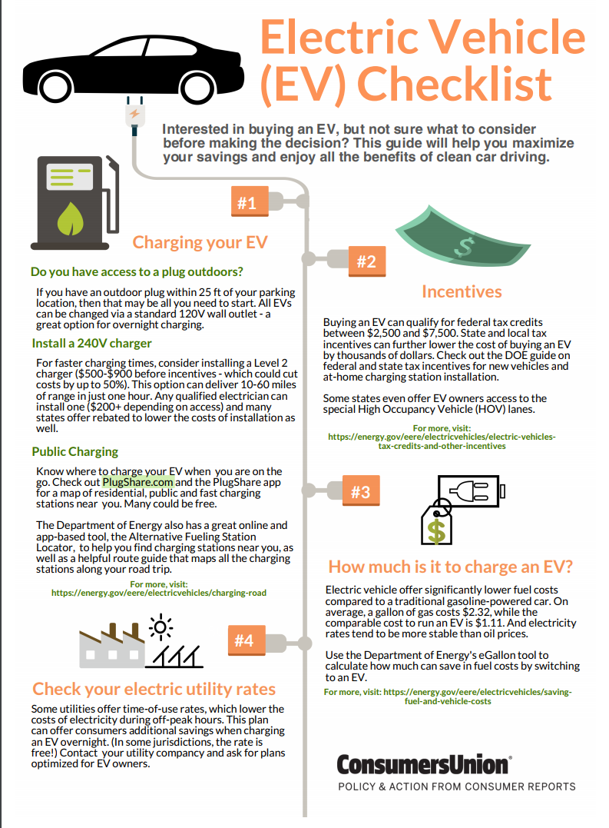
Consumer Reports Activities Around EVs
EV quiz to see if an EV is right for you
EV 101: basic info and FAQs for potential EV buyers
EV testing (ongoing at ATC)
EV buying checklist
Charger testing (in the past)
Editorial coverage of EV vehicle and technology developments
Advocacy supporting Zero Emission Vehicle program

Slide 4
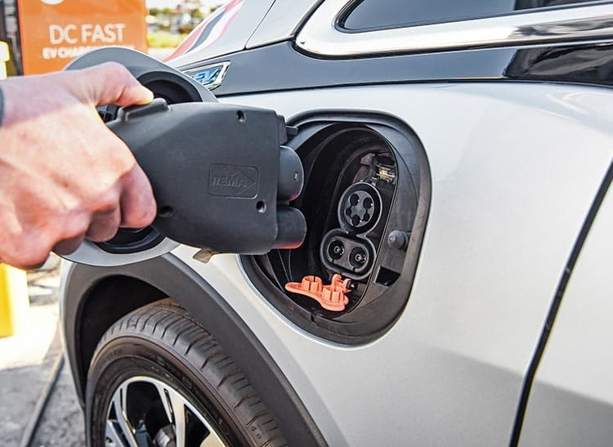
What are the benefits of increasing electrification?
Health
Lower air pollution
Value
Lower fuel costs and maintenance
Innovation
Growth and competition, complement to shared and autonomous developments
Grid
Resiliency, energy storage, and load management/demand response services
Diversification of Fuel Supply
Competition, national security
Notes:
https://energy.gov/sites/prod/files/2017/06/f34/Challenges_and_Opportunities_of_Grid_Modernization_and_Electric_Transportation.pdf
This paper discusses the challenges and opportunities associated with an increase in plug-in electric vehicle (PEV) adoption and how working together both sectors stand to benefit from closer integration.
HEALTH: This report is by U.S. Department of Energy. According to a June 2016 report by Argonne, Electric vehicles reduce grams of carbon dioxide produced per mile by 26%. In addition, reduction of greenhouse gas emissions create a healthier world. (Page 10)
http://secureenergy.org/wp-content/uploads/2016/03/EC_Roadmap.pdf
Innovation:
The Electrification Roadmap endeavors to serve a practical function: to provide a public policy guide to transforming the U.S. light-duty ground transportation system from one that is oil-dependent to one powered almost entirely by electricity.
This pdf makes a case for electrification (benefits) AND LATER PRESENTS THE CHALLENGES AS WELL!!
GRID: “Grid investments that support electric vehicle deployments as a part of planned modernization efforts can enable a more efficient and cost-effective transition to electric transportation and allow investor-owned electric companies and public power companies to realize new revenue resources in times of flat or declining loads.”
Many car companies and charging station suppliers are preparing to offer automated managed charging, reverse power flow, and vehicle-to-load capabilities by using the electric grid.
https://cleantechnica.com/2016/09/06/economic-benefits-electric-vehicles/
Value: This article offers a great visual about how much money the US spends on oil expenses per day and comparison of the cost of climate action and climate inaction.
Air pollution from road transport costs OECD countries approximately $1 trillion a year in negative health effects (cancer, premature death, asthma, heart attacks, etc.).
The “cost of outdoor air pollution” in the US simply in terms of premature death was estimated to be $500 billion in 2010, with about half of that cost coming from road transport. Again, that is the estimated cost only from premature deaths — it doesn’t include the costs of asthma, cancers that people survive, heart attacks that people survive, etc.
If you consider the toll global warming and climate change will take on the economy, the bill grows to incomprehensible heights. (See chart below on the estimated costs of climate inaction.)
The USA spends perhaps $75 billion a year on the military in order to secure access to foreign sources of oil and keep supply routes open (h/t EV Annex), further growing the economic and quality of life burden of oil-based transportation.
https://www.nrel.gov/docs/gen/fy07/40969.pdf
Value: “The analysis finds that petroleum reductions exceeding 45% per vehicle can be achieved by PHEVs equipped with 20 mi (32 km) or more of energy storage. However, the long-term incremental costs of these vehicles are projected to exceed US$8,000. A simple economic analysis is used to show that high petroleum prices and low battery costs are needed to make a compelling business case for PHEVs in the absence of other incentives.”
http://www3.weforum.org/docs/WEF_Future_of_Electricity_2017.pdf
Innovation and Grid: This article focuses on the future of electric vehicle infrastructure and the grid.
“Using grid edge technologies and services, customers will produce, consume, store, and sell electricity”
“Automated tech and analytics will influence customer consumption and contribute to new customer services”
“By increasing the efficiency of the overall system, optimizing capital allocation and creating new services for customers, grid edge technologies can unlock significant economic value for the industry, customers and society.”
https://www.iea.org/media/workshops/2015/esapworkshopvi/StrbacPapadaskaplopoulos.pdf
This is a workshop/presentation, and on page 4 it discusses the benefits and challenges of electrification of transport.
• Challenges
Driving patterns: disproportionately higher increase in demand peaks than increase in energy demand
Low asset utilisation
• BUT…significant flexibility potential
Inherent ability to store electrical energy
Stationary on average for more that 90% of time, opportunity for smart charging
Vehicle to Grid (V2G) capability
Smart fast charging of fleet vehicles
Second life of EV batteries – grid application: contribution to supply adequacy
https://www.nrel.gov/docs/fy17osti/68214.pdf
Health:
By the National Renewable Energy Lab. Looks at:
1. The potential to reduce carbon dioxide (CO2) emissions through coupled decarbonization of the power sector and widespread electrification of end-use processes across the U.S. economy.
2. How the power sector may evolve to meet the rapidly growing demand for electricity while simultaneously reducing power sector GHG emissions.
3. How increased end-use efficiency can mitigate the necessary investment in the power sector to meet the growing electricity demand.
https://energy.gov/sites/prod/files/2015/09/f26/Quadrennial-Technology-Review-2015_0.pdf
Three enduring strategic objectives are foundational to our nation’s energy system: energy security (not a benefit) , economic competitiveness (diversification of fuel supply), and environmental responsibility (health). Can be found on page 2 under Executive Summary.
https://info.ornl.gov/sites/publications/Files/Dev296070.pdf
The performance, availability, and cost of electric drive commercial vehicles could be improved through basic and applied research in energy storage, electric drives, vehicle systems, and related technologies.
Laws and incentives could encourage the development and use of electric drive vehicles in the goods
Fleet owners could incorporate into decision-making both the economic and non-monetary value of enhanced vehicle operator
http://www.gotransit.com/electrification/en/project_history/docs/ElectricificationStudy_FinalReport.pdf
This is an extensive research report containing lists, benefits, findings,etc. On electrifying public transportation by Metrolinx.
Categories and related considerations included:
Environment and Health: Considerations – greenhouse gas emissions; regional and local air quality; electromagnetic fields; noise and vibration.
User Benefits/Quality of Life: Considerations – journey time savings; reliability Social and Community: Considerations – impacts on residents and users of community, institutional and recreation facilities.
Economic: Considerations ‐ cost‐effectiveness; employment effects; land use and property values.
Financial: Considerations – capital and operating cost; revenues.
Deliverability: Considerations – constructability, acceptability.

Slide 5
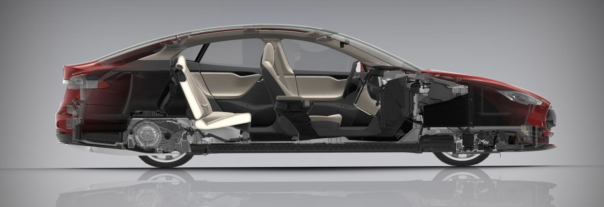
What are the challenges for electrification?
Cost
Purchase price/technology costs
Obsolescence/depreciation
Education
Lack of awareness/information on the part of consumers and dealers
Infrastructure gaps
Charging time
Environmental and social externalities
Power plant emissions, mineral extraction
Advantages/influence of incumbent oil industry
Notes:
Address safety concerns, NHTSA data
http://secureenergy.org/wp-content/uploads/2016/03/EC_Roadmap.pdf
Challenges that come with electrification are broken down and looked at in this pdf as:
Batteries & Vehicles
Charging Infrastructure
Electric Power Sector
Consumer Acceptance
https://info.ornl.gov/sites/publications/Files/Dev296070.pdf
Electrified work trucks and vocational trucks can be particularly challenging to produce and certify. These vehicles are often produced by upfitting a powertrain and work body to a mass produced chassis. The upfitter then serves as the manufacturer of record and must take responsibility for certification of the vehicle to federal regulations. This process is time consuming and costly and these companies must recoup the cost over their relatively small production volumes.
https://energy.gov/sites/prod/files/2017/06/f34/Challenges_and_Opportunities_of_Grid_Modernization_and_Electric_Transportation.pdf
Other challenges include privacy, and data management as well. There are questions being raised to the reliability of these grids and and management systems. Cyber Security has been identified as a huge challenge for grid development as well, and the FBI has released a Public Service Announcement on vehicle vulnerabilities in March 2016.
https://energy.gov/sites/prod/files/2015/09/f26/Quadrennial-Technology-Review-2015_0.pdf
Again, this talks about cyber security issues with the new technology and the grid system.
“Cybersecurity vulnerabilities are related to the compromise of ICT-based controls that operate and coordinate energy supply, delivery, and end-use systems. Supply security risks are related to price shocks and international supply disruptions of energy commodities, critical materials, and/or equipment. Conflict–related security risks are associated with unrest in foreign countries linked to, or impacting, energy. Climate change increases physical security risks with sea level rise and intensification of extreme weather.”
http://www.cpuc.ca.gov/uploadedFiles/CPUC_Public_Website/Content/About_Us/Organization/Divisions/Policy_and_Planning/PPD_Work/PPD_Work_Products_(2014_forward)/PPD%20Transportation%20Electrification%20Whitepaper%20.pdf
“This paper seeks to bridge the gaps between electricity and transportation infrastructure planning processes.The goal is to explore charging infrastructure deployment strategies and best practices that are compatible and synergistic with local, regional, and statewide land-use planning goals to reduce greenhouse gas emissions in the transportation sectors.”
http://content.sierraclub.org/creative-archive/sites/content.sierraclub.org.creative-archive/files/pdfs/1371%20Rev%20Up%20EVs%20Report_09_web.pdf
This paper focuses on salespeople knowledge on EV cars, charging times, and incentives. It also explores that EV car salesmen are not even at dealerships at all times of the day. This is a great source to find first hand quotes from customers. Page 7.
http://www.theicct.org/sites/default/files/publications/Consumer-EV-Awareness_ICCT_Working-Paper_23032017_vF.pdf
Lack of Awareness:
This paper shares their research on how much the public knows about electric vehicle infrastructure and incentives that the government provides to EV owners. It goes in depth, provides numbers and statistics on the matter as well. On page 3 they have an extremely detailed chart presenting studies evaluating the importance of consumer awareness.
http://www.adlittle.com/fileadmin/editorial_us/downloads/ADL_BEVs_vs_ICEVs_January_24_2017_USA.pdf
Purchase Price/ Technology Cost:
This research argues that due to costs of battery change, initial payment of the car, and need for alternative transportation would be the cause of consumers spending more money on the overall BEV experience.
Their research conducted that “BEVs Total Vehicle Cost (TVC) was 70% higher for the 2015 Compact Passenger and 98% higher for the 2015 Mid-Size Passenger.” Total Vehicle Cost is the largest portion of the Total Vehicle ownership cost. Although, electricity saves money when we look at long-term costs, initial price of a electric vehicle is much higher than a combustion engine.
https://www.afdc.energy.gov/fuels/electricity_infrastructure.html
U.S. Dept of Energy outlines how long each level of charging takes.
http://leg.wa.gov/JTC/Documents/Studies/EV/FinalChargingInfrastructureGaps.pdf
Infrastructure Gaps:
“The business case for providing EV charging along corridors is challenging because stations may not be used enough to cover the cost of installing and operating them. High-powered, DC fast charging is the preferred charging method in this case because it is unlikely that drivers will want to spend extended periods at charging locations between their trip origin and destination. A single DC fast charging station, for instance, may cost over $170,000 to own and operate over its lifetime and is unlikely to be profitable through a pay-per-use business model alone. Project developers will likely have to secure additional sources of revenue or funding to achieve a sustainable business model.”
http://energy.mit.edu/news/3-questions-future-electric-utility/
An interview with the MIT Energy Initiative Director of Research, Francis O’Sullivan, about current trends in the utility industry, as well as potential solutions to current challenges.
INFRASTRUCTURE GAPS:
He states that the most salient problem right now is “the need to put in place the digital infrastructure that will support the effective integration of today’s new generation and storage technologies onto the grid.”

Slide 6
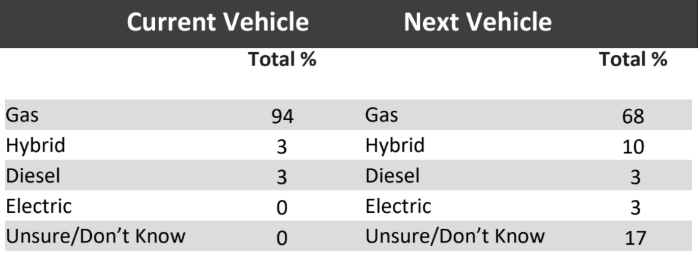
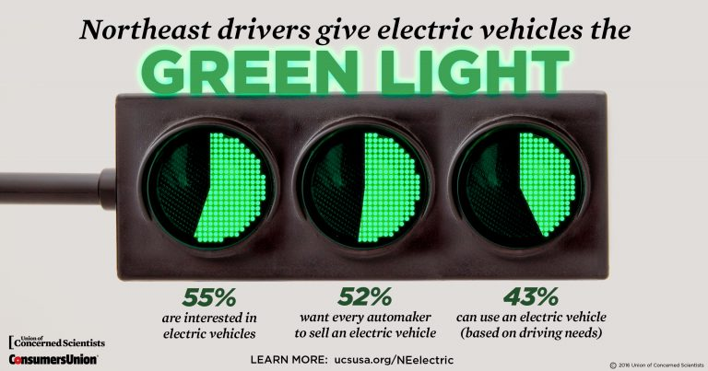
Findings of Consumer Reports’ Surveys on EVs
National: 10% considering a hybrid vehicle for their next purchase and 3% are considering an electric vehicle (CU 2017)
2016 Survey of CA and NE Residents
NE: 35% of drivers are likely to consider an EV for their next vehicle and 55% have some interest in EV technology (UCS-CU 2016)
CA: 54% drivers are likely to consider an EV in their next vehicle purchase or lease, and 65 percent are interested in electric vehicles generally
EV-ready households: 44% of households in California and 43% in the Northeast states could potentially use a PHEV
Notes:
Making sure alternatives are known to consumers and available, useful to do 3 or 4 pager for the goals and what the basis is for the work in this area (proposal for one CR format), but what we’re doing

Slide 7
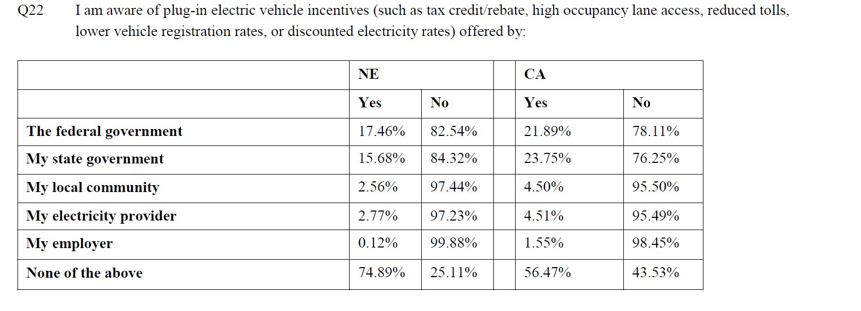
Very low awareness of existing incentives

Slide 8
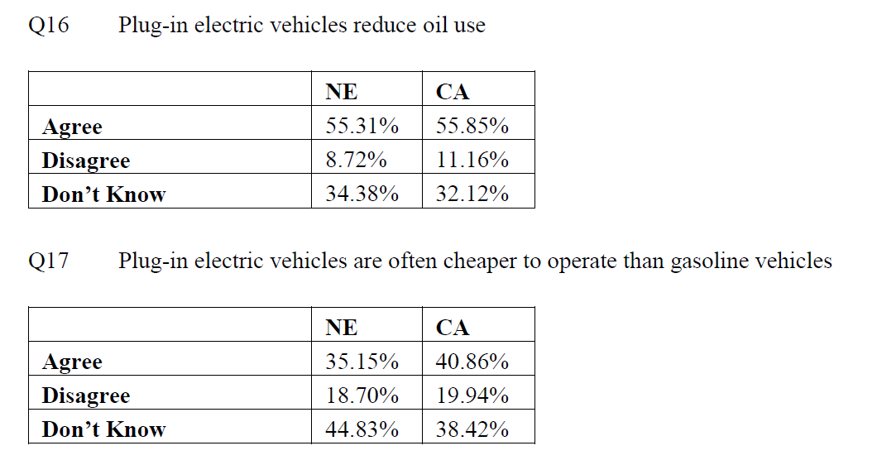
Very Low Awareness about EVs Generally

Slide 9
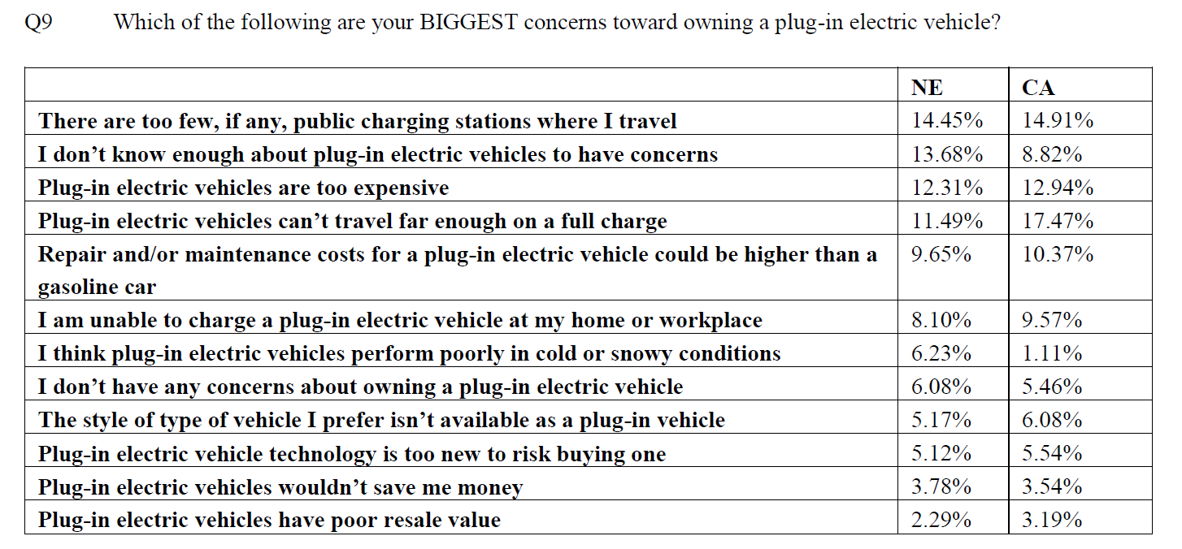
Biggest Concerns About Owning an EV
Notes:
Top 3 are infrastructure, price and range

Slide 10
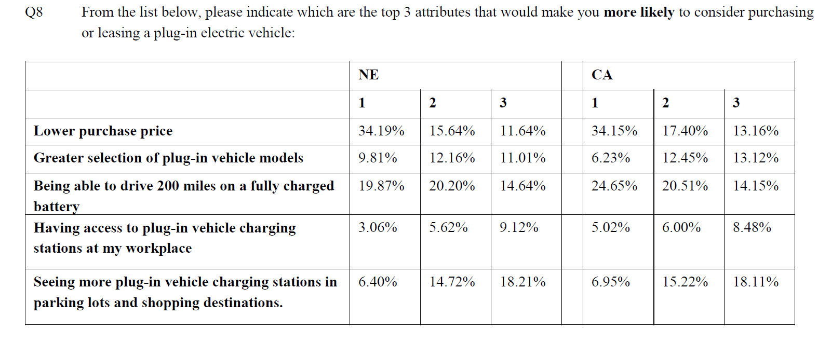
What People Say Would Make an EV More Attractive
Notes:
Price, greater selection and range

Slide 11
Consumer dimensions of utility investments in EV infrastructure
Doing it Wrong | Doing it Right
Increasing peak so have to build new power plants or running dirty peaker plants longer | Using EVs to optimize grid utilization and facilitate load management
Building stranded assets (chargers that won’t be used or become obsolete) | Siting chargers where they will be used and useful and aligning incentives so utility will be accountable for underused assets
Overcharging for power so EV adoption remains low | Smoothing out load curves so EV charging happens when there’s excess power and can be offered at a low price
Crowding out competition or duplicating efforts for building chargers | Building chargers where residents have a need that is not fulfilled by the charger private market
Blaming rate or bill increases on EV infrastructure or adoption | Communicating clearly and delivering benefits to EV owners and non-EV owners

Slide 12
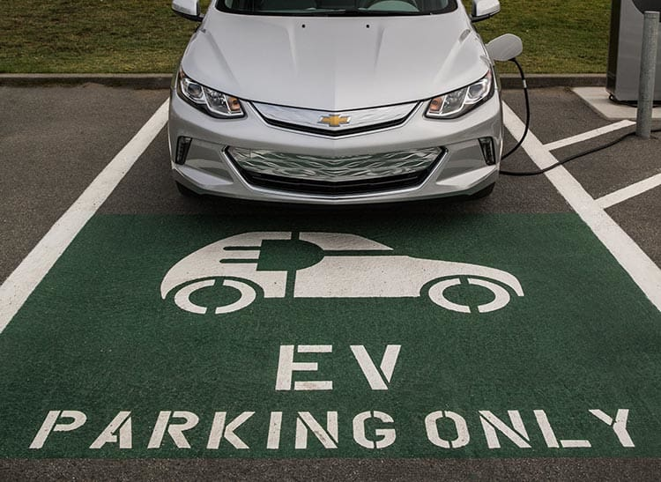
Conclusions
Many consumers could benefit from an EV right now, but don’t know it
Purchase price, charging infrastructure, and range are most urgent concerns to address (both through better education or actual improvements)
Utility investments must include education components and must be able to answer the questions:
How does this improve the value proposition for potential EV buyers?
What are the benefits of these investments for non-EV buyers (other ratepayers)?
Questions?
Shannon Baker-Branstetter, bakesh@consumer.org

