Slide 1
Electric Buses
Technology Overview and Deployment Considerations
Blake Whitson
November 16, 2017

Slide 2
Outline
Electric Bus Technology
Charging Equipment
Why Buses?
Deployment Considerations
State of the Market Today

Slide 3
About CTE
Mission: To improve the efficiency and sustainability of U.S. energy and transportation systems
non-profit, non-governmental, membership-based
$400+ million portfolio of RD&D projects
  alt. fuel and advanced vehicle technologies
  bridge the gap between laboratory and commercial product
  support early adopters after commercialization
national presence
  Atlanta, Berkeley, Los Angeles, St. Paul
Notes:
Project sponsorship
Federal Transit Administration
Departments of Energy, Defense, Interior, NASA

Slide 4
Types of Electric Buses
Different types of buses use electric-drive technology:
diesel-electric hybrid bus
trolleybus
fuel cell electric bus (FCEB)
battery electric bus (BEB)
zero-emission bus (ZEB)

Slide 5
Efficiency of Electric-Drive
Sources: Fuel Cell Bus in U.S. Transit Fleets: Current Status 2012; National Renewable Energy Laboratory; “Comparison of Modern CNG, Diesel, and Diesel Hybrid-Electric Transit Buses, Efficiency and Environmental Performance, MJB&A 11/2013; “Clean Diesel vs. CNG Buses: Cost, Air Quality, & Climate Impacts, MJB&A 2/2013; CTE TIGGER analysis
Notes:
focus on commercially available technology… deployment project, not development or demonstration... increasing volume of vehicle deployed
focus on three primary tasks:
1. Deployment of AFV Fleets and Infrastructure
2. Facilitate Development of Alternative Fuel Corridors
3. Development of Strategic AFV Fleet Partnerships

Slide 6
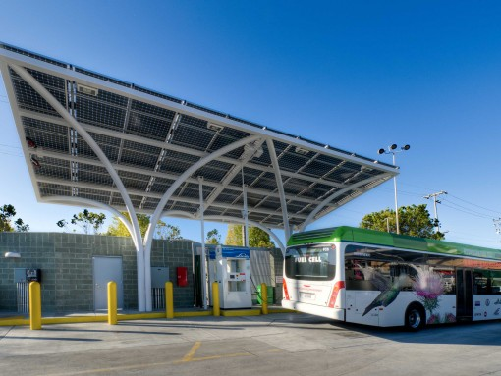
Fuel Cell Electric Bus (FCEB)

Slide 7
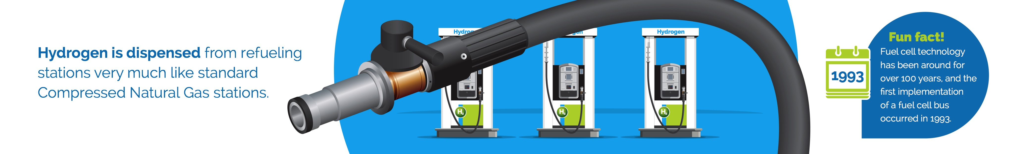
Fueling a FCEB
Vehicle fueling is similar to CNG
Bus can be filled in about 15 minutes
Sufficient range for most transit service

Slide 8
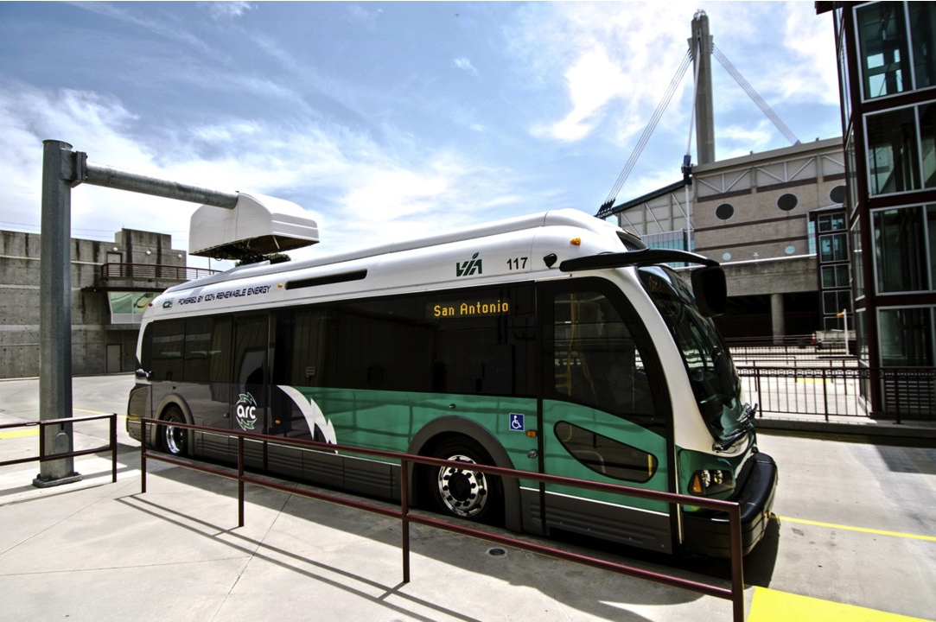
Battery Electric Bus (BEB)

Slide 9
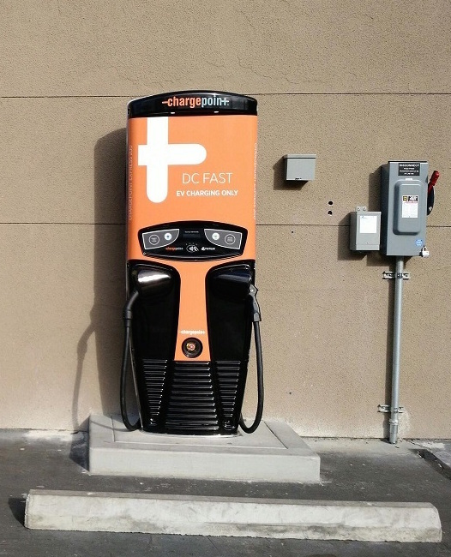
Depot Charging Equipment
stationary plug-in charger
positioned near bus parking area with cord to connect to bus
50-100 kW output
connector and current (DC or AC) must be compatiable with bus
Suppliers: 10+ third party vendors for DC, few for AC

Slide 10
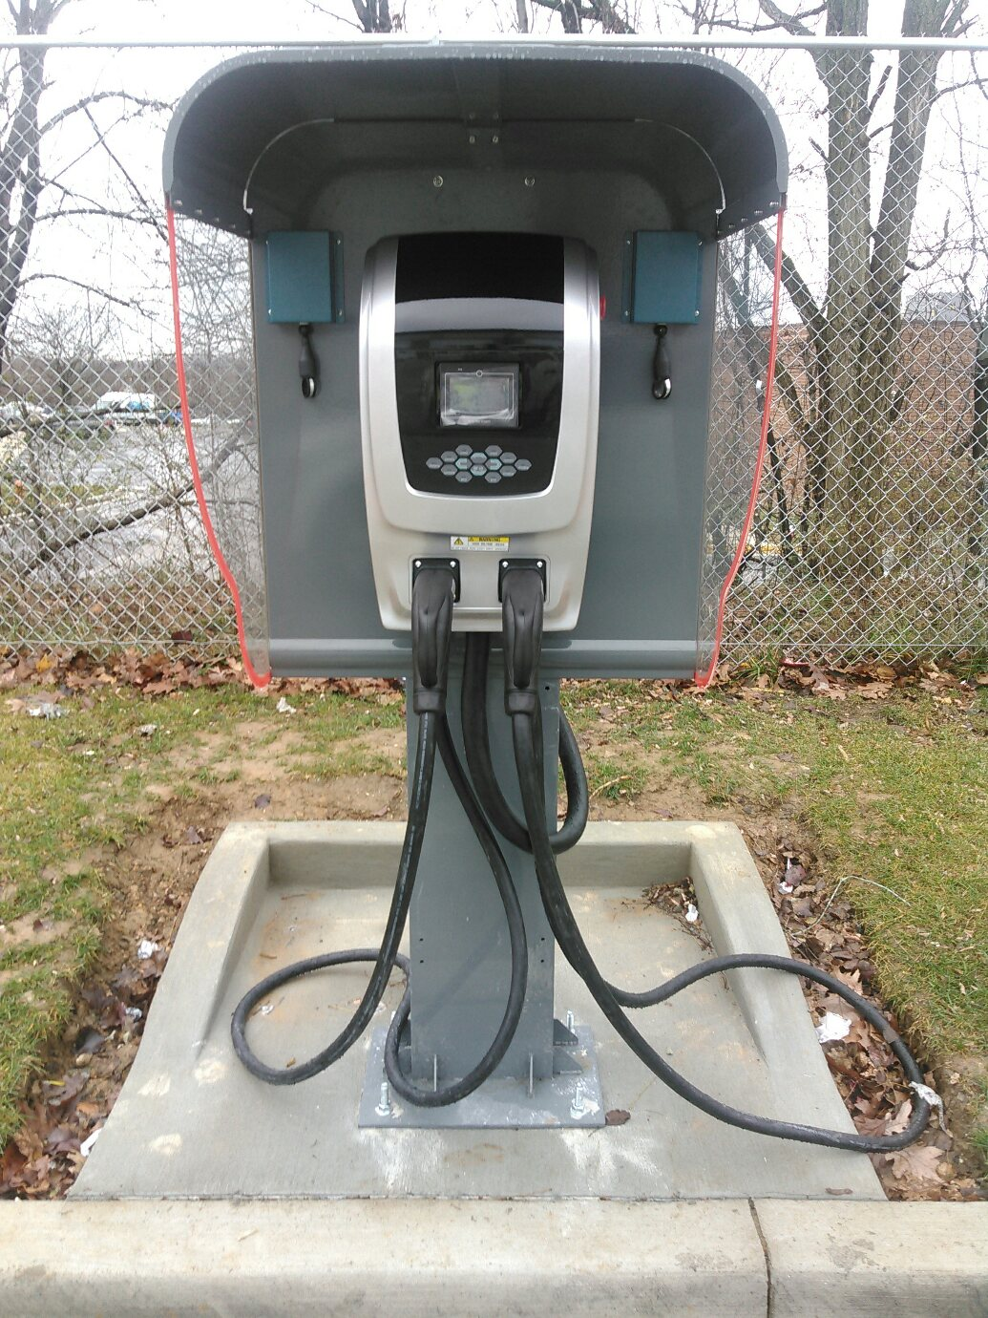
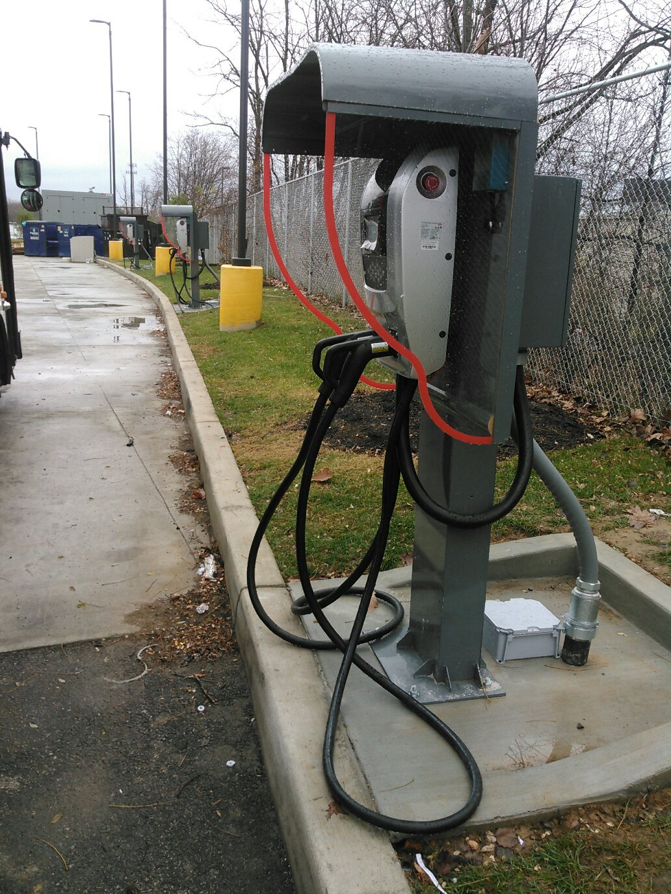
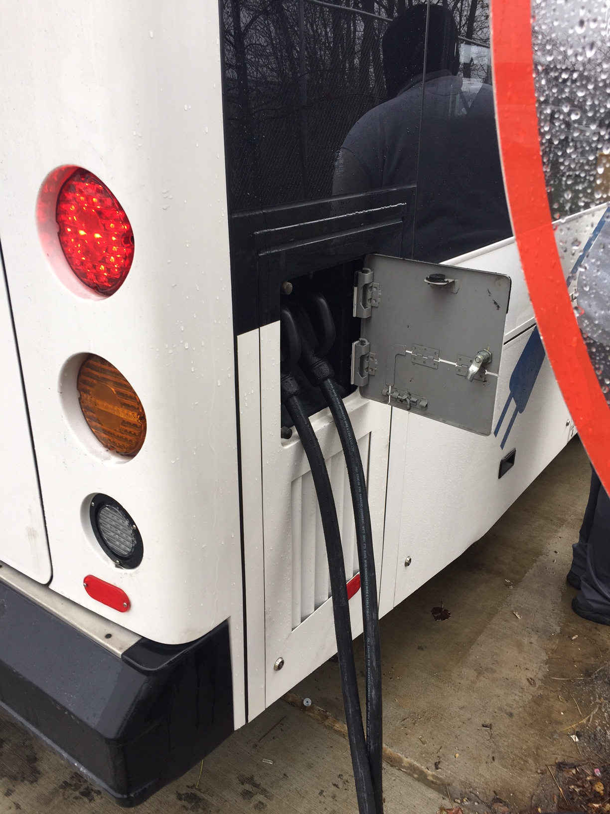
Depot Charger (example)
Input: 480 VAC, 95 A, 60 Hz, 3-Phase
Output: 40 kW AC, per connector
IEC 62196, standard 7PIN connector

Slide 11
On-Route Charging Equipment
Inductive “wireless” charger
mounted in roadway
50 kW output
6 installations to date
high power systems under development (200+ kW)
Suppliers: WAVE, Momentum Dynamics
Conductive charger
mounted over roadway
~200-400 kW output
20+ installations to date
Suppliers: Proterra, Siemens, ABB

Slide 12
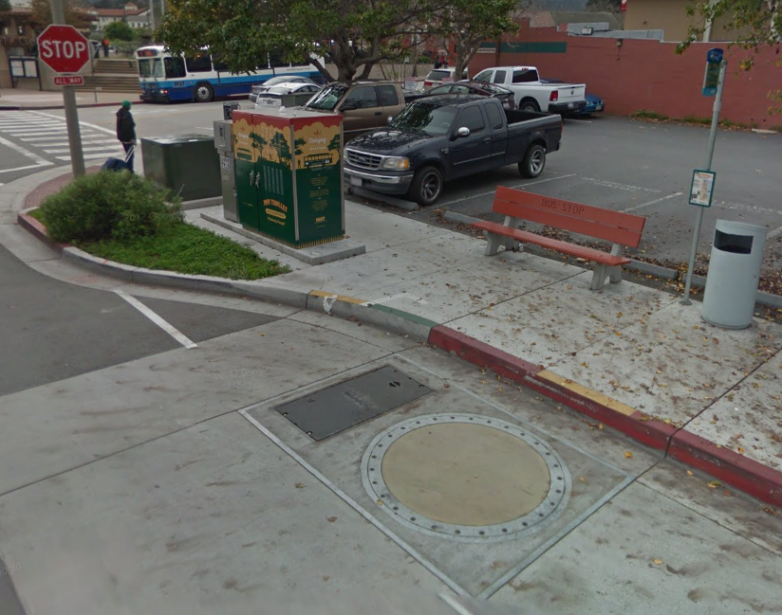
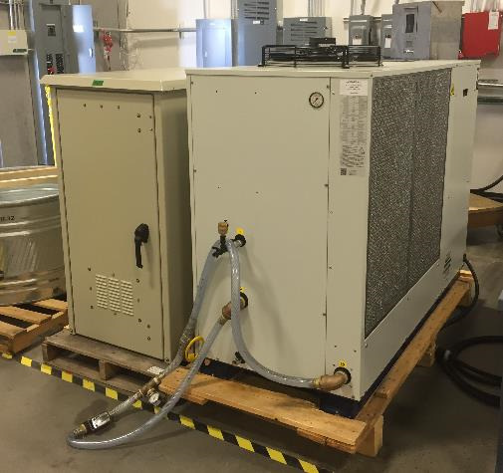
Inductive Charger (example)
Utility Requirements: 480 VAC, 3-phase
transformer, chiller, electrical cabinet

Slide 13
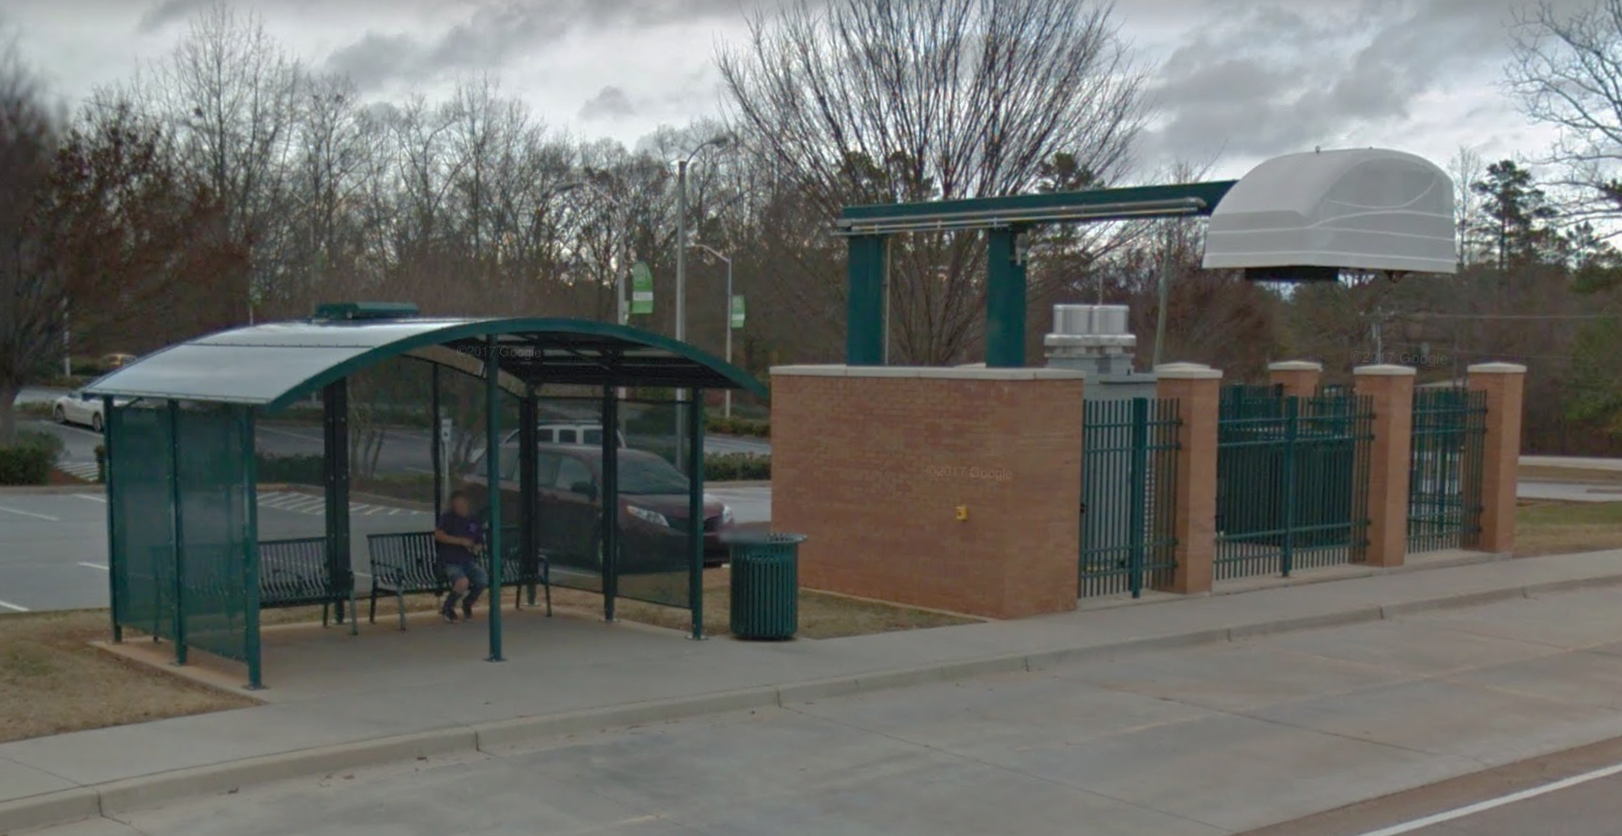
Conductive Charger (example)
Utility Requirements: 480 VAC, 3-phase
transformer, chiller, electrical cabinet

Slide 14
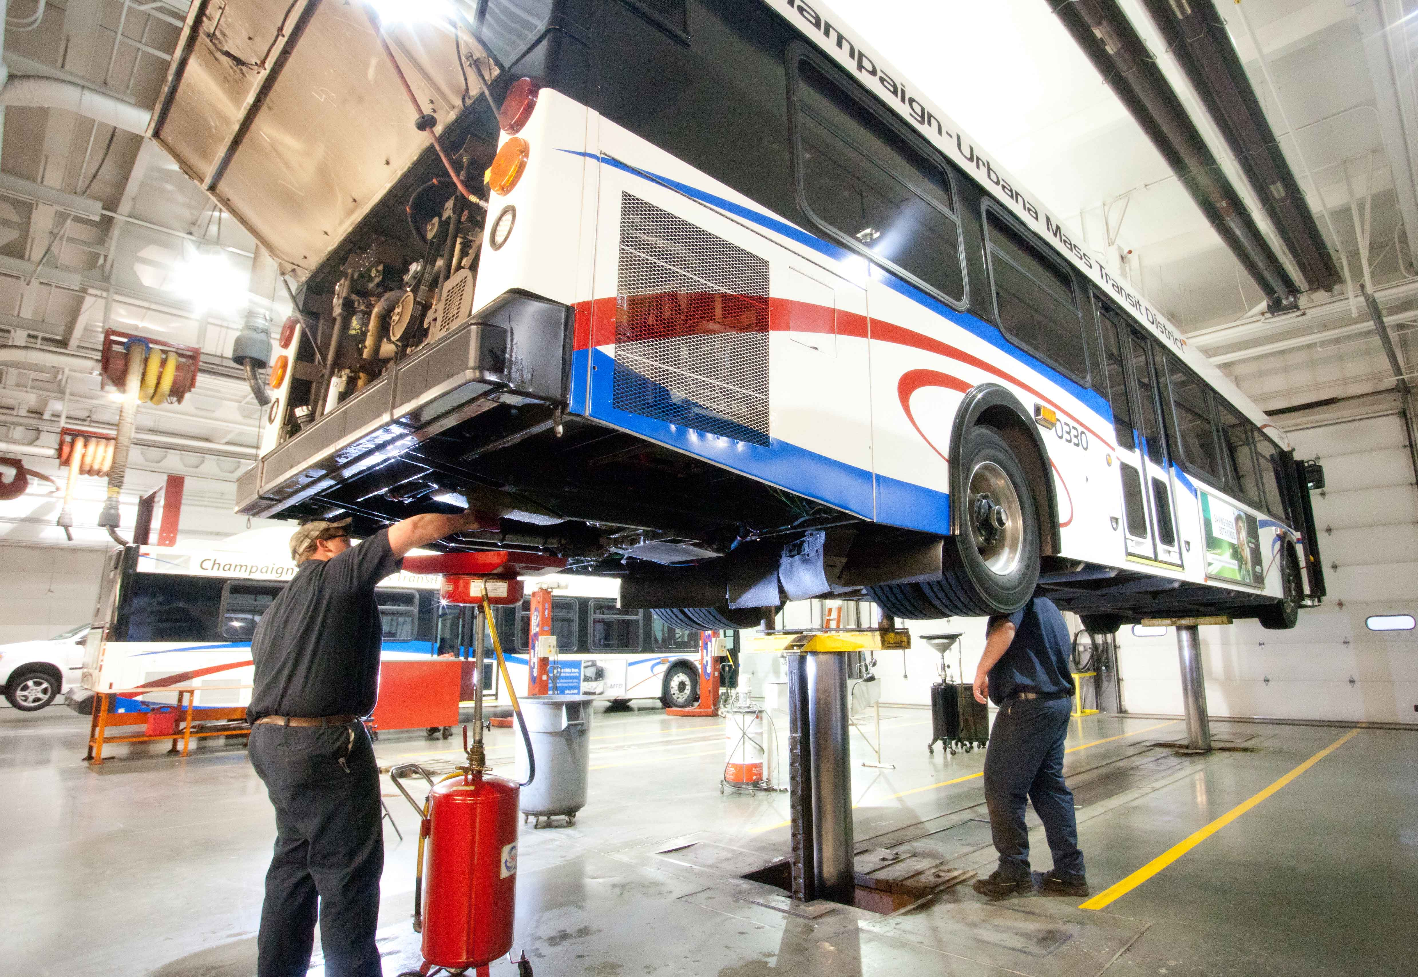
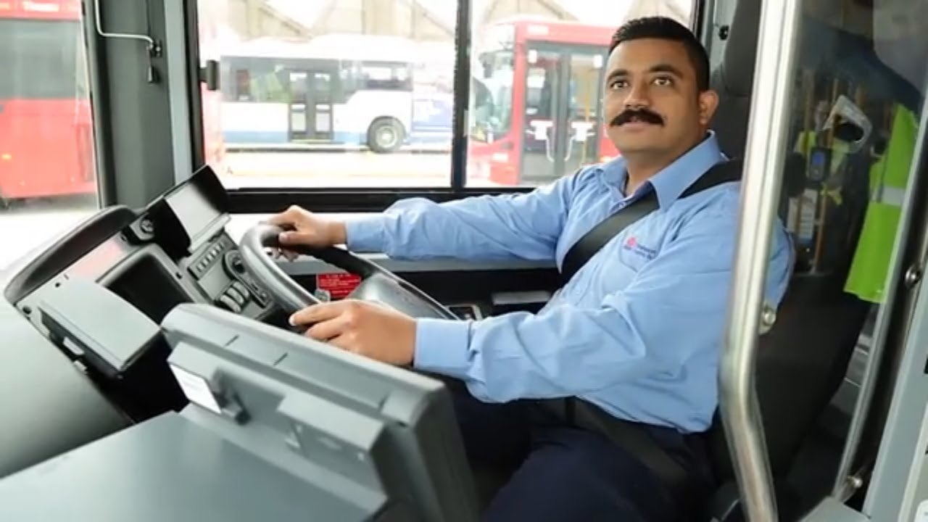
Why buses?
Why does transit deploy the coolest technology first?
professionally maintained at regular intervals
centralized parking and fueling
professional drivers on regular duty cycles
high-mileage, long-hours

Slide 15
Deployment Challenges
Barriers to adoption exist:
uncertainties about vehicle range
refueling location and duration
refueling equipment procurement & installation
unknown operating costs
finding the optimal solution for a specific application… broad market with no clear winner
scaling a small deployment into a fleet-wide change
inoperability between different buses & chargers

Slide 16
Best Practices
Smart Deployments are Key to Deployment Success
Project stakeholders must be informed and prepared at every stage of the project:
      Procurement
      Deployment
      Day to Day Management
Industry must work together to continue to understand and eliminate barriers.

Slide 17
Best Practices
Understand bus performance and fueling constraints for your application.
  Bus Modeling & Simulation
Predict Fueling/Charging Costs.
  Rate Modeling
Establish the Business Case.
  Life Cycle Cost Analysis
  Risk Assessment
Communicate with stakeholders and set realistic expectations.
Route
Requirements
Bus & Route
Modeling
Energy
Consumption
And Charging
Schedule
Vehicle
Specifications
Charge/Fueling
Strategy
Rate
Modeling
Fueling Cost
Structure
Annual
Fuel Costs
Life Cycle
Cost
Analysis
Capital
Costs
Life Cycle Cost
Estimate
Maintenance
Costs
Risk
Assessment

Slide 18
ZEB Awards in the U.S.
Notes:
focus on commercially available technology… deployment project, not development or demonstration... increasing volume of vehicle deployed
focus on three primary tasks:
1. Deployment of AFV Fleets and Infrastructure
2. Facilitate Development of Alternative Fuel Corridors
3. Development of Strategic AFV Fleet Partnerships

Slide 19
Awards for Each OEM
Notes:
focus on commercially available technology… deployment project, not development or demonstration... increasing volume of vehicle deployed
focus on three primary tasks:
1. Deployment of AFV Fleets and Infrastructure
2. Facilitate Development of Alternative Fuel Corridors
3. Development of Strategic AFV Fleet Partnerships

Slide 20
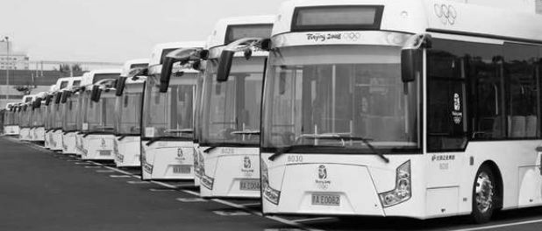

Blake Whitson
Technical Project Manager
Center for Transportation and the Environment blake@cte.tv
Chateau Elan
November 16, 2017

Slide 21
Key Terminology
kW and kWh describe very different things!
Unit | Describes what? | Conventional Equivalent | Examples
kW | Power | Horsepower (hp) | This battery pack can provide 230 kW (308 hp)
kWh | Energy | Gallons of diesel | This bus stores 300 kWh (7.9 gallons diesel)
Notes:
focus on commercially available technology… deployment project, not development or demonstration... increasing volume of vehicle deployed
focus on three primary tasks:
1. Deployment of AFV Fleets and Infrastructure
2. Facilitate Development of Alternative Fuel Corridors
3. Development of Strategic AFV Fleet Partnerships

Slide 22
Key Considerations
Understanding how much of the battery is usable for service is critical.
Battery will lose energy storage capacity over time.
Unusable
Energy
Minimum Limit
Service Energy
Unusable
Energy
Reserve Limit
Maximum Limit
Total Battery Capacity
(also known as Nameplate or Advertised Capacity)

Slide 23
 | OEM Brochure | Simulation Results
Route A (summer, no passengers) | 1.7 – 2.0 | 1.72
Route A (summer, avg. passengers) | 1.7 – 2.0 | 2.11
Route A (summer, max passengers) | 1.7 – 2.0 | 2.46
Route A (winter, no passengers) | 1.7 – 2.0 | 1.91
Route A (winter, avg. passengers) | 1.7 – 2.0 | 2.64
Route A (winter, max passengers) | 1.7 – 2.0 | 3.10
Route B (fall, no passengers) | 1.7 – 2.0 | 1.68
Route B (fall, avg. passengers) | 1.7 – 2.0 | 2.06
Route B (fall, max passengers) | 1.7 – 2.0 | 2.20
Worst Route, Worst Case |  | 6.17

Slide 24
Funding Opportunities
Federal agencies are the most popular source of funds for ZEB deployment.
No voucher programs available in SE and state grants are rare
Volkswagen Settlement may be a source of funding in near-future.
  Alabama: no lead agency to date
  Florida: Dept of Environmental Protection
  Georgia: Gov Office of Planning and Budget
  South Carolina: Dept of Insurance
  Tennessee: Dept of Environment & Conservation

