Slide 1


Slide 2



Electric Buses
Charging Systems
David Warren
Director of Sustainable Transportation
November 16, 2017

Slide 3
Agenda
New Flyer Introduction and Electric Bus Experience
Xcelsior CHARGE Electric Bus Technology
Charging Systems

Slide 4


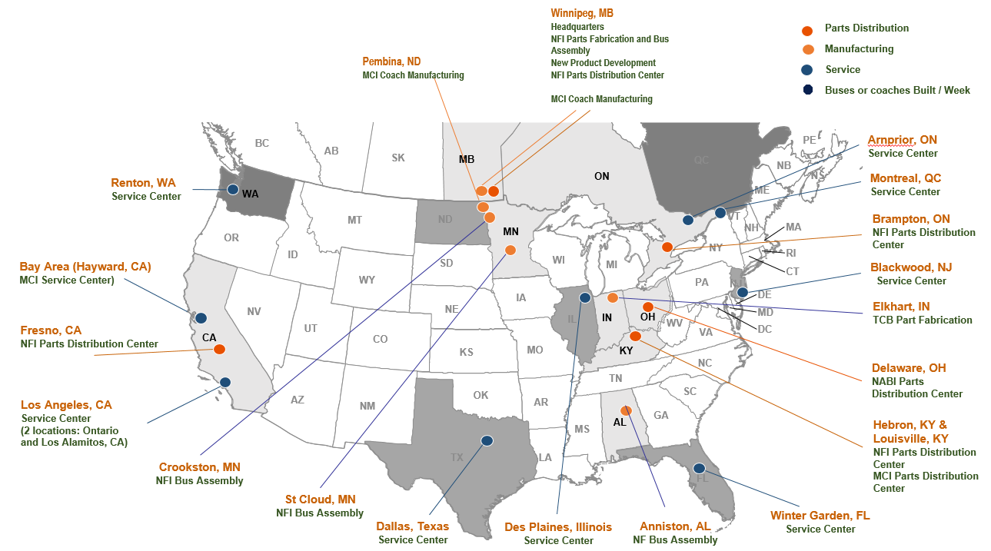
The New Flyer Group of Companies
North America’s Leading Bus & Coach Manufacturer
87 Years of Experience
> 5,800 Employees
31 Locations throughout North America
Manufacture approximately 3,800 buses and coaches, annually*
  Delivered 45% of North American heavy-duty transit buses in 2016
  Delivered 39% of North American motor coaches in 2016
Support 41% of heavy duty transit buses in service
  Supply 33% heavy duty transit bus parts
  Supply 40% motor coach parts
* Equivalent Units

Slide 5
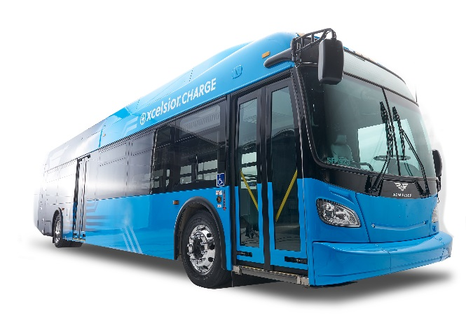
New Flyer Has 50 Years of ZEB Experience
Our Zero Emission Technology Roadmap
Pre-1993:
Conventional Fossil Fuels (Diesel, Gas)
Early electric trolleys (1960s and 1970s)
2014: Launch of the Xcelsior XE40 Electric Bus
Delivered to Chicago Transit Authority and also delivered to Winnipeg Transit
1993: Electric Trolley
Delivered to San Francisco MUNI
2015: Launch of the Xcelsior XHE60 Fuel Cell Bus (Ballard)
2016: Launch of the Xcelsior XHE40 Fuel Cell Bus (Hydrogenics and Ballard)
1994: Compressed Natural Gas
Delivered to San Diego Transit Commission
2017: Xcelsior CHARGE™ Launch, featuring Long Range Batteries, High Grade Package, Interoperable Depot and On-Route Charging
2002: Diesel–Electric Hybrid delivered to Seattle
The Road Ahead:
Increased Battery Energy Density
Autonomous Driving Features
Advanced Power Management
Diagnostics & Prognostics
2010: Hydrogen Fuel Cell Buses
Delivered to BC Transit
2012: e-Accessories
Delivered to Minneapolis Metro

Slide 6
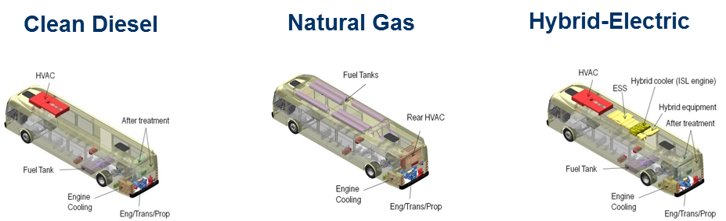
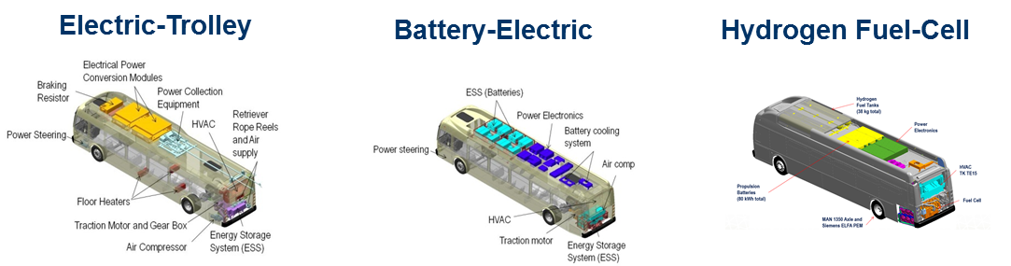
New Flyer Low and No Emission Propulsion
Transforming Communities with Sustainable, Clean Transit Technology
Proven Heavy Duty Transit Bus Platform
> 12,00 Xcelsior buses delivered and on-order
Broadest Range of Propulsion Options
Only Platform with all 3 Types of ZEBs
Built for Accessibility
Designed for Maintainability
Flexible Battery Pack Design – Evolves with Battery Technology
LOW EMISSIONS
ZERO EMISSIONS

Slide 7
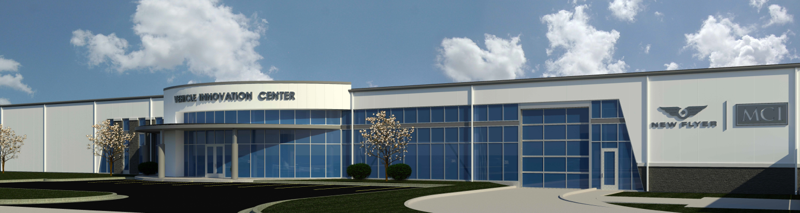


Vehicle Innovation Center
Our Vision: To be America’s leader in the exploration and advancement of bus and coach technology connecting people to places.
Our Mission:
Explore and advance bus and coach technology through sustainable research and development, fresh innovation, progressive manufacturing, and bold thinking;
Foster dialogue through discussion, education, and training on the latest zero-emission and autonomous driving vehicle technologies;
Engage learning through current and interactive exhibits, simulation and hands-on experiences, and observations;
Generate energy and commitment to clean air quality, safety, and economic benefits for people, communities, and business; and
Harness the positive influence of collaboration, environmental stewardship, and social change to advance mobility solutions.
Features of the Center:
Interactive Technology Exhibit Space
Demonstrator Buses with Custom Transport Rig
New Flyer Institute Manufacturing Lab
Classroom Training
Charging and Hands On Training Bay
Engineering Testing Area
Battery Assembly Area

Slide 8
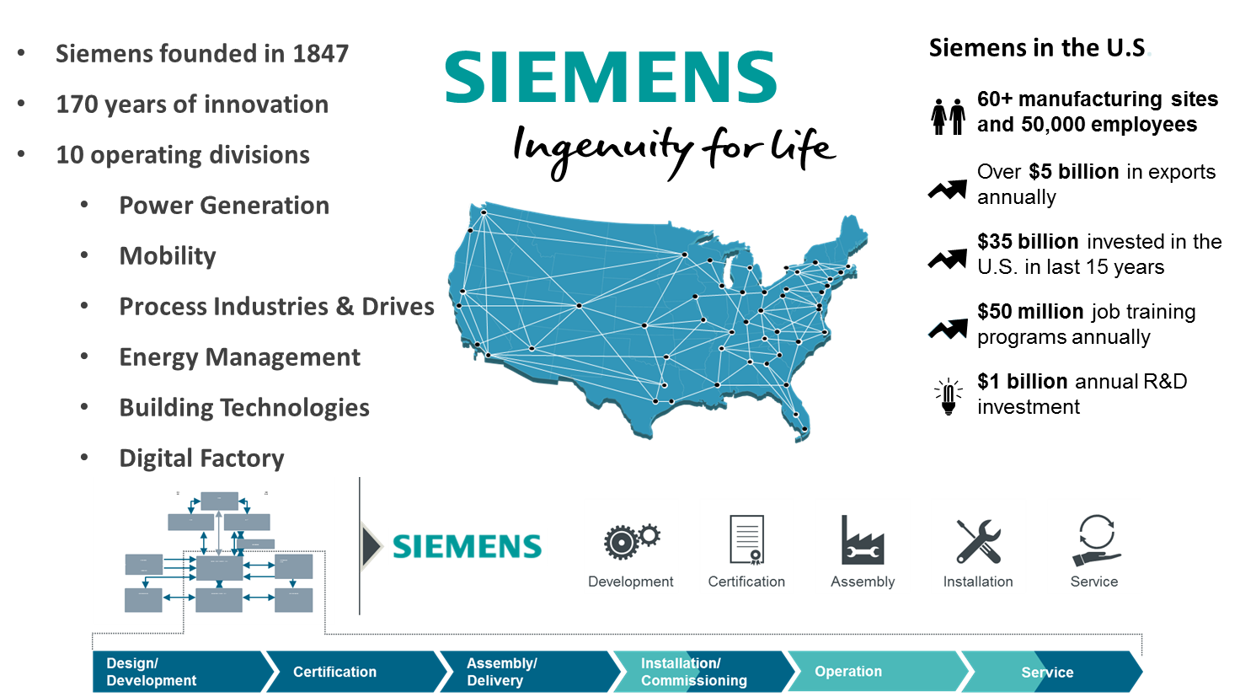
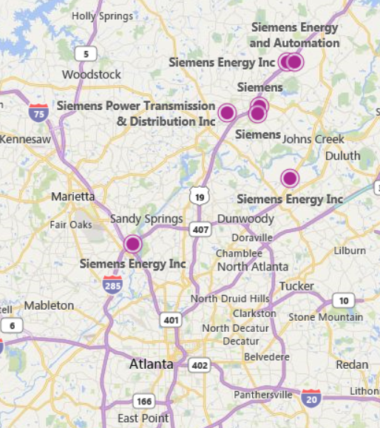
Siemens – eMobility Technology based in the Southeast
Alpharetta, GA

Slide 9


New Flyer eBus Partnerships and Membership based in the Southeast

Slide 10
Agenda
New Flyer Introduction and Electric Bus Experience
Xcelsior CHARGE™ Electric Bus Technology

Slide 11
Built on the proven Xcelsior transit bus platform
Extended range battery technology designed in America
Industry leading gradeability
Interoperable
Available in 35, 40, and 60-foot bus rapid transit articulated models.
New Flyer’s Next Generation Battery-Electric Bus

Slide 12
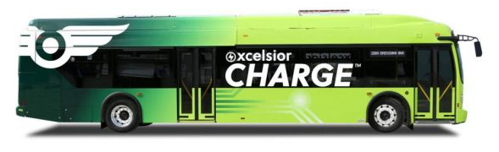
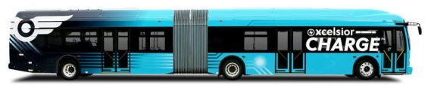
XE35/XE40
Long Range &
Rapid Charge
XE60
Long Range &
Rapid Charge

Slide 13
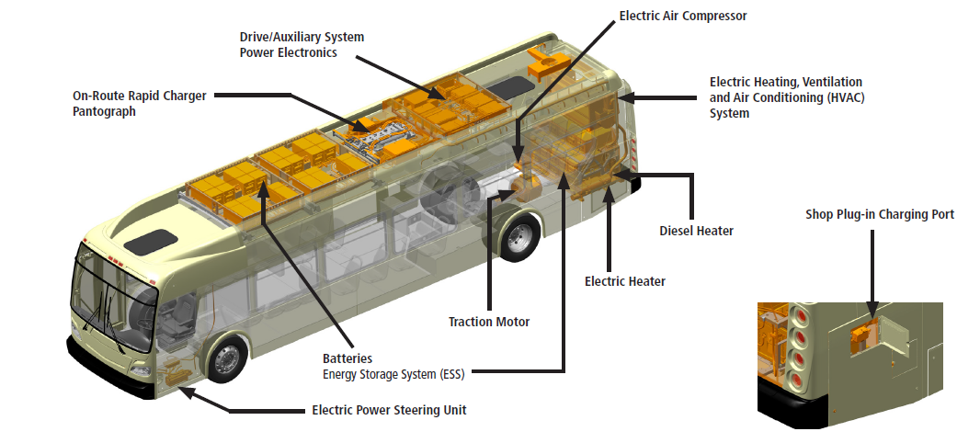
Design Highlights
New!
New!
On-Route Charging Compliant with OppCharge
Interoperable with multiple charger and vehicle OEM’s.
Plug In Charging Compliant with SAE Standards
Interoperable with multiple charger and vehicle OEM’s.
New!
Optional
New!
High Gradeability Traction Motor Options
New!
Extended Range and Rapid Charge Energy Storage Configurations

Slide 14
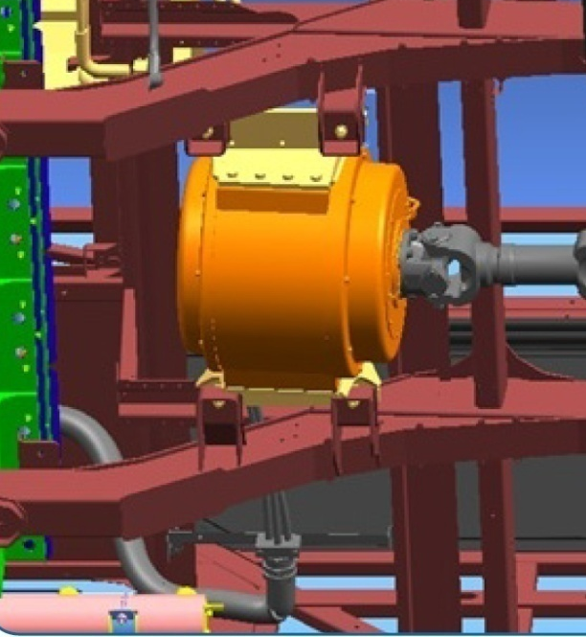
High Torque
Motor
New!
Electric Traction Motor
OEM | Siemens
Type | Permanent Electromagnetic Motor (PEM)
Models | 1DB2016 | 1DB2022
Motor Inverters | 1 | 2
Rated Power | 160 kW | 210 kW
Rated Torque | 1,033 lb-ft | 1,475 lb-ft
Grades | Up to 12.5% at GVWR | Up to 19% at GVWR

Slide 15

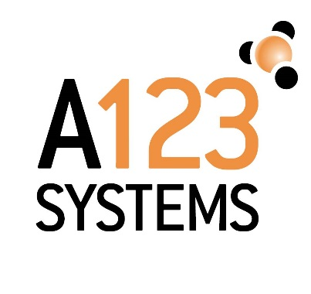
Energy Storage Systems
New!
 | XE35 | XE40 | XE60 | XHE (fuel cell electric)
Long Range | NMC Batteries | NMC Batteries | NMC Batteries | NMC Batteries
Rapid Charge | NMC Batteries | NMC Batteries | NMC Batteries
Notes:
New Flyer Has Experience Integrating Battery Suppliers and Technologies
New Flyer’s ESS architecture is not limited to battery type or supplier
New Flyer actively evaluates new batteries to stay current on latest battery technology
Best batteries are considered for each battery buses configuration:
Xcelsior XE35/40 & XE60 (rapid charge) use XALT Energy NMC batteries
Xcelsior XE35/40 (long range) use Xalt Energy NMC batteries
Xcelsior XE60 (long range) use A123 Systems NMC batteries
Xcelsior XHE40 & XHE60 (range extended) use A123 Systems LFP batteries
NFI also has experience with Mitsubishi Heavy Industries NMC batteries

Slide 16
The Path to Energy Density & Range
Improve Cell Chemistry Using the Same Footprint & Weight
Range
New!
Passengers | Xcelsior CHARGE |  | Xcelsior CHARGE 2019
 | ESS (kWh) | Range (mi) | ESS (kWh) | Range (mi)
67-76 | 200 | 87 | 300 | 142
 | 400 | 189 | 490 | 232
 | 480 | 227 | 590 | 280
116-119 | 250 | 80 | 375 | 125
 | 450 | 155 | 575 | 200
 | 600 | 200 | 760 | 260
 |  |  | 885 | 300
Range miles are based on FTA Test Protocol.

Slide 17
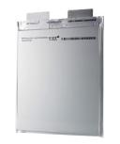
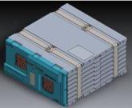
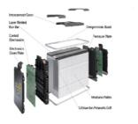
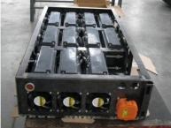
Battery
Architecture
Battery Supplier |  |  | New Flyer
Cell | Bundle | Module / Pack | Bank / String | Bus
One Cell | Multiple cells pre-bundled, laser-welded bus bars, heat transfer plates between cells, pre-wired for temp and volt measurement | Cell Bundle plus CMU (cell monitoring unit) monitoring cell temp and voltage and transmitting data to BMS. Also balances cells within bundle. | Multiple Modules with BMS Battery Management System, cooling & environmentally sealed. Full System voltage, Fusing and Contactors | Multiple Strings for power and energy required. Master BMS consolidates messages from strings for Vehicle Controller and Charger. Additional System Fusing and Contactors
Xcelsior CHARGE Battery Strings are designed to be
interchangeable with any battery supplier

Slide 18
Weight
Distribution
FACT - Lithium-ion batteries have significantly less energy density compared to the energy density of diesel or CNG
  Battery-Electric buses carry more weight to store the same amount of energy and cover the same mileage as a CNG and diesel bus
  New Flyer’s design biases the weight distribution of the battery packs to the rear of the bus where axle and tires are capable of higher legal rated loads
  Xcelsior CHARGE are capable of carrying the equivalent seated and standee passengers as our non-electric Xcelsior

Slide 19
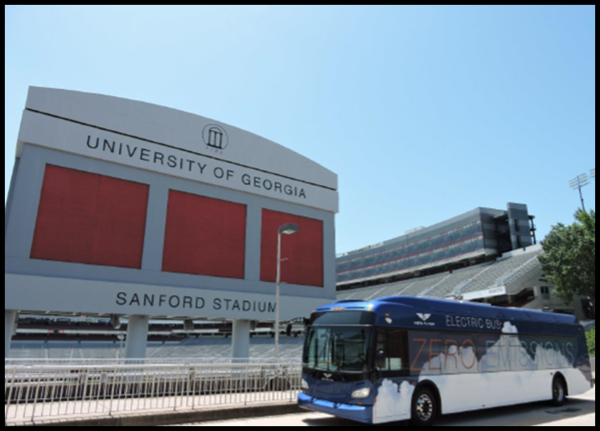
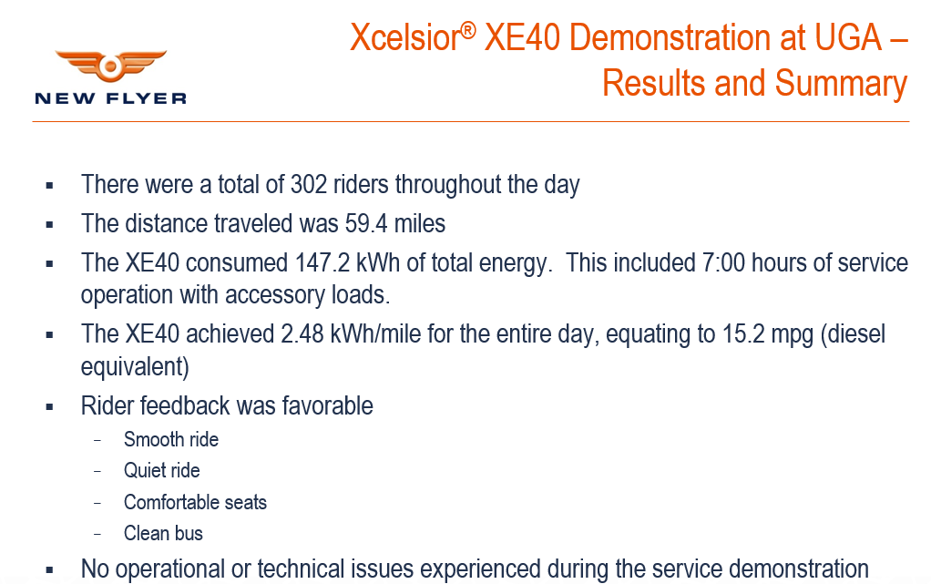
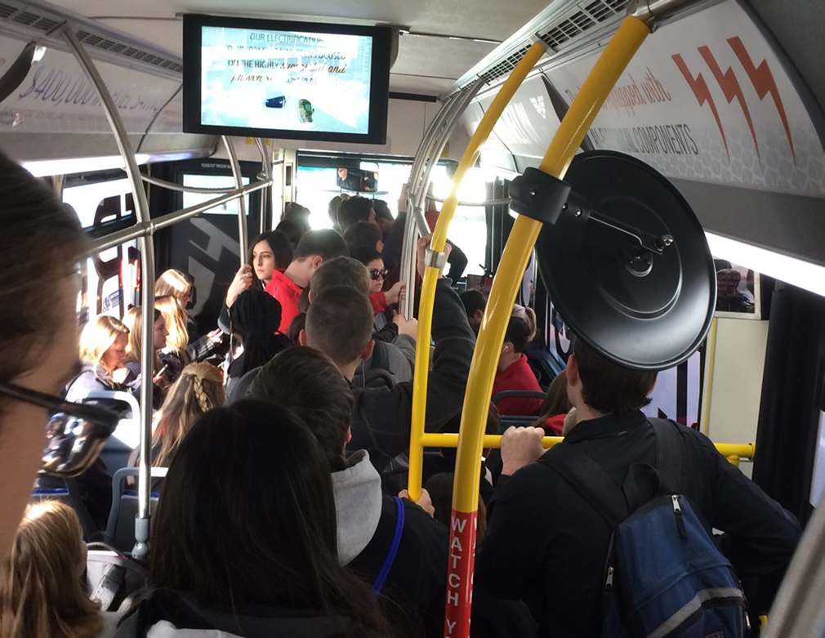
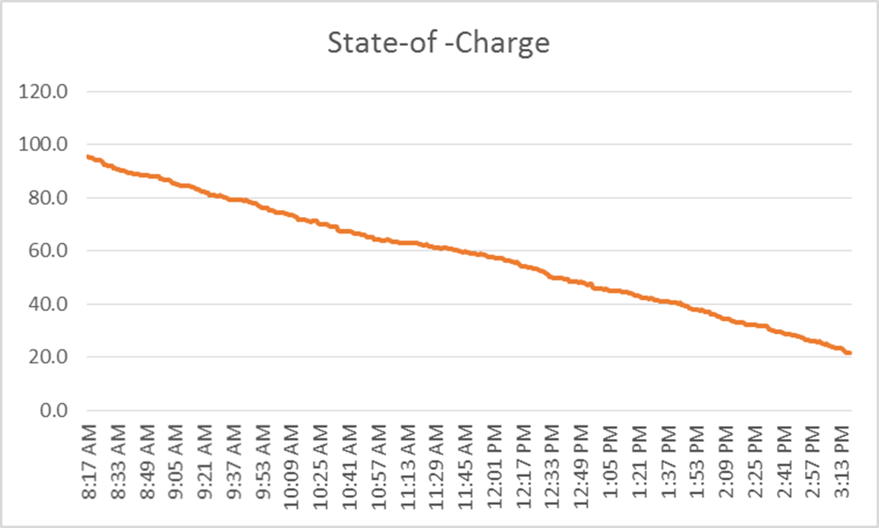
UGA Electric Bus
Demonstration

Slide 20
Agenda
New Flyer Introduction and Electric Bus Experience
Xcelsior CHARGE Electric Bus Technology
Charging Systems

Slide 21




Interoperability
Xcelsior CHARGE is Interoperable, conforming to emerging industry standards
  SAE J3068 and SAE J1772 compliant depot charging equipment can be used to charge buses, coaches, trucks and cars from other manufacturers
  Opportunity charging accomplished with OppCharge compliant fast charging equipment. Efforts to align with SAE J3105 (Overhead Fast Charge – Standard under development)
New Flyer Charging equipment available from multiple globally recognized suppliers

Slide 22
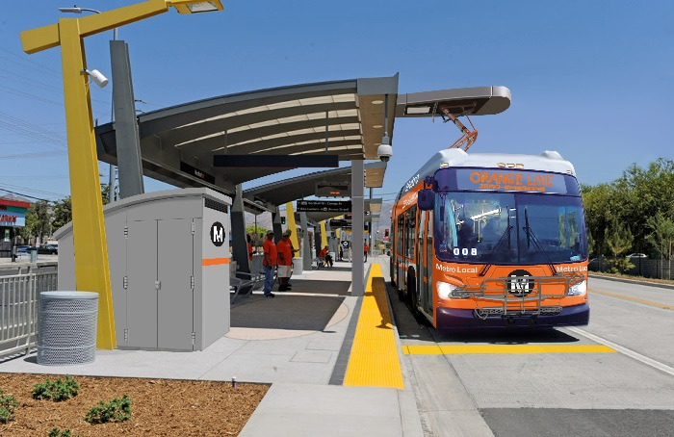
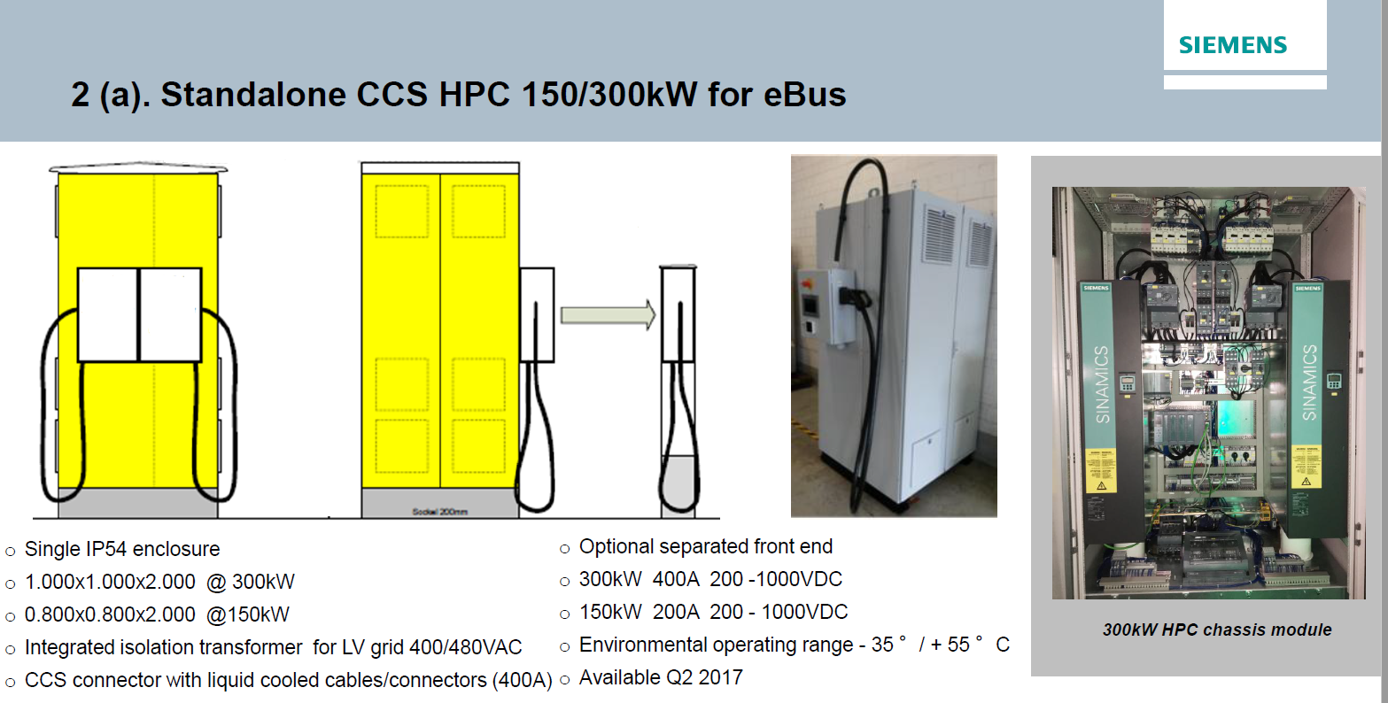
Charging Solutions
Depot Plug-in Charging
100 - 150 kW
Overhead On-Route Charging
300 - 450 kW
Notes:
The type considered directly depends on range, passenger loads and energy costs.
If carrying the highest number of passengers is the top priority and the route chosen is conducive for on an on-route charger, this strategy would allow the bus to operate around the clock and carry as little as 25 percent of the batteries of an extended range bus.
If energy cost is the primary consideration, an extended range bus, potentially carrying fewer passengers and charged overnight with plug-in charging may be the most economical alternative.
Based on forthcoming standards, New Flyer will supply chargers to industry standards using a DC Depot Charger from companies such as Siemens and ABB
Depot charger will utilize a CCS 1 or CC2 Plug Connector (similar to automotive), capable of charging up to 150 kW
In the future, New Flyer expects transit agencies will purchase chargers directly from equipment suppliers

Slide 23
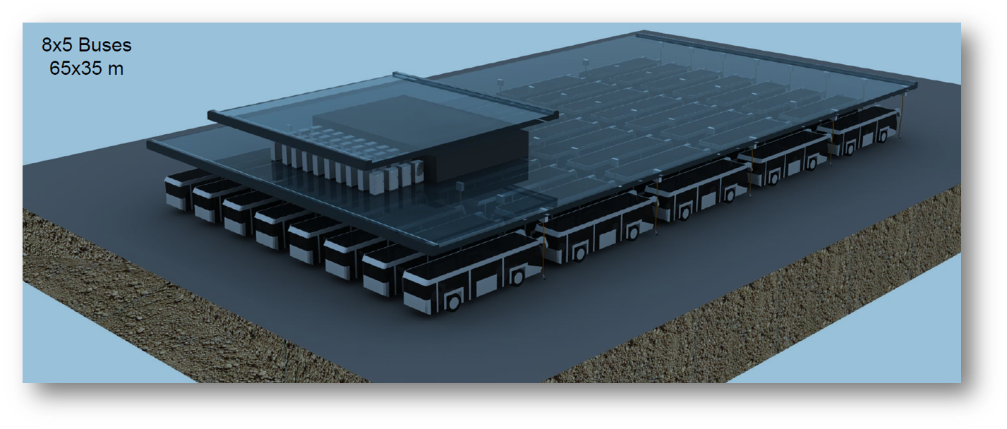
Smart Charging Solutions for Electric Buses are Evolving
New Flyer firmly supports industry interoperable charging equipment and high versatility of the invested assets
Short-Term: New Flyer will assist transit agencies by providing both buses and interoperable charging systems to support successful ZEB deployments
Long-Term: New Flyer expects future RFPs will separate charging equipment from bus procurement
Engineering and infrastructure firms such as Black and Veatch, Burns and McDonald, WSP and others will likely have a major role in innovating with Transit Agencies, Energy Providers (Utility Companies), Charging Equipment Manufacturers, and Bus OEMs to create some innovative charging solutions for large fleet deployments, which will evolve into industry best practices

Slide 24
Agenda
New Flyer Introduction and Electric Bus Experience
Xcelsior CHARGE Electric Bus Technology
Charging Systems
Summary

Slide 25
The Complete Solution.
Xcelsior CHARGE
Automotive Lithium Ion Batteries
Established Parts and Service organization
Highest Passenger Standee Capacity
Platform for Autonomous Features and Advanced Diagnostics
Proven Xcelsior Platform
Proven Reliable Supply Chain

Slide 26

Technology that Works. Transforming Your Community with Sustainable Clean Technology
Investment in Our Communities: Leading Transit with Investment in American Jobs
Progressive, but Prudent Innovation. Supporting Smart Cities with Technology, Training and Collaborative R&D
For More Information:
David Warren
Director of Sustainable Transportation
New Flyer Inc.
david_warren@newflyer.com
(256) 473-3246

